Slide 1
Building Weather & Climate Services for the Energy Sector
World Energy & Meteorology Council
Lessons Learned from the Shorter Ranges: Weather Forecasting
for Energy Applications
Dr. Sue Ellen Haupt
Research Applications Laboratory
National Center for Atmospheric Research, Boulder, CO USA
Director of Education, WEMC
Shanghai, China May 19, 2018

Slide 2

Outline
Examples:
Solar Power Forecasting
Wind Power Forecasting
Hydro Power Forecasting
Theme: Smartly blending data, dynamics, physics, and statistical learning methods
Stakeholder Needs
Ingredients
Forecasting Across Scales
  Numerical Weather Prediction
  Data Assimilation
  Nowcasting (Minutes to Hours)
  Blending
  Power Conversion
  Uncertainty Quantification
  Extreme Events
Assessment
Valuation

Slide 3


























It Takes a Community
Funding Organization
Operations
Monitoring
Operations
Translation
Basic Research Community
End User
Operations
Computing
Applied
Research Community
Partnership:
Public
Private
Academic
Notes:
It takes a community working together to accomplish this process effectively.
First the team must understand the needs of the end user.
The basic and applied research community can then build tools.
Public and private entities provide operational monitoring and computing.
It is important to translate the forecasts into usable information based on in depth knowledge of the problem and working closely with the end users.
This process requires collaboration across the sectors – private, public, and academic
[click in individual players]
The SunCast project has striven to bring these communities together as seen in the plethora of collaborators on this project.
The full rainbow cannot be accomplished in any one organization

Slide 4

Industry Needs for Renewable Energy Forecasts
Need to predict POWER based on met variables
  80-m wind speed
  Surface irradiance – GHI, DNI, DIF
Time frames for prediction
  Long range – weeks –
  maintenance and distribution
  Medium range – days – hourly
  day ahead trading
  Nowcast range – hours – 15-min
  grid integration
  Very short range – seconds to minutes –
  voltage control

Slide 5
Industry Needs for Renewable Energy Forecasts
Need to predict POWER based on met variables
  80-m wind speed
  Surface irradiance – GHI, DNI, DIF
Time frames for prediction
  Long range – weeks –
  maintenance and distribution
  Medium range – days – hourly
  day ahead trading
  Nowcast range – hours – 15-min
  grid integration
  Very short range – seconds to minutes –
  voltage control

Slide 6
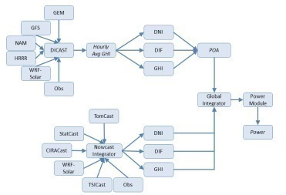
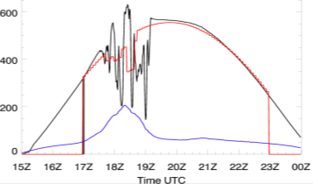
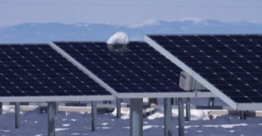
Value Chain:
What is the value of solar power forecasting?
$$
Weather
Monitoring Observation
Modelling
Forecasting
Dissemination & Communication
Uses / Decision Making
Perception Interpretation
Outcomes
Economic & social values
Clear Sky
SURFRAD
WRF-Solar
Power Conversion
Clouds
HRRR
DICast
Projected Power Production
Satellites
Unit Allocations
Day Ahead Planning
Production Cost Changes
StatCast
Point Forecast
Area Forecast
Total Sky Imagers
Actual Power Production
Aerosols
TSICast
Real Time Operation
Reserve Estimates
Pyranometers
NowCast
Uncertainty Quant
Reserve Analysis
CIRACast
Load Balancing
MADCast
Inspired by Jeffrey Lazo

Slide 7
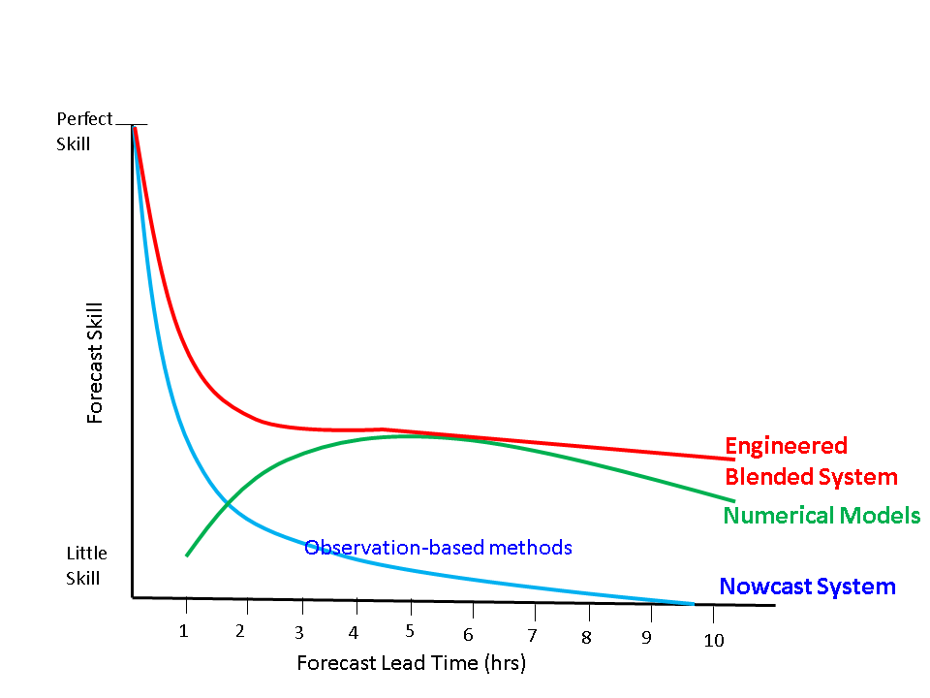
Meteorological Prediction:
= Physical approach
Adapted from Ravela, 2008
Auligne, 2014

Slide 8
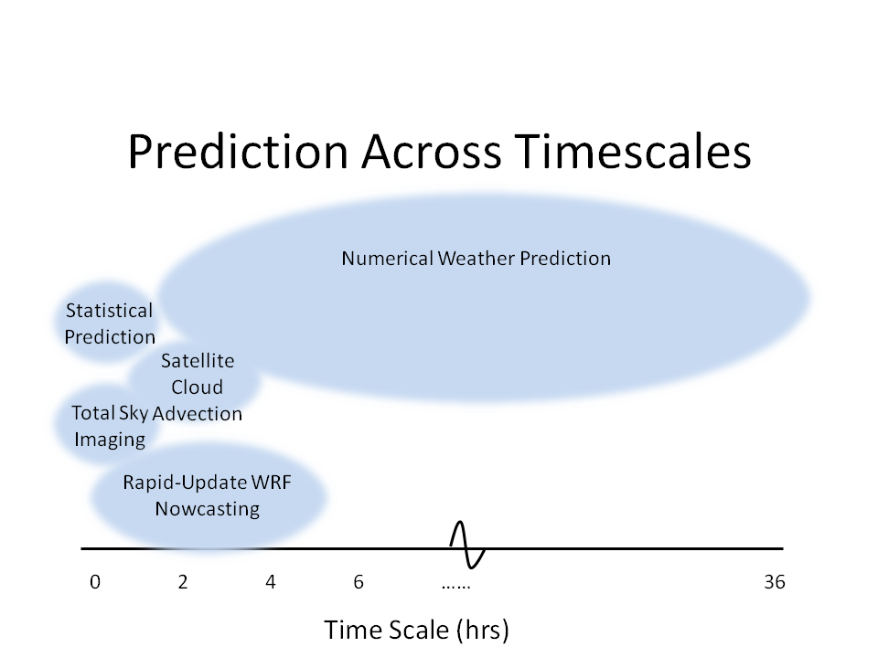
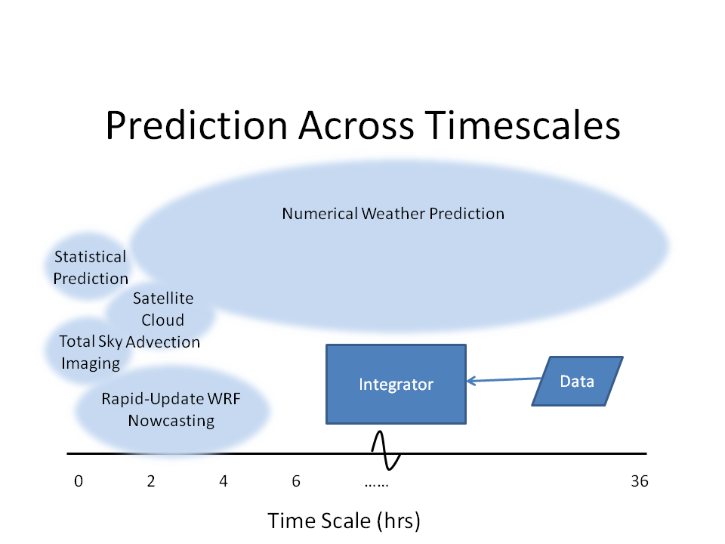
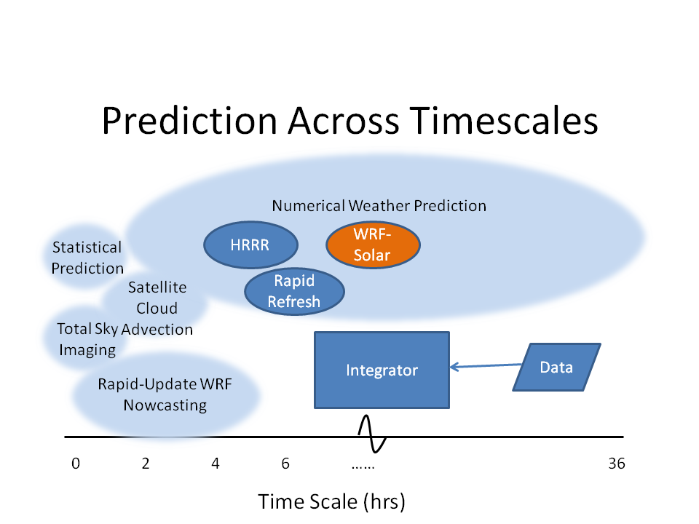
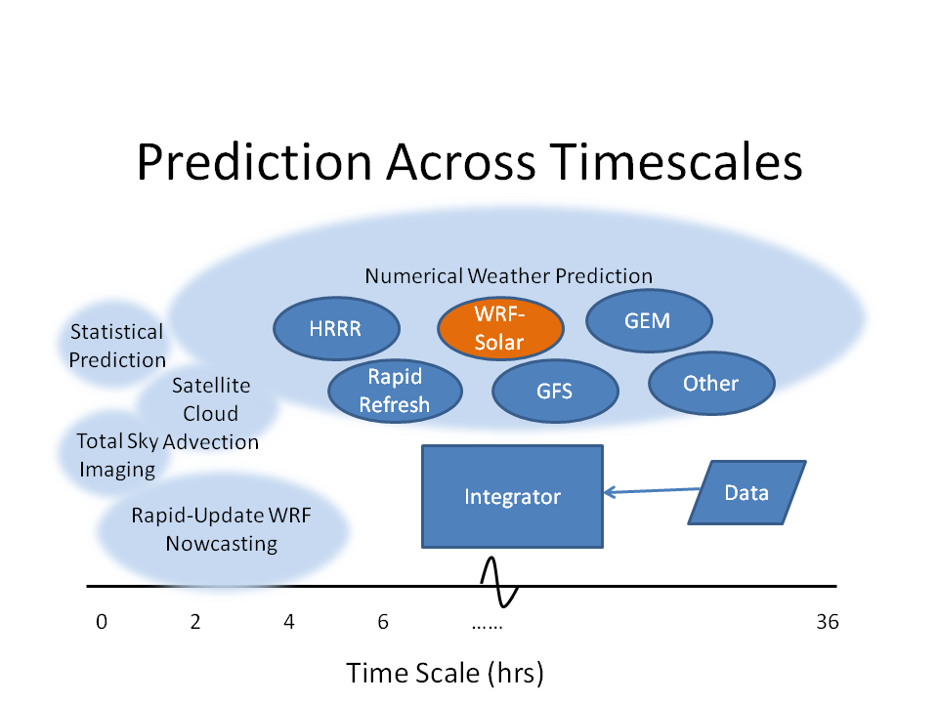
Meeting the Needs:
Seamless Approach to Solar Power Forecasting
48

Slide 9
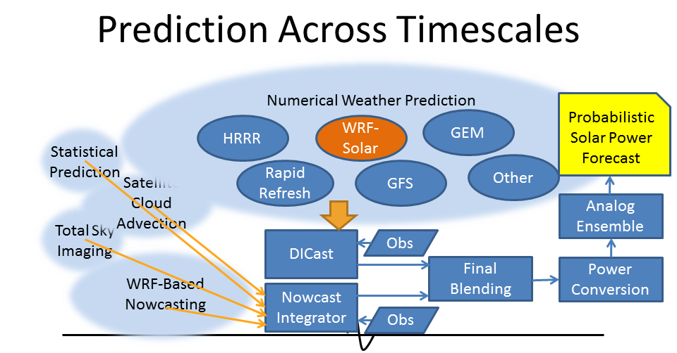
Forecasting System

Slide 10
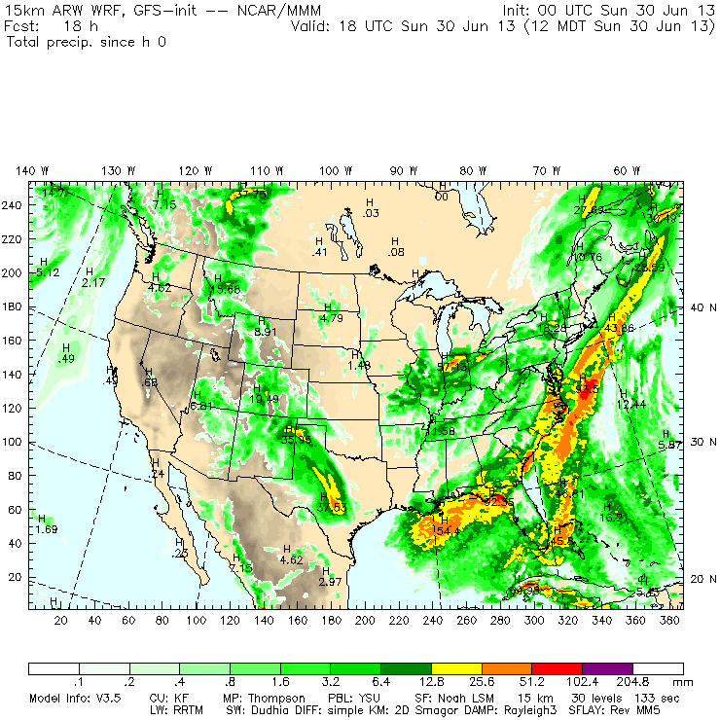
Atmospheric Modeling
Numerical Weather Prediction
Dynamics
Physics
Quality Assurance
Sensitivity to Initial Conditions
Preprocessing – Needs for Assimilation
Postprocessing – Blending Information
Validation

Slide 11
Dynamic Meteorology
Numerical methods treat this as an initial value problem
  Discretize in space
  Integrate in time
  Constrained by continuity
  Related by state eqn
Nonlinearities make it difficult

Slide 12


Quality Assurance in Atmospheric Modeling
Bulletin of the American Meteorological Society
Thomas T. Warner

Slide 13
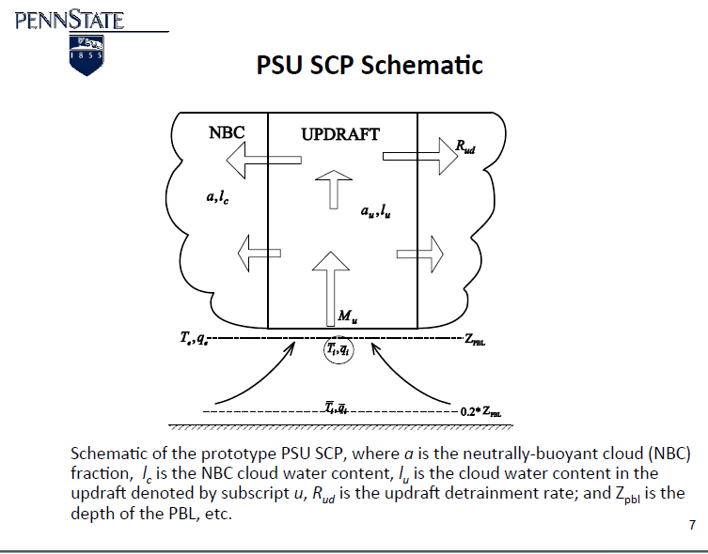
Physical Parameterizations
AJ Deng, Dave Stauffer
Various processes that we can’t resolve
Thus, parameterize given
  Knowledge of physical process
  Empirics
  Constants and tuning

Slide 14
WRF (Weather Research & Forecasting) Model Physics
Turbulence/Diffusion (diff_opt, km_opt)
Radiation
  Longwave (ra_lw_physics)
  Shortwave (ra_sw_physics)
Surface
  Surface layer (sf_sfclay_physics)
  Land/water surface (sf_surface_physics)
PBL (bl_physics)
Cumulus parameterization (cu_physics)
Microphysics (mp_physics)
http://www.google.fr/url?sa=t&rct=j&q=&esrc=s&source=web&cd=2&ved=0CDcQFjAB&url=http%3A%2F%2Fwww.mmm.ucar.edu%2Fpeople%2Fdudhia%2Ffiles%2Fpresentations%2FWRF_Physics_Dudhia.ppt&ei=mKjQUa3qJa6w4QSdnoDgCw&usg=AFQjCNGb933vSVDkzHeeDRk-swIMEZdMrQ&bvm=bv.48572450,d.bGE

Slide 15
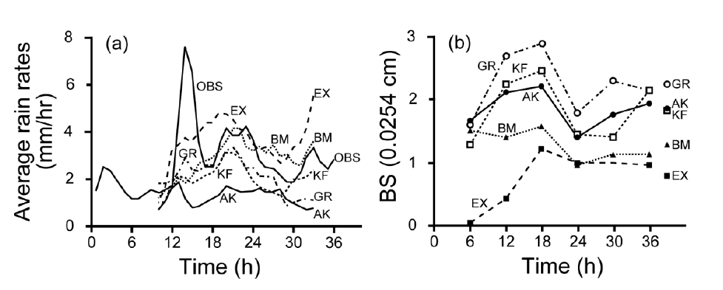
Different Schemes, Different Results
Figure 4. Average rainfall rate, for a spring-season convective event (a), based on
observations (OBS) and for five simulations that used different treatments for the convection -
four different parameterizations, and no parameterization (EX). Also depicted is the rainfallrate
bias score averaged for three warm-season convective events (b), again for each of the
four parameterizations and for the use of no parameterization. The four convective
parameterizations were the Grell (GR), Kain-Fritsch (KF), Betts-Miller (BM), and Anthes-
Kuo (AK) schemes. Adapted from Wang and Seaman (1997).

Slide 16
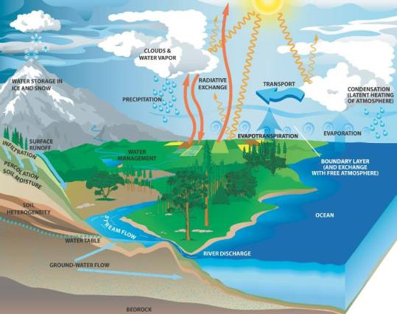

Opportunities for prediction
hydrological predictability
meteorological predictability
Hydrological predictability:
How well can we estimate the amount of water stored in the snow and soil?
Meteorological predictability:
How well can we forecast the weather?
Water Cycle (from NASA)

Slide 17
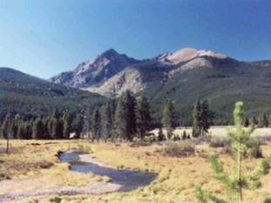
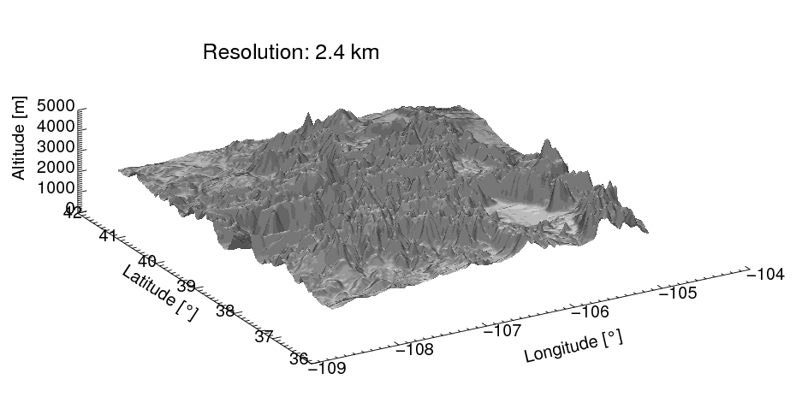
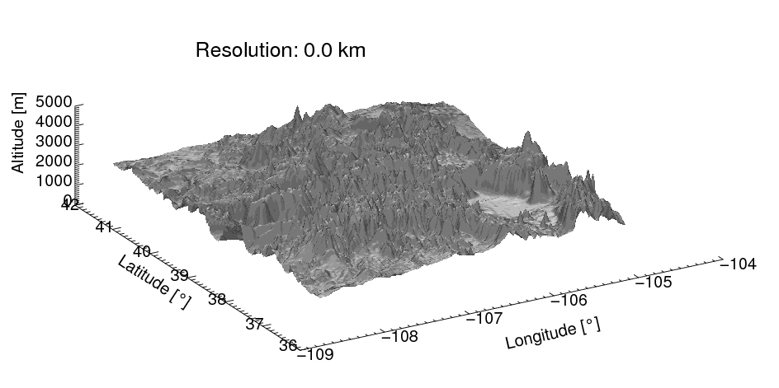
Value of high-resolution regional model
Resolution : 2.4 km
Notes:
Added value of simulation performed with high-res. regional model can be illustrated in this animation.
This animation shows how model terrain gets smoothed out with increasing grid spacing.
Running high resolution model over complex terrain is very important because:
It can resolve vertical motions tied to complex terrain and thus able to produce “close to observed” precipitation pattern.
Having accurate spatial distribution of precipitation is important for properly representing hydrologic balance.

Slide 18
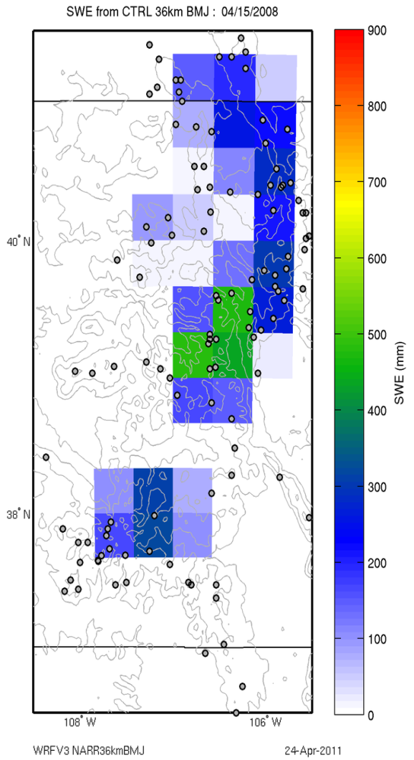
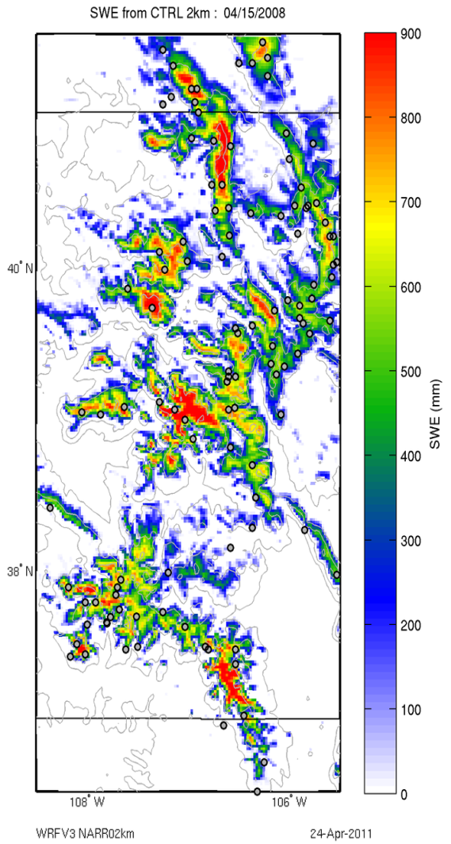
Snowpack in Central Rockies: too little at high elevation and melts three months too early at coarse resolution
36 km
2 km
April 15 snapshot of snow pack at two model resolutions
(Simulation of 2007-2008 water year)
Notes:
Showing snow water equivalent from December 1, 2007 at 36 km and 2km resolutions. The 36 km resolution is similar to resolutions of global climate models. 36 km resolution WRF simulation over water year shows complete loss of snowpack by April 1 and the smearing of snowpack across topographic gradients while 2 km simulation shows snowpack to last through the end of July and also produces the correct spatial pattern as compared to the 111 SNOTEL sites (black dots).
Snow is much less at high elevations and some places that topography is overly smoothed over at 36 km compared with 2km resolution.
Complete loss of snowpack in the 36 km simulation by the end of April, while 2 km has snow lasting through the end of July.
This has a significant impact on runoff seasonality and available water for the drier season when simulating future climate.
The snowpack continues to accumulation in the spring for the 2 km simulation whilethe 36 km model is melting the snow.
Location of snow accumulation also is an important factor to simulate correctly, as southern facing hills melt snow more efficiently, and so on.

Slide 19
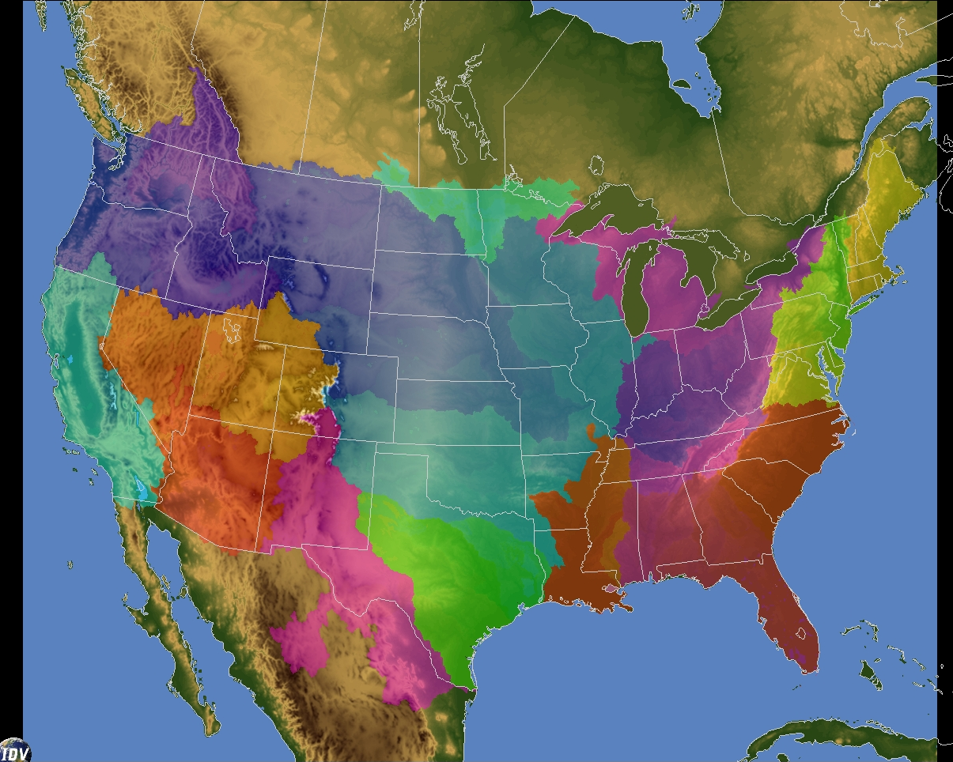
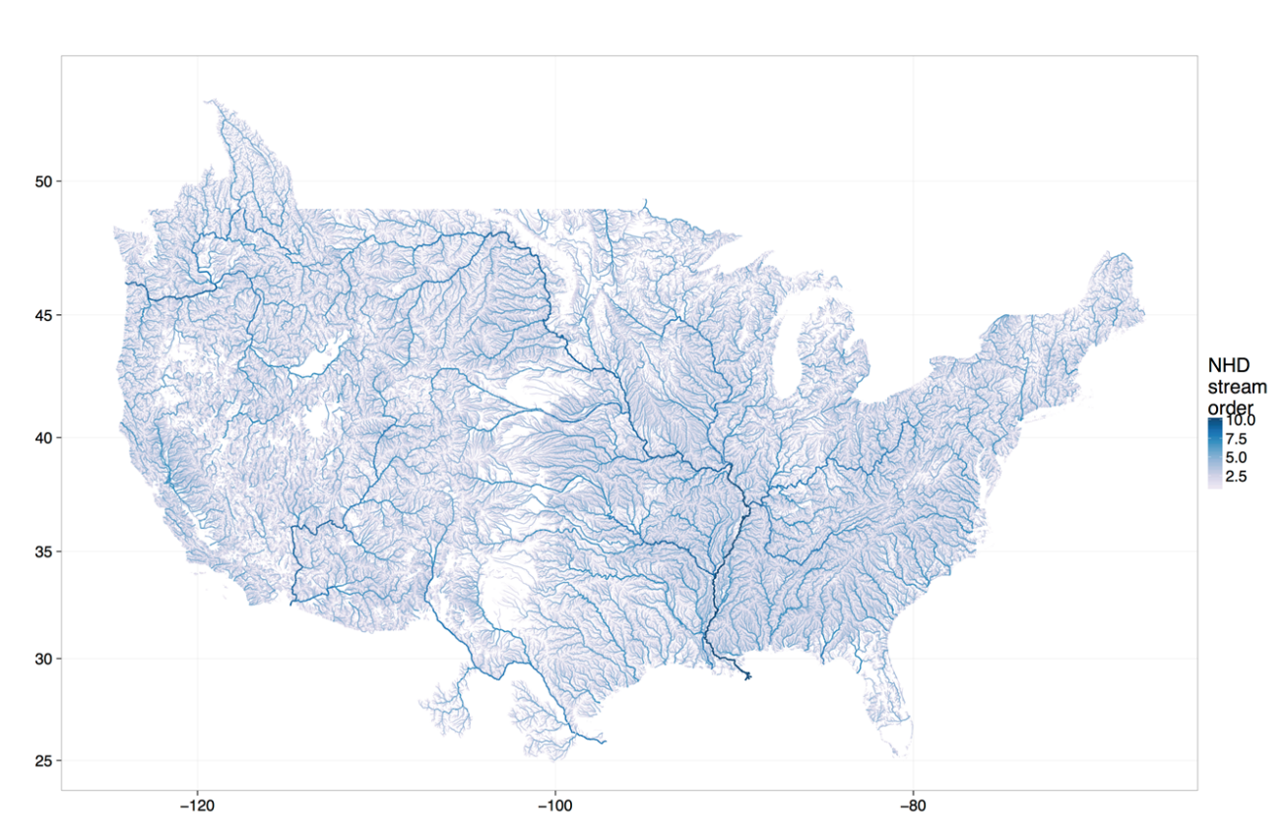
National Water Model v1.0 Physics Configuration
Model Setup:
David Gochis
NHDPlusV2-Encompassing Domain
1km NoahMP land model:
  USGS-NLCD land cover (2011)
  NRCS STATSGO, 1km soils
  Climatological vegetation structure (v1.0)
250m routing
  Diffusive wave overland flow
  Saturated subsurface flow
  NHDPlusv2 catchment-based baseflow parameterization
NHDPlusv2 channel routing
  Muskingum-Cunge
  oCONUS manual reach processing….
  2.7M river reaches
  1260 passive, level-pool reservoirs
Any Questions: gochis@ucar.edu

Slide 20
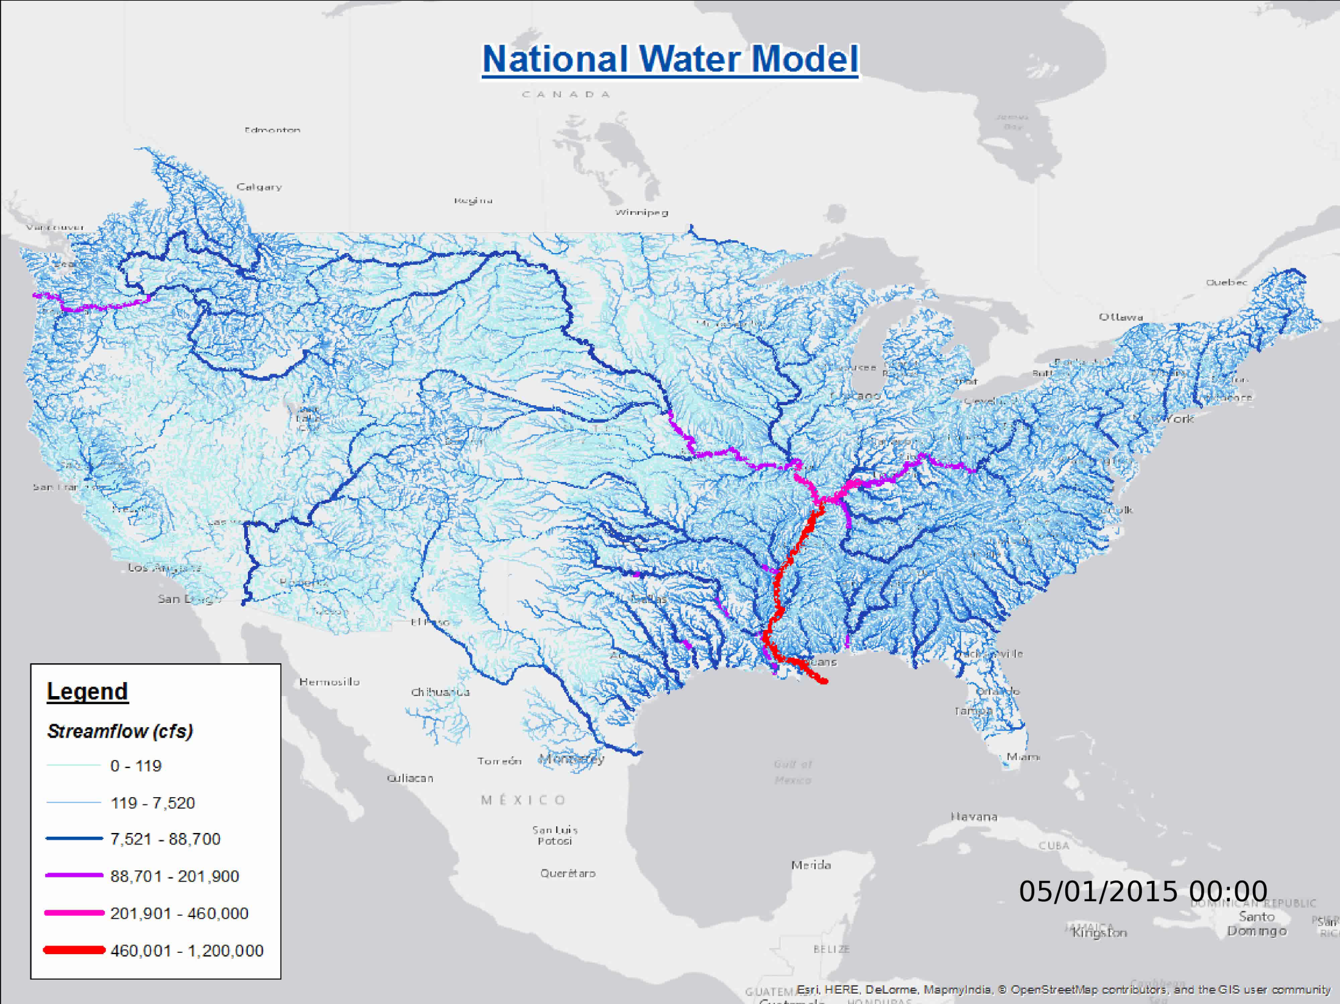



Animation created by:
F. Salas, NOAA/NWC
Seamless Simulation of Nation’s Hydrologic System

Slide 21
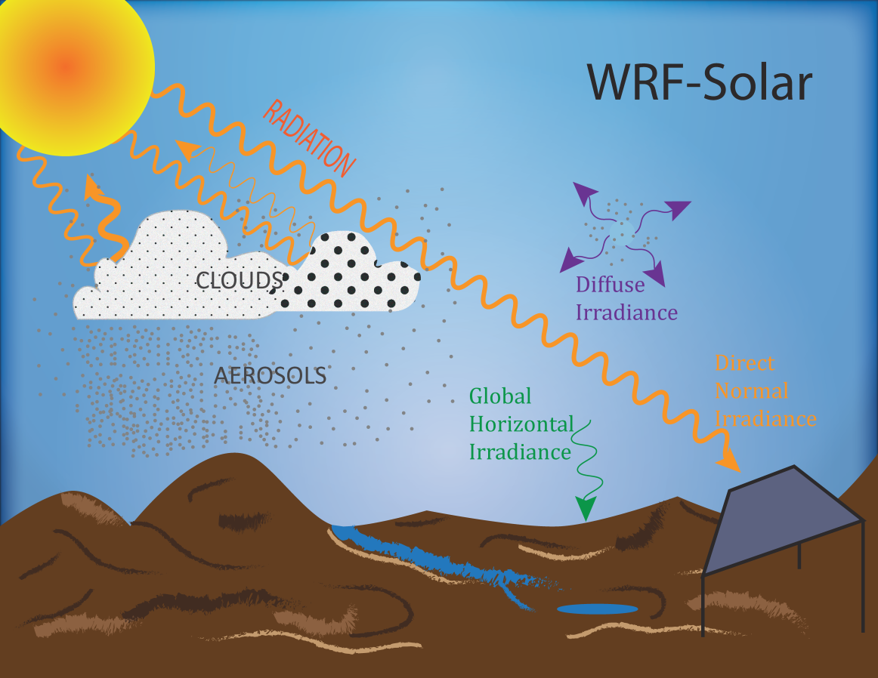
Application of Forecasting: Solar Power
Sun4Cast

Slide 22
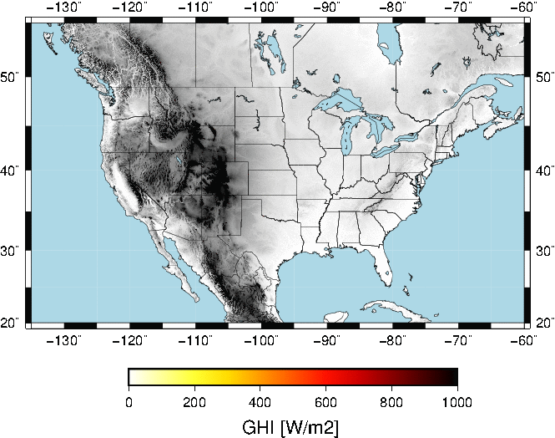
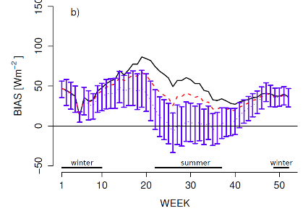
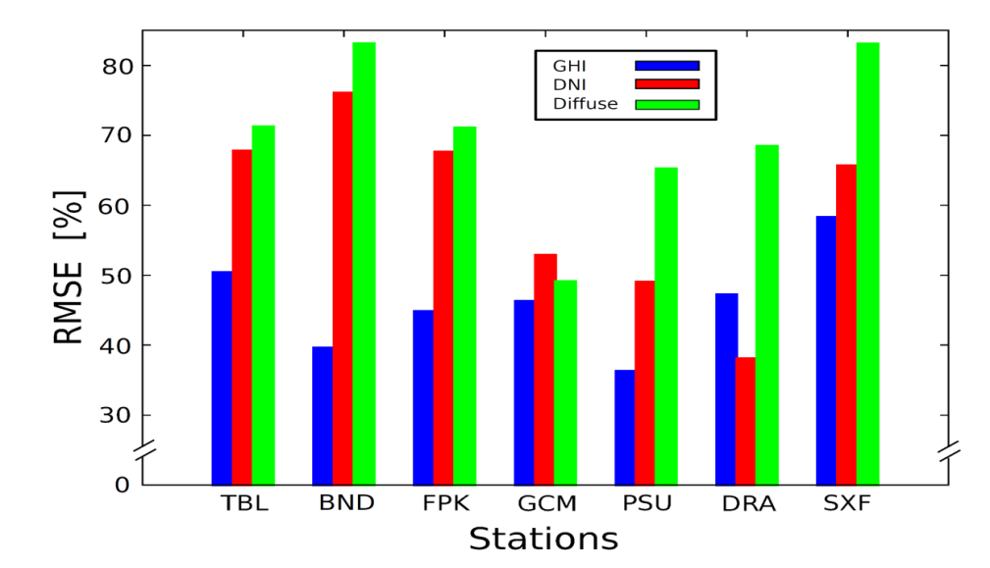
WRF-Solar
CLOUD-RADIATION-AEROSOL INTERACTION
% Improvement over standard WRF
Courtesy: Pedro Jimenez

Slide 23

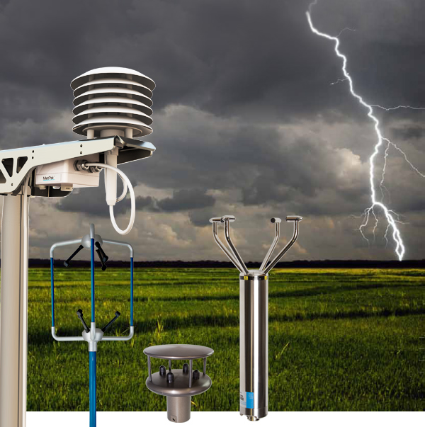
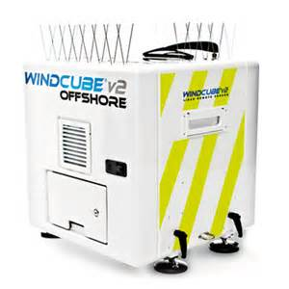
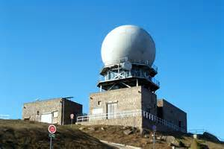
Assimilation provides best ICs
Data Assimilation – incorporating observations into a model
  Surface observations
  Satellite observations
  Atmospheric profiles
  Radar observations
  Data from wind or solar farms
  Specialized data

Slide 24
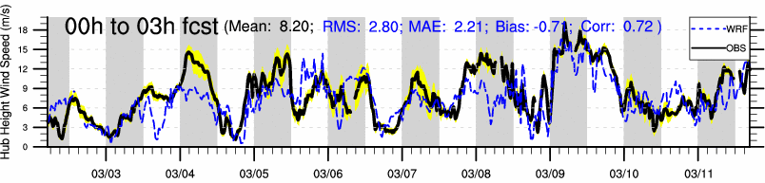
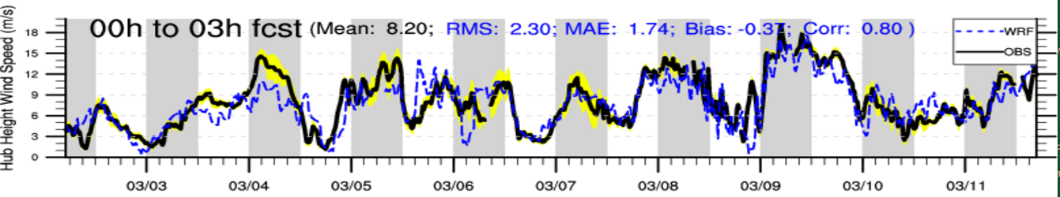
Application: Wind Energy Ramping
Real Time Four Dimensional Data Assimilation
RTFDDA
0-3 hour Wind Energy Predictions
W/O
Farm DATA
Gain:
17 % in RMS
20% in MAE
11% in Bias
With
Farm DATA
Courtesy: Yubao Liu

Slide 25
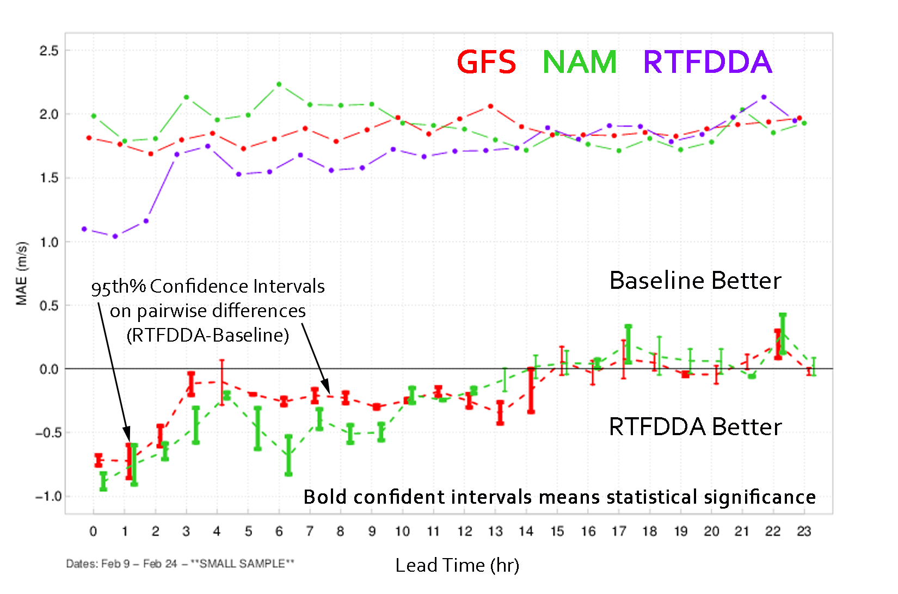
WRF- RTFDDA Improves
Short Term Forecasts (0-9h)
Courtesy: Tara Jensen, Yubao Liu

Slide 26
Rational for Nowcating:
Wind Energy Ramp Event
800 MW increase then decrease over 4 hrs!
Cold Front
Power (MW)
Passing Thunderstorms
Time (LST)

Slide 27
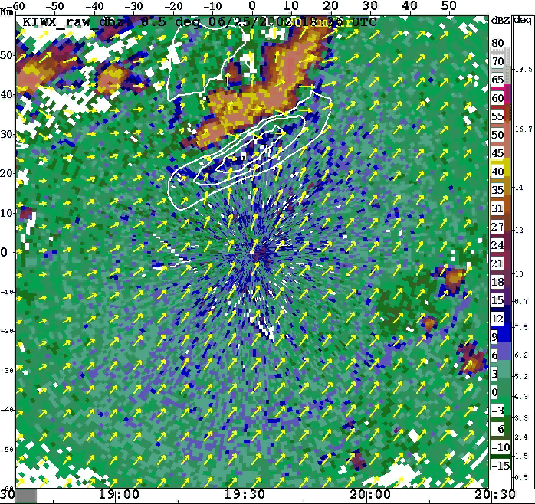
Application: Wind Energy Ramping
Variational Doppler Radar Analysis System
VDRAS
Gust fronts
approaching
‘wind plant’
Wind ramp
event is
imminent
Wind Farm
Need to provide time-of-arrival and magnitude of wind energy ramp.
Courtesy: Jenny Sun
NCAR Auto-Nowcasting System

Slide 28
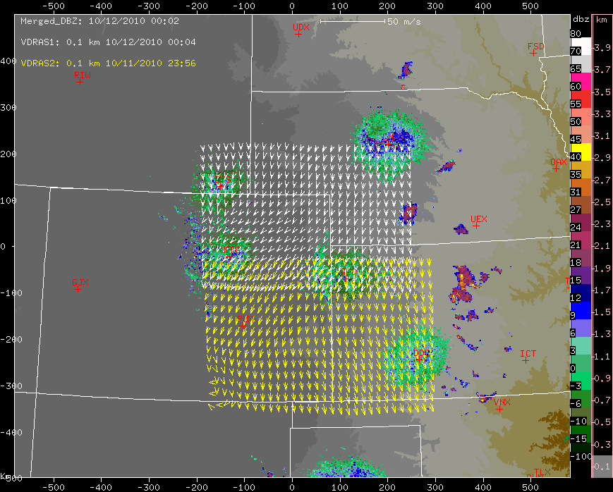
Wind Energy Ramp Event Nowcasting
VDRAS
Variational Doppler Radar Analysis System
+
Expert System (obs-based)
Courtesy: Jenny Sun
Notes:
To integrate wind energy into the grid on a short term basis requires accurate prediction of wind ramps, which are rapid changes in wind power. To do this, NCAR leverages the Variational Doppler Radar Analysis System (VDRAS), which uses four-dimensional variational (4DVar) assimilation techniques to blend Doppler radar data into a cloud-scale model to provide a physically balanced current state of the atmosphere. An observation-based expert system for nowcasting wind energy ramps has also been developed and is being blended with VDRAS output

Slide 29
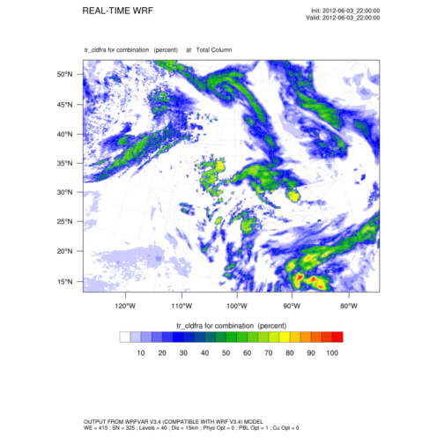
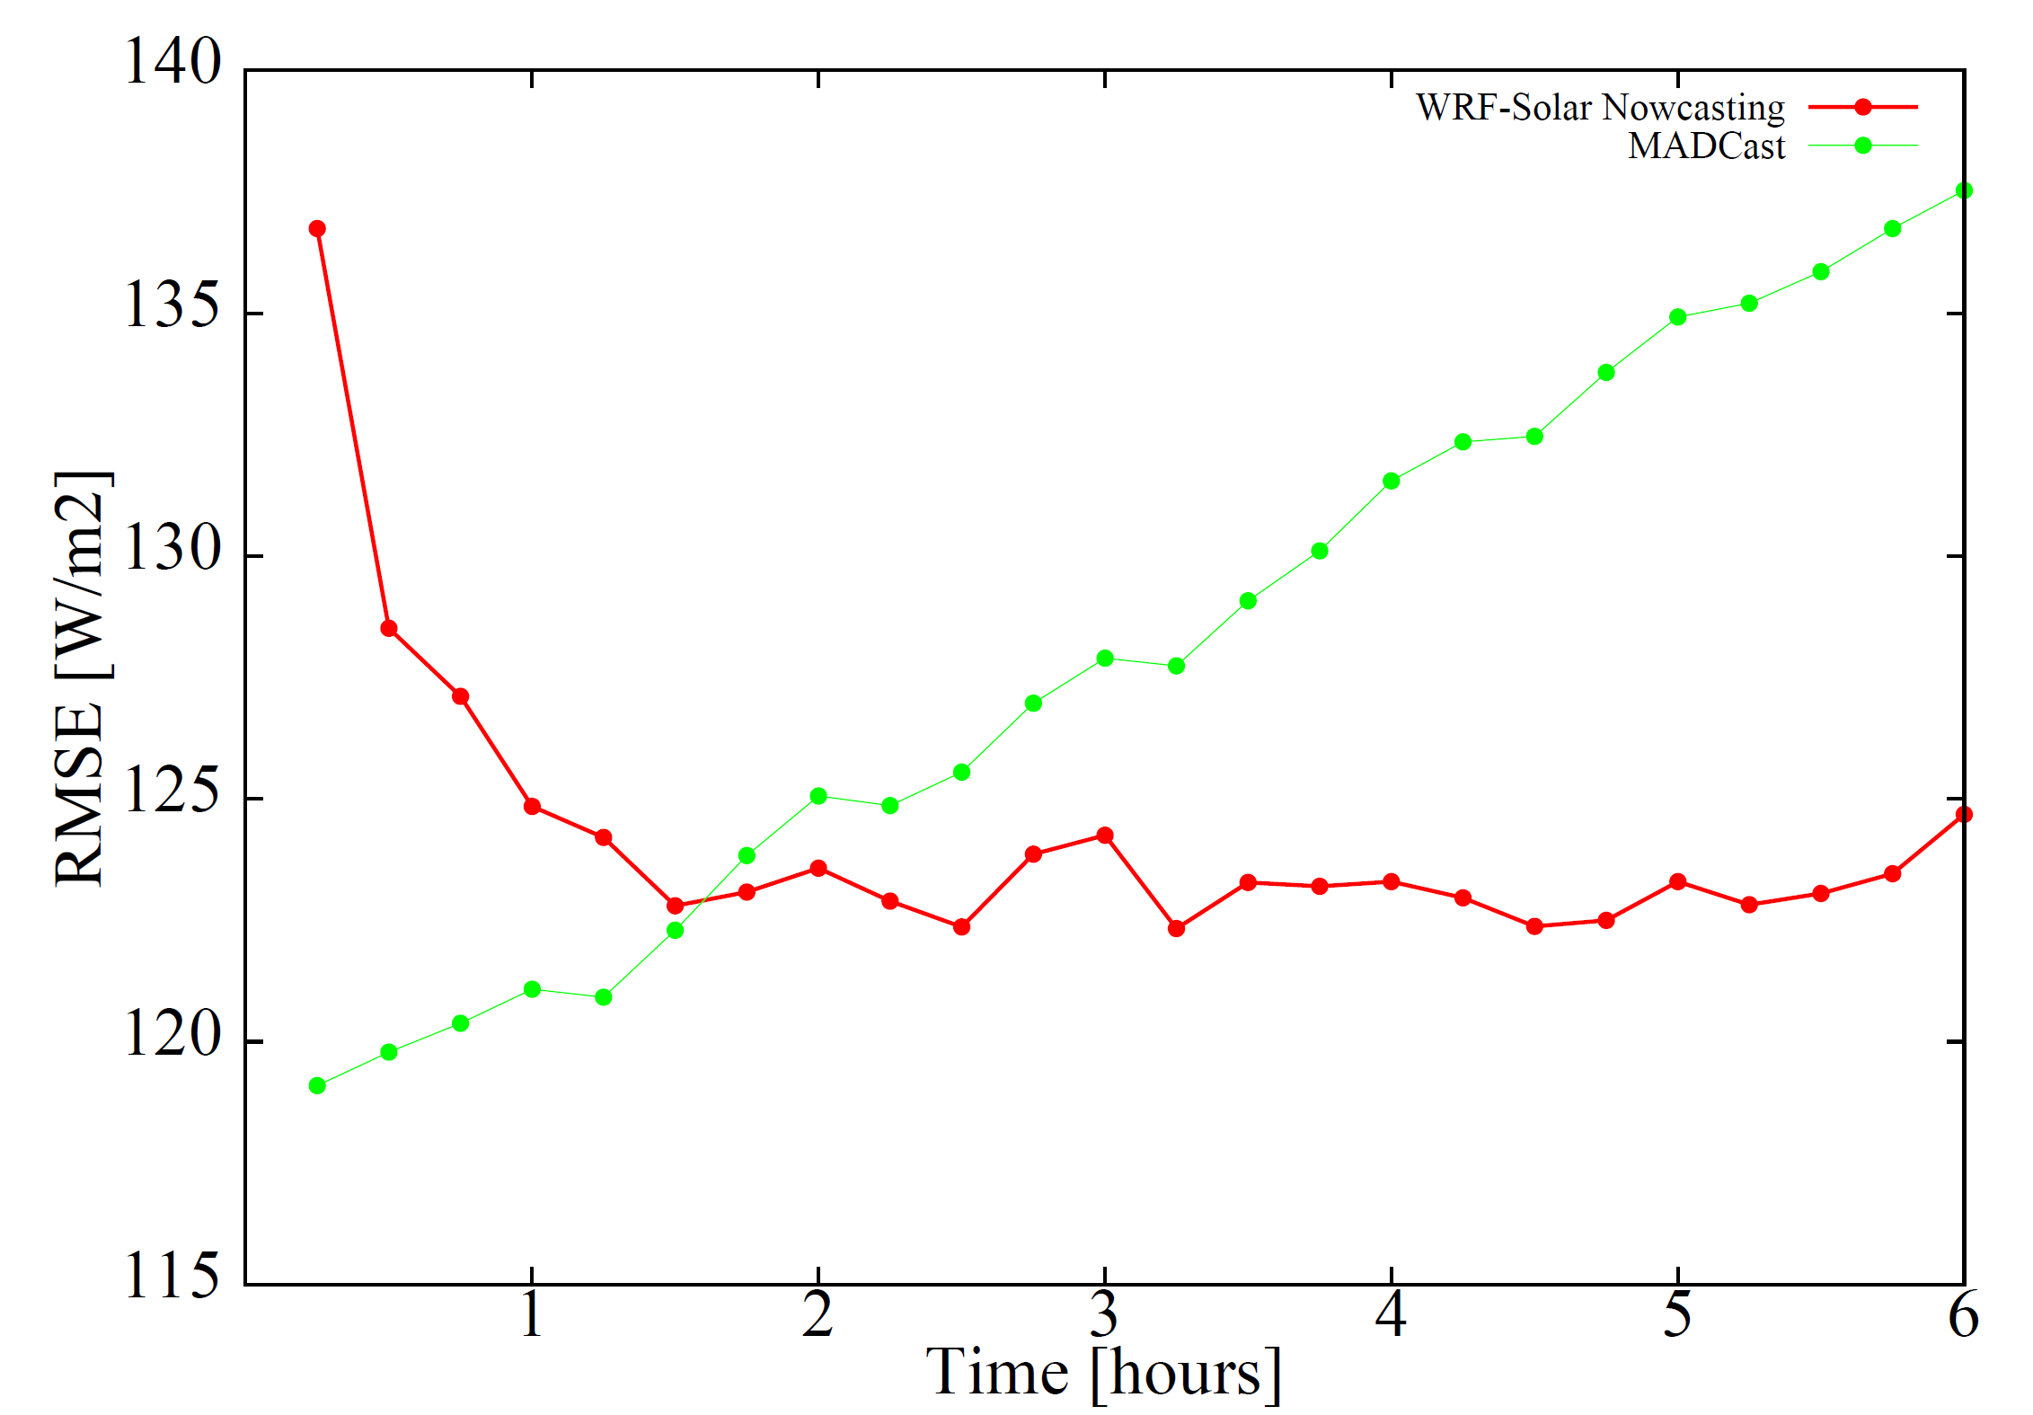

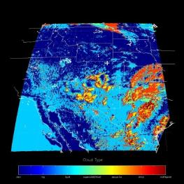

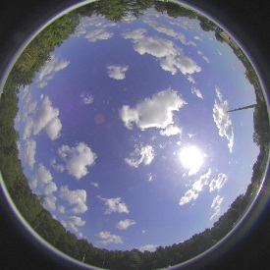
Nowcast System for Solar Power
Nowcast Integrator
StatCast
WRF-Solar
MADCast
TSICast
CIRACast
MAD-WRF
Irradiance Calculation (POA)
Obs
(Irradiance)

Slide 30
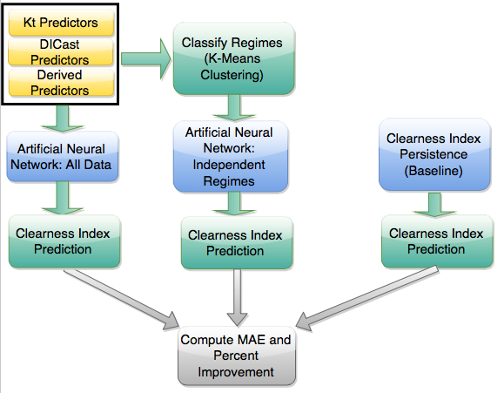
Some Models Employ AI: StatCast
Tyler McCandless

Slide 31
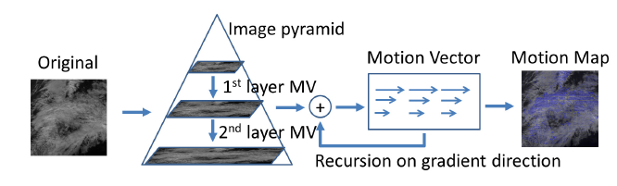
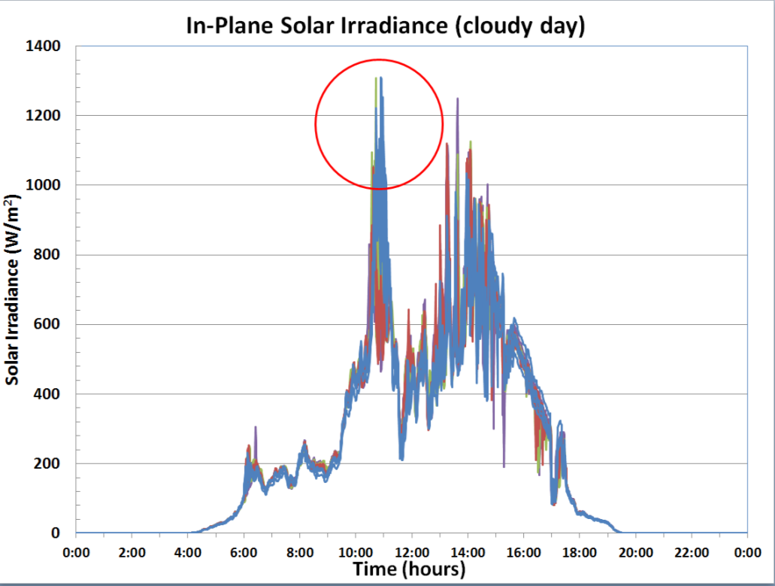
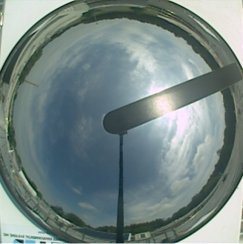
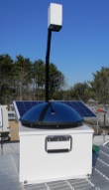
Sky Imager Forecast
θ₁
θ₂
6/19/12
Brookhaven NL

Slide 32

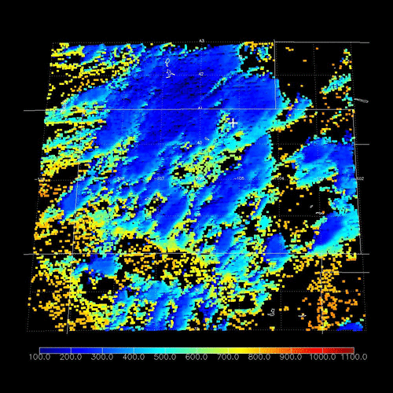
Satellite-Based Forecasting
CIRACast - Attention to Details
Imagine we are viewing this cloud from the satellite
Without account for sensor/sun geometry, the placement of cloud shadows can be 10’s of km in error
X
Advection of complex cloud layers requires proper account for wind shear
PV Array
TYPES OF WIND SHEAR
Speed Directional Both
Matt Rogers & Steve Miller: Colorado State University

Slide 33
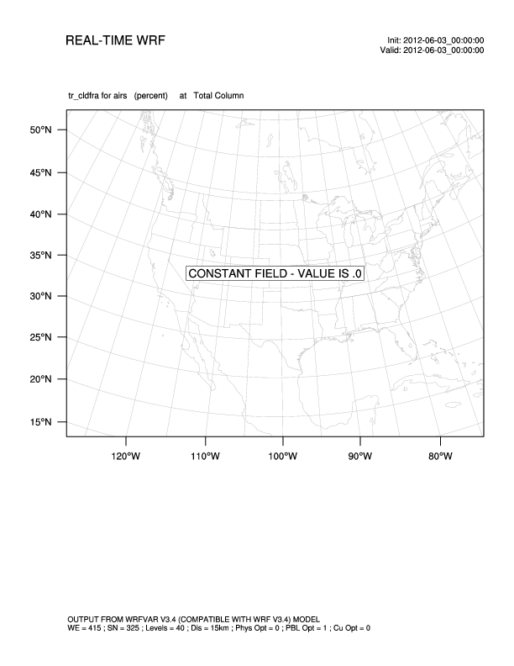
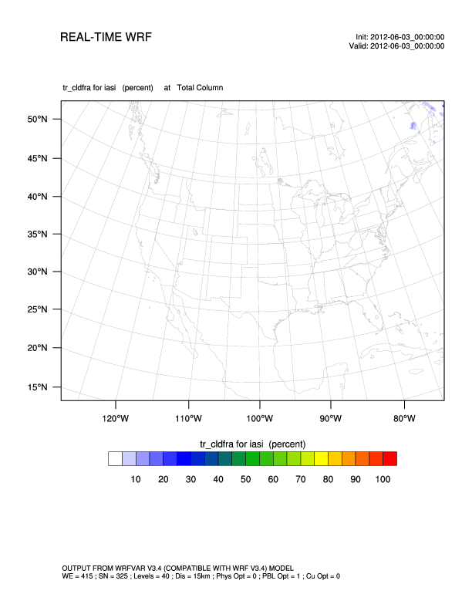
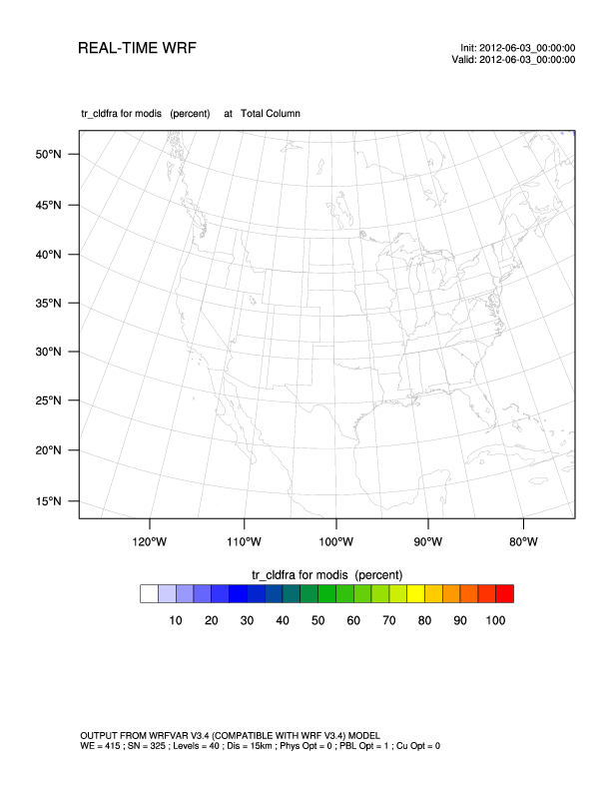
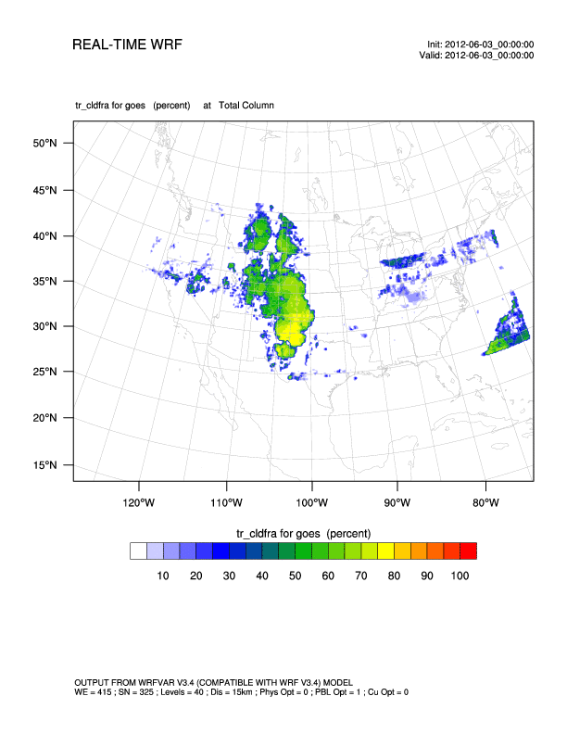
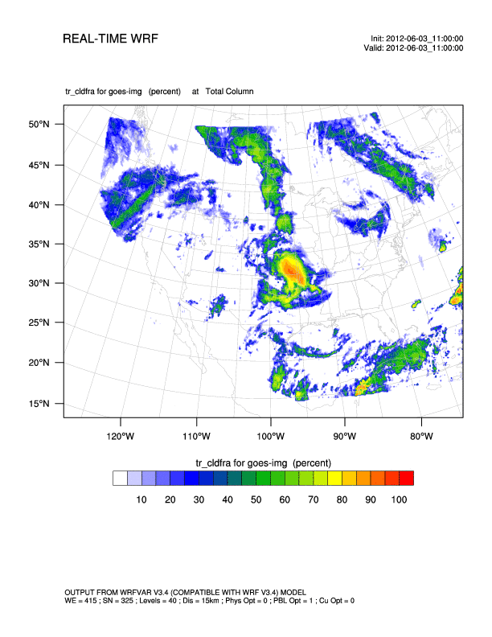

MADCast
Multi-sensor Advective Diffusive foreCast
Tom Auligne; Xu et al. (Adv. in Atmos. Sci. 2014)
AIRS
IASI
MODIS
GOES Sounder
GOES Imager
Multi-sensor

Slide 34
Quantify Value - Metrics
 | Model-Model Comparison | Economic Value
Base | Mean Absolute Error Root Mean Square Error Distribution (Statistical Moments and Quantiles) Categorical Statistics for Events | Operating Reserves Analysis Production Cost
Enhanced | Maximum Absolute Error Pearson's Correlation Coefficient Kolmogorov-Smirnov Integral Statistical Tests for Mean and Variance OVER Metric Renyi Entropy Brier Score incl. decomposition for probability forecasts Receiver Operating Characteristic (ROC) Curve Calibration Diagram Probability Interval Evaluation Frequency of Superior Performance Performance Diagram for Events Taylor Diagram for Errors | Cost of Ramp Forecasting
Tara Jensen

Slide 35
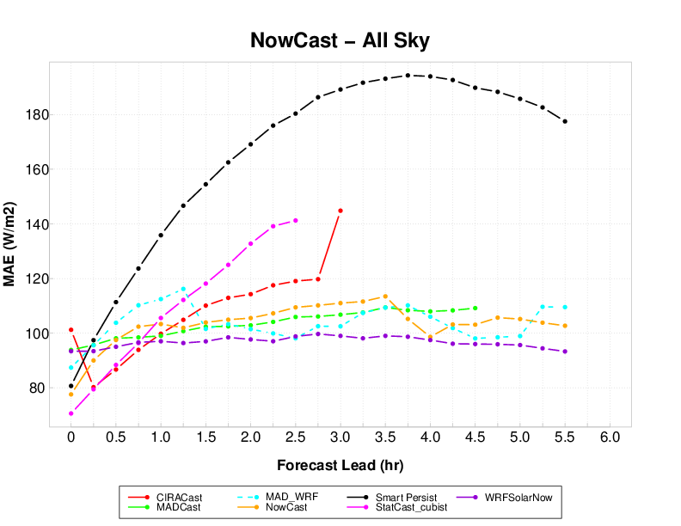
NowCast Performance
Aggregated over All Issue times and All Sky Conditions
CIRACast
MADCast
MAD_WRF
NowCast
SmartP
Statcast_cubist
WRFSolarNow
Component performance varies by lead time
All Compontents have lower MAE (greater skill) after 30 minutes into forecast (lead time)

Slide 36
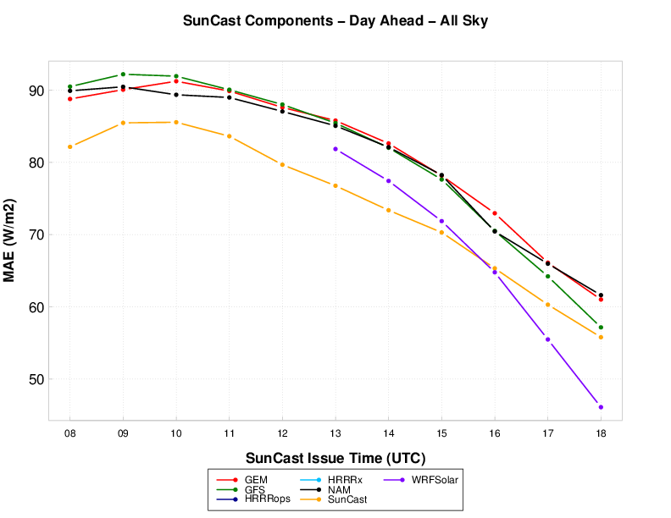
SunCast Performance – Day Ahead
NAM, GEM, GFS
SunCast Irradiance
Day Ahead (DA)
SunCast and WRFSolar
Outperform Baseline (NAM)
and other components
WRFSolar

Slide 37

Dynamic Integrated Forecast System (DICast)
WRF RTFDDA
Integrator
HRRR
Nacelle Winds
RAP
GFS
Turbine Power Prediction
Wind speed example
10-15% improvement
over best model
GEM
ECMWF
.
.
.
Wind Power Forecast
Other Model Data
Bill Myers

Slide 38

Customized Power
Conversion Curves
Observation-based power curves represent the site better than manufacturers’ power curves
Gerry Wiener
Notes:
38

Slide 39


Power Conversion
Empirical Power Conversion: Regression Tree - Cubist
Example for single axis tracking PV plant
Pattern depends heavily on time of day, AM takes higher route; PM more linear route

Slide 40

DICast System Blends Output from Several Numerical Weather Prediction Models
Public Service of Southwestern Public Service Company
Total Power, 03/08 Ramp
CAPACITY (%)
TIME

Slide 41

Probabilistic Prediction
Recent emphasis in popular scientific literature to emphasize probabilistic approach
Nate Silver thinks meteorologists are ahead of the rest:
  Embrace uncertainty
  Quantify it
  This produces better deterministic forecasts as well

Slide 42

Fluid Flow is Sensitive to
Initial Conditions
Atmospheric flows display sensitivity to initial & boundary conditions and to physics parameterization
Chaotic Attractor
How do we stay on the correct trajectory?
Assimilation Uncertainty Quantification
Lorenz (1963)

Slide 43


Ensemble Prediction

Slide 44


What if we had only one member? Analog Prediction
Analog Ensemble Method
Statistical learning method to calibrate model output and provide probabilistic information
Based on observed past model-observation pairs
Algorithm search for analogs and clusters them
Shown to perform at least as well as full NWP ensemble systems
Binned-spread/skill plot of power predictions from the calibrated ECMWF EPS (red), calibrated COSMO LEPS (blue) and AnEn (black)
Luca Delle Monache & Stefano Allasandrini
Notes:
The AnEn method has been applied to a nine 850-kW turbines wind farm located in a region with complex topography in Sicily, southern Italy, to produce an ensemble of power forecasts for the 01/2012-10/2012 period (training data set: 11/2010-12/2011). The AnEn was based on 4-km 78-h predictions from the meteorological model Regional Atmospheric Modeling System (RAMS), with initial and 6-hourly boundary conditions provided by the European Centre for Medium-Range Weather Forecasts (ECMWF) analysis and forecasts, respectively. The performance of the AnEn method has been compared with two advanced NWP-based ensemble forecasting systems, the ECMWF Ensemble Prediction System (EPS) and the COnsortium for Small-scale Modelling (COSMO) Limited-area Ensemble Prediction System (LEPS). Both ECMWF EPS and COSMO LEPS hub-height winds are calibrated with a neural network algorithm (for the first moment) and a variance deficit correction procedure (for the second moment). The ECMWF EPS and COSMO LEPS calibrated wind predictions are then converted to power via the turbine manufacturer power curve. A summary of this comparison is illustrated, which shows the root-mean-square-error (RMSE) of the ensemble means (Fig 1a) as a proxy of ensemble skill, and the binned-spread/skill plot to assess the spread-skill relationship of the analyzed ensembles (Fig 1b).
The AnEn method outperforms the other two advanced systems in this case, exhibiting a 10% (or more) RMSE reduction. Particularly interesting is the better spread/skill correlation of AnEn (being closer to the 1-to-1 line), which equates to better uncertainty quantification and possibly better decision making if those forecast were to be used for real-time operations.

Slide 45
Probabilistic Power Prediction
With Analog Ensemble Method
* Deterministic forecast
* Observations
Percentiles
Normalized Power
Normalized Power (Nameplate Capacity)
Forecast Lead Time

Slide 46

Icing Forecasting System ExWx Provides Categorical Forecast of Icing
Predicting wind turbine icing is critical for power trading on open market and short term load balancing.
In order to successfully develop a robust wind turbine icing forecasting system, a truth dataset must be developed.
Limited documentation of icing events and monitoring equipment make identifying icing after the fact difficult.
Plus, there is a “Big Data” problem.

Slide 47


Variable Energy Forecasting System
Natl Center Data
HRRR, NAM, GFS, RAP
GEM (Canada), ECMWF
Wind Farm Data
Nacelle wind speed
Generator power
Node power
Availability
CSV Data
Operator GUI
Statistical
Verification
WRF RTFDDA System
Wind to Energy Conversion Subsystem
Ensemble System
Dynamic, Integrated Forecast System
(DICast®)
Probabilistic and Analog Forecast
Solar Energy Forecast
Meteorologist GUI
Potential Power Forecasting
Supplemental
Wind Farm Data
Met towers
Wind profiler
Surface Stations
VDRAS
(nowcasting)
Data Mining for Load Estimation
Expert System
(nowcasting)
WRF Model Output
Extreme Weather Events

Slide 48

Engineering the System
Big Data Application

Slide 49
Wind Power Forecasts Resulted in Savings
for Ratepayers
  Forecasted MAE Percentage Savings
  2009 2014* Improvement
  16.83% 10.10% 40% $60,000,000
*Data through November, 2016
Also: saved > 267,343 tons CO2 (2014)
Drake Bartlett, Xcel
Notes:
2014 emissions savings for Colorado System (PSCo) due to economic cycling on baseload units = 267,343 tons of CO2. The ability to cycle baseload units (both coal and natural gas) is enhanced by confidence provided by accurate wind forecasting system

Slide 50

Valuation
Production Cost Modeling
Accomplished by Utility Partner – Xcel
  Value of 50% Forecast Improvement: $820,000 (2024 – increased utility scale capacity)
Upscaled by NCAR (Lazo)
  Annual National Savings:
  $10 – $21M / year (2015-2024)
  26 year savings: $455M

Slide 51

Gridded Atmospheric Forecasts: GRAFS-Solar
Observations
SMUD
MADIS
OK Mesonet
BNL
SURFRAD
Xcel
DeSota
ARM
NWP Models
NAM
GFS
WRF-Solar
GEM
RAP/HRRR
Initial Grid
Interpolated to 4 km CONUS Grid
1-Hour Averaging
Archive data near observation sites
Statistical Correction/Blending
DICast Point Correction
Gradient Boosted Regression Trees
Cubist
Random Forests
Analog Ensemble
Output Products
Maps of solar irradiance
Single point forecasts
% of clear sky irradiance
Future:
Other met. variables

Slide 52

GRAFS
A new forecast is generated every hour
Individual images are generated for each lead-time
  Currently hourly out to 60 hours.

Slide 53

GRAFS
AI methods at SMUD Sites

Slide 54
Summary
Theme: Smartly blending data, dynamics, physics, and statistical learning methods
We need good models of the dynamics & physics
We need high quality data to assimilate
Statistical learning (artificial intelligence) can add value and help to determine the characteristics of the physics
Specialized applications may require specialized forecasts

Slide 55

Questions

Slide 56
Supplementary Slides

Slide 57


StatCast
Forecast Clear Sky Index
Separate into:
  Clear
  Partly Cloudy
  Cloudy
Tyler McCandless

Slide 58

Regime-Dependent Statcast
Tyler McCandless
Notes:
The next step was to implement the Artificial Neural Network method for AI prediction. The predictors the model are provided include the past three GHI observations and the DICast predictors from all three sites for a total of 21 predictors. The data is split into a 2/3 training and 1/3 testing to optimally configure the model.

Slide 59



Empirical Power Conversion Curves
Manufacturer's Power Curve
Actual Power Curve
Not Straightforward!
Gerry Wiener
Notes:
59

Slide 60

Some Highlights
WRF-Solar improved on Standard WRF by 20-80%
WRF-Solar also important component of NowCast system, often best component
StatCast-Cubist can improve upon smart persistence by 37-62% - short range (0-3 hr)
TSICast better than persistence first 15 min – 29-34%
Cloud advection and assimilation methods predict ramps well – Nowcast with WRF-Solar-Now
Nowcast improvement 45-53% MAE averaged all conditions, all sites
Saw 47% improvement in prediction at Xcel sites, despite 2016 harder to predict (El Nino)
DICast® improves on best forecast
10-28% MAE
AnEn improves by another 16-96% MAE
SunCast improvement 90% MAE (SMUD)

Slide 61

Recommendations for Solar Fcsting
Blend various component models or systems together with machine learning.
Use a base NWP model enhanced and tuned for the purpose.
Include multiple NWP models.
It is possible to improve upon persistence, even at the very short-range by using methods trained on in situ observations.
Satellite based cloud advection is useful, but tricky.
NWP can be combined with satellite data via assimilation for nowcasting.
The analog ensemble approach is helpful for both improving the deterministic blended forecast as well as for producing a probabilistic prediction.
An empirical power conversion method
viable, even where data limited.
Enhanced metrics necessary.

