Slide 1
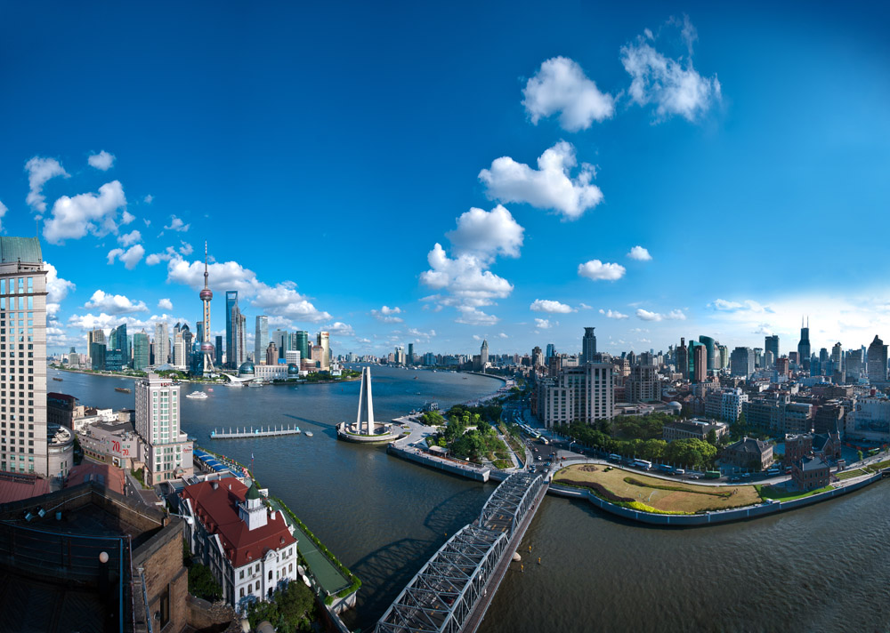
Climate Service for Mega City :
A Case of Shanghai
LIANG Ping, LIU Xiaochen, Sun Landong
Shanghai Climate Center
Shanghai Meteorological Service
Shanghai, 18th May 2018
World Energy & Meteorology Council
Trainning Course: Buliding Weather & Climate Services
Notes:
Regal International East Asia Hotel, Shanghai, China, Friday 18th – Sunday 20th May 2018

Slide 2
Outline
Climate and climate challenges in Shanghai
Climate services in Shanghai
Next steps

Slide 3
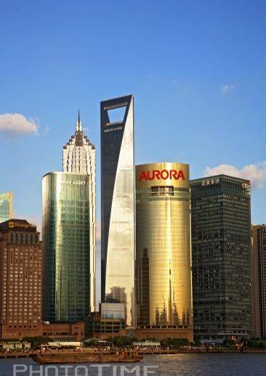
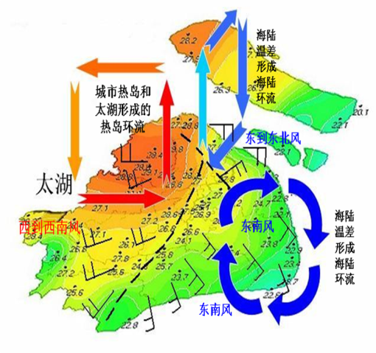
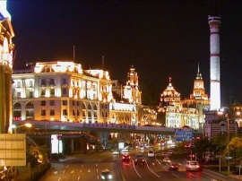
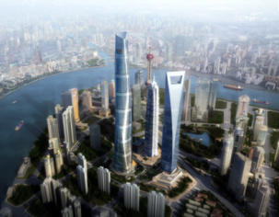
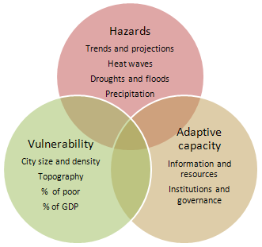
The unique climate pattern
sea breeze circulation
Circulation induced from UHI
and lake-land thermal contrast.
The Yangtze River
TheTai Lake
The Pacific Ocean
Boundary convergence line
sea breeze circulation

Slide 4

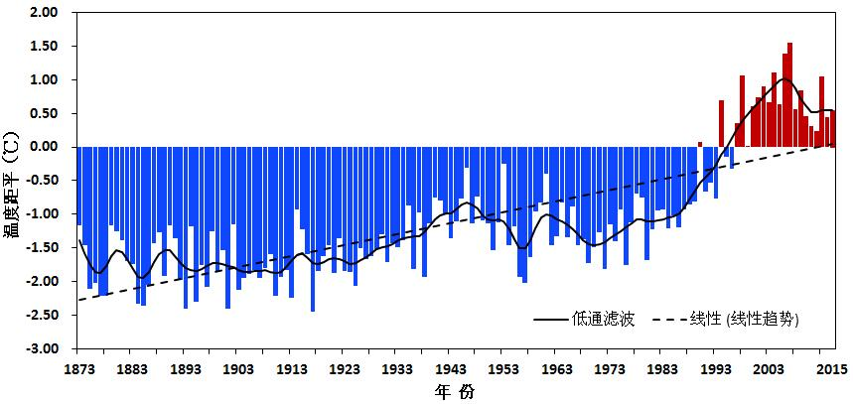
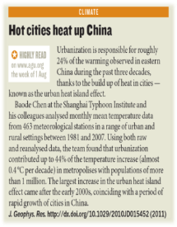
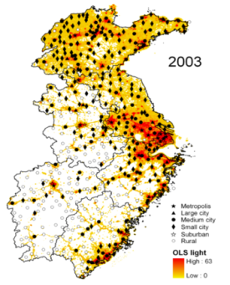
Climate Change Observations
The observed warming trend
0.87℃/ 10yr
More than 40% warming is due to urbanization.
Annual Average Temperatures, 1873-2015

Slide 5
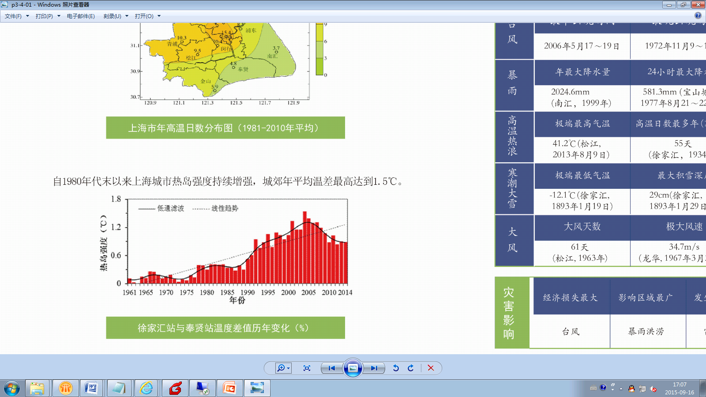
The Urban Heat Island Effect
11.7 Days
Average annual hot days, 1981-2010
Urban heat island intensity, 1961-2014

Slide 6
Observed Climate Change-Extreme precipitation
Changes of hourly precipitation extremes in Zikawi over the last hundred years
The time axis omitted the missing year（1939-1948）
Extreme precipitation events become increasingly prominent.

Slide 7
Changes of Wind Speed
Changes in average wind speed anomaly, 1961-2014

Slide 8
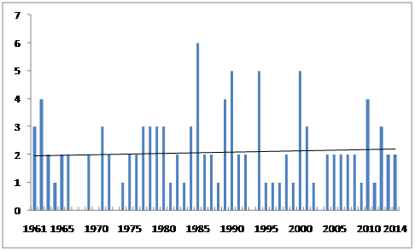
Changes of typhoon
There was no significant change in the number of typhoons in Shanghai, while the intensity of typhoon increased.
number of typhoons
影响上海台风个数的年际变化
Reference: Shanghai Climate Change Monitoring Bulletin,2015
Reference: Assessment Report on Impacts of Climate Change on Tropical Cyclone Frequency and Intensity in the Typhoon Committee Region,2012

Slide 9
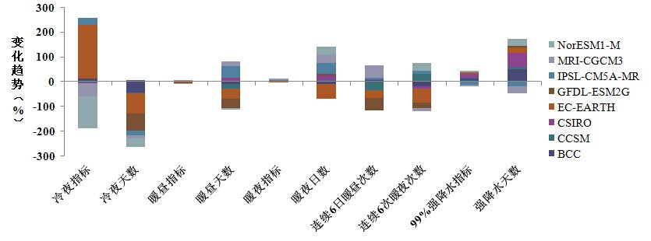
Climate Change Projection
Projected changes in number of days for cold night, warm daylight, warm night and heavy rainfall in Shanghai, derived from eight GCMs.
Cold Nights
Warm Daylight Days
Warm Nights
Heavy
Rainfall Days
% Change

Slide 10

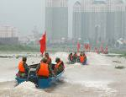








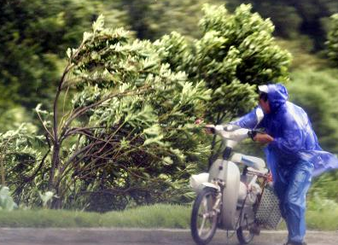
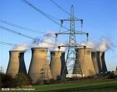
Requirements for climate service
Typhoon
Flood Control
Public Health
Severe Convective Weather
Agriculture
Heat wave
High-impact
climate events
and urban sectors
Transportation
Heavy fog
Aviation
Navigation
Strong Wind
Power Supply

Slide 11
Outline
Challenges
Climate services in Shanghai
Next steps

Slide 12

Urban Framework for Climate Service (UFCS)
Disaster Reduction（MHEWS）
For Shanghai to be an int’l economic center it must provide a safe and secure place to do business
Almost all of Shanghai’s natural hazards are weather-related and likely to increase as climate changes.
Environment
Energy
Observation & Monitoring
Climate Service
Water
Agriculture & Eco-system
Information
System &
Research
Prediction & Projection
Insurance industry
Infrastructure
Resilience of city = engineering resilience + service resilience + coordination resilience
Resilience of city depends on resilience of individual systems and resilience between the systems.
Public Health

Slide 13
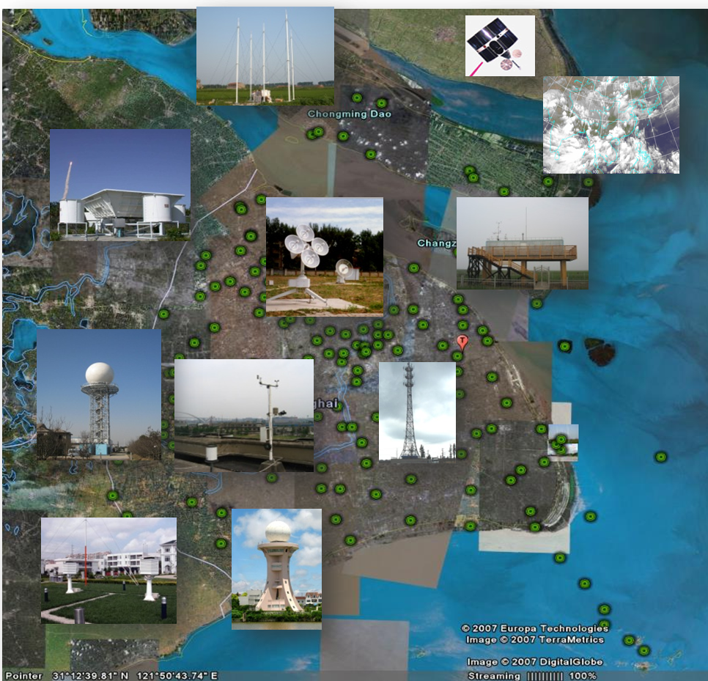
Observation Networks
Lightning positioning system
Supporting for various service needs
Wind profiler
AWS ( 5 – 6 km) | 256 | 1 min
Weather radar | 2 | 6 min
Wind profiler | 10 | 30 min
Met-towers | 13 | 1 min
L-band radiosonde | 1 | 6 h
Lightning positioning system | 7 | 1 s
GPS/MET | 31 | 30 min
Satellite receivers | 9 | 30m/1h
Atmospheric component | 10 | 1 min
Video monitoring | 27 | Real-time
Mobile observation | 5
L-band radiosonde
Atmospheric component

Slide 14
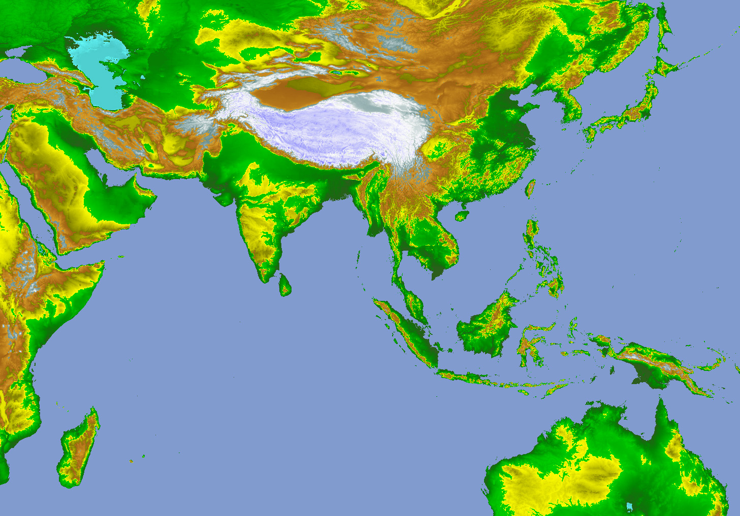
Climate Monitoring
Typical Subtropical Monsoon Climate
Cold air
Asian Summer Monsoon Systems
Meiyu Front
Plateau forcing
D
Subtropical High
Southwest Vortex
Monsoon Low
D
D
Monsoon Trough
Somalia Jet
Typhoon
越赤道气流
越赤道气流
越赤道气流
MJO东传
Tropical Convective Cloud
Southeast Trade
Mascarene High
Australia High

Slide 15
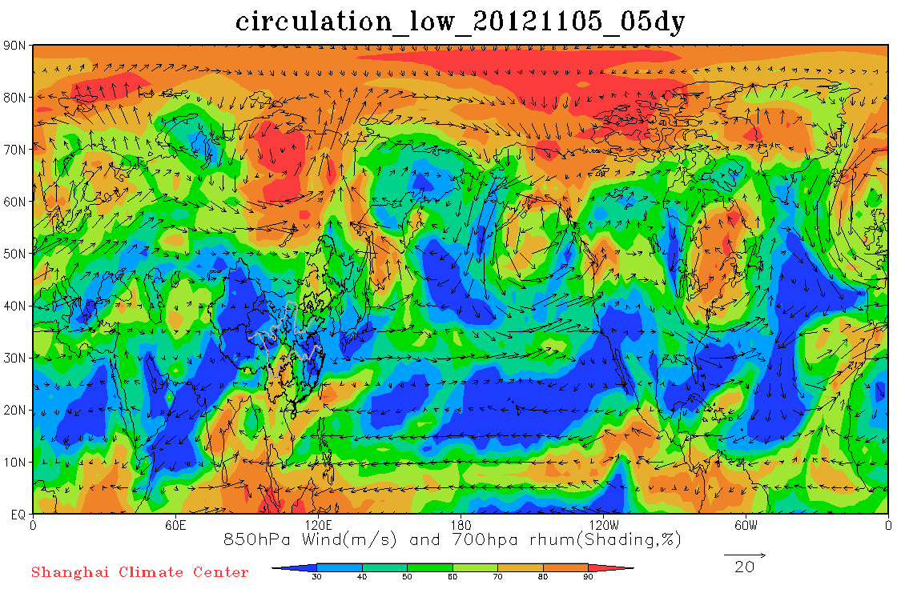
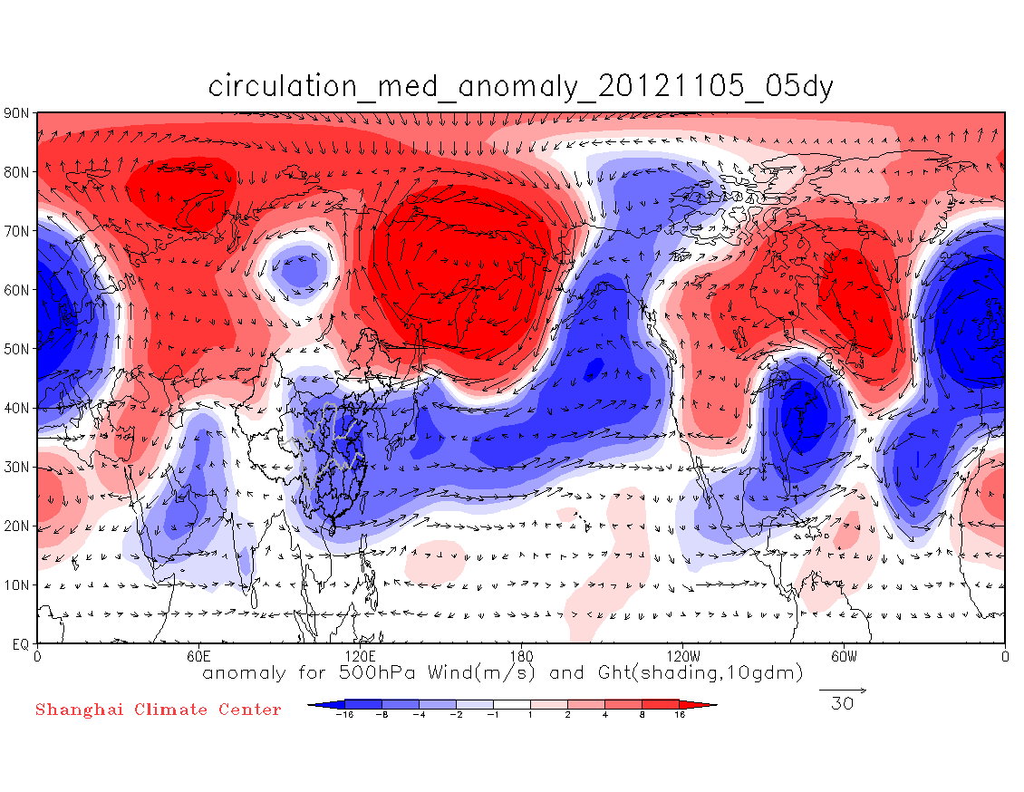
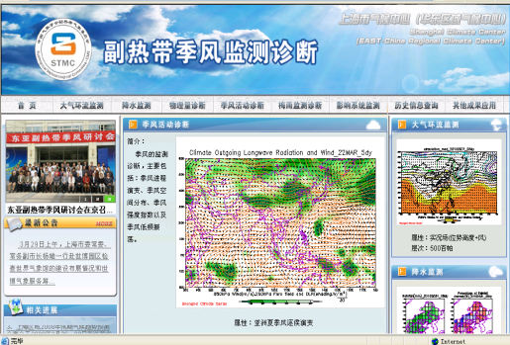
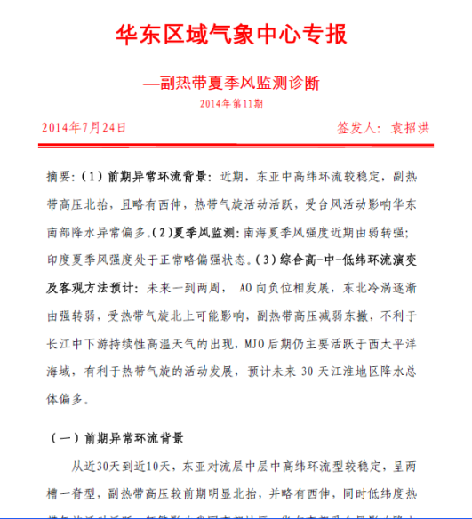
Climate Monitoring
Key products----monitor & analysis products
East Asia Subtropical Monsoon Monitoring Website: http://monsoon.climate.sh.cn/
Circulation monitoring for last 5 days
Circulation anomaly monitoring for last 5 days
Key products
Northeast cold vortex index monitoring
夏季风活动北界
Key products
Weekly Bulletin of Subtropical Monsoon
Monsoon north-most edge monitoring
Western Pacific Monsoon Index monitoring

Slide 16
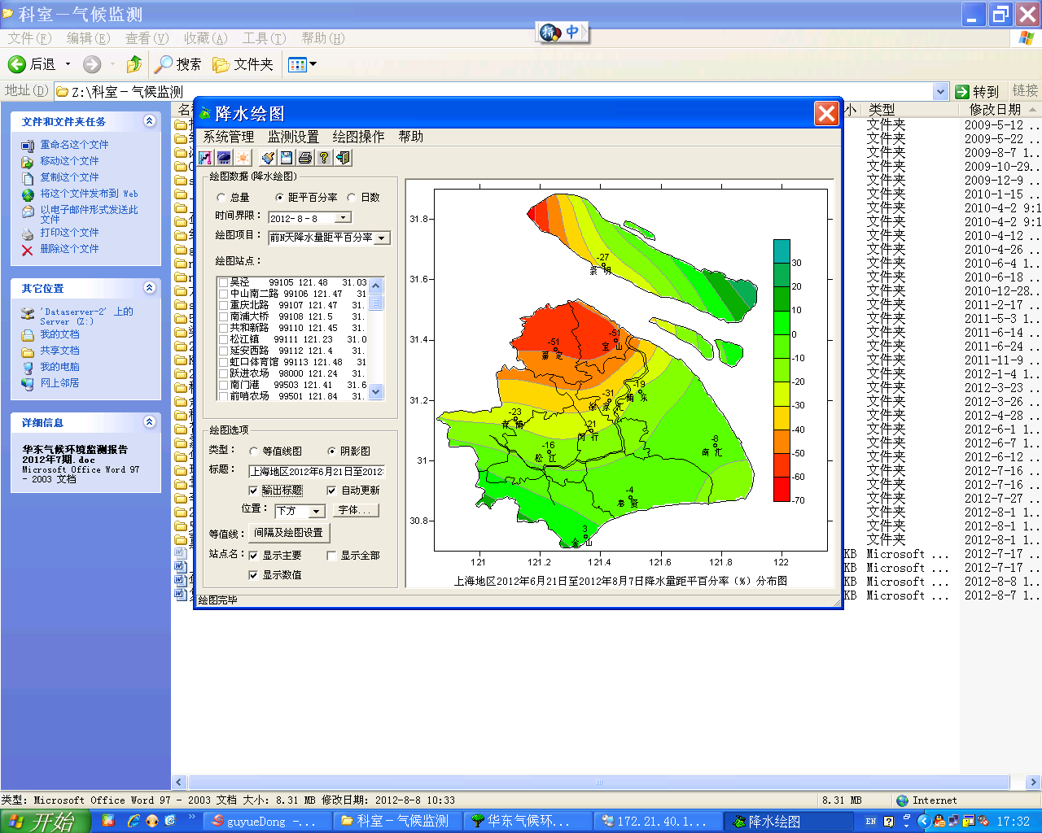
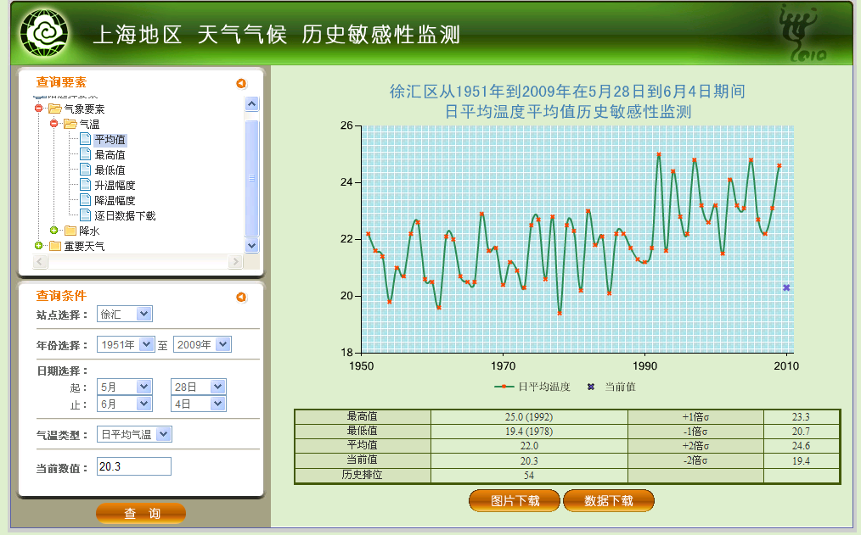
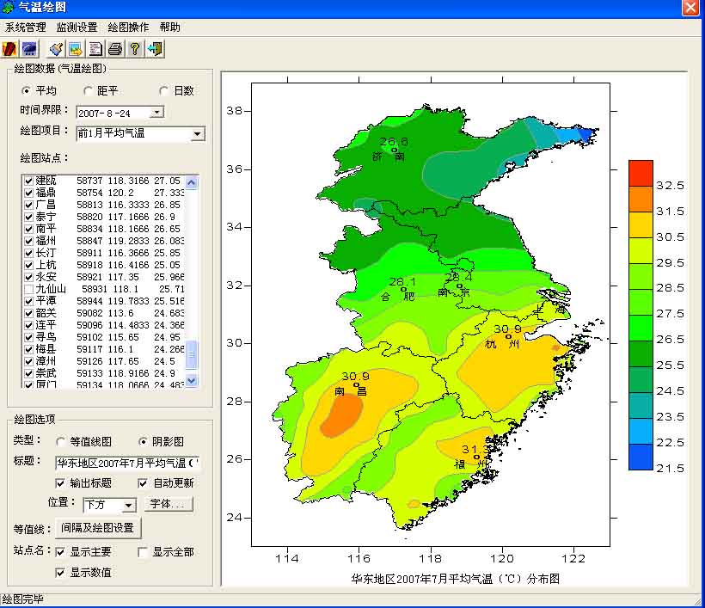
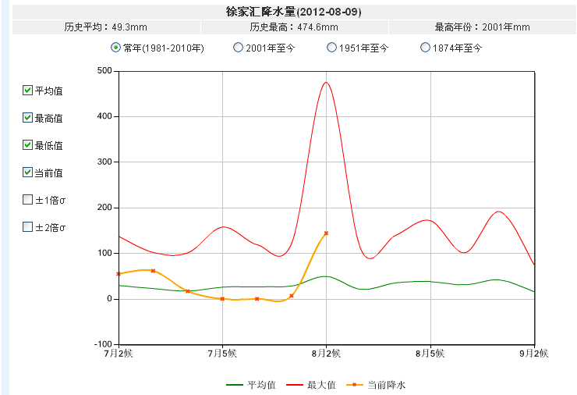
Climate Monitoring
Interface of extreme events monitoring & inquiry operation system
Extreme events monitoring & inquiry
Climate monitoring of Shanghai & East China region

Slide 17
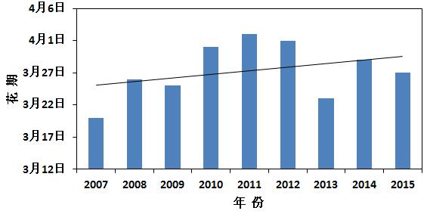

Climate Monitoring
Phenology observation & analysis
The early florescence of peach blossom tend to delay in 2007-2015 with an average of 1 d delayed per year.
The florescence of 2015 is March 27th, which is near the average date.
Variation in the first-flowering time of
of Peach blossom , 2007-2015
Peach blossoming on 27th March, 2015 in Shanghai Botanic Garden

Slide 18
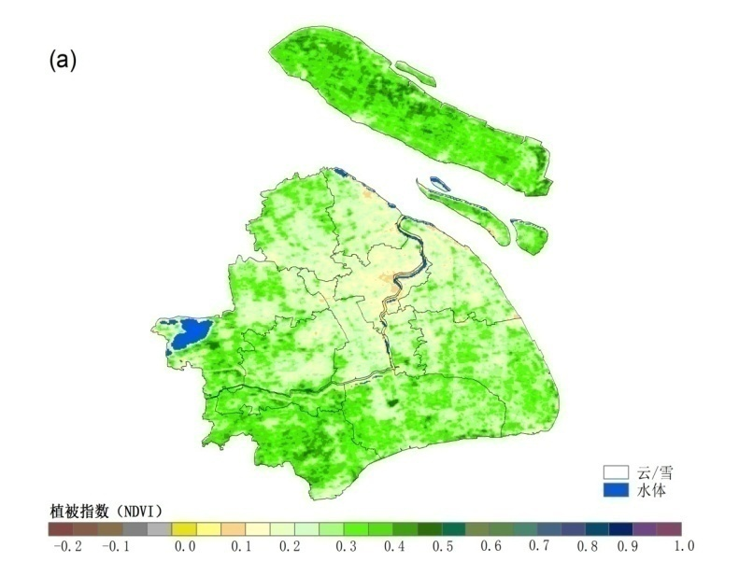
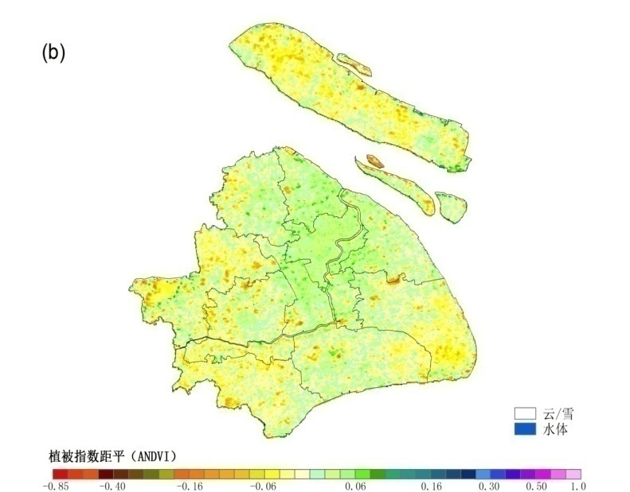
Climate Monitoring
Ecology observation & analysis
From the spatial distribution, the vegetation cover is better in the outskirts than in the central urban and its nearby suburban areas.
From the time variation, the vegetation indexes in outer suburbs are slightly lower than the past 10-year average while the vegetation index in urban center and suburban area are slightly higher than the past 10-year average.
The vegetation ecological quality generally maintains normal or even better over the most area of Shanghai.
Distribution of annual vegetation index (a) and anomaly(b) over Shanghai in 2015

Slide 19
Seamless Suite of Forecast
Products Spanning Weather and Climate
Short or medium term forecast
提升模式系统预报能力
信息客观提取及订正
主观和客观融合技术
精细化格点处理技术
11-30dy
10-15dy daily elements forecast
15-30dy high impact events forecast
Forecast uncertainty
12hr-10dy
Short or medium term disaster or extreme weather forecast
Seamless and refined forecast products
Short term convective weather forecast and early warning & refined grid forecast
2-12 hr
Extended range forecast
动力模式降尺度技术
动力统计解释应用技术
动力统计集合预报技术
Short-term forecast
Near echo extrapolation forecast
Multi source fusion grid point analysis
0-2hr
风暴尺度数值预报系统
高频客观订正和融合
短时预报解释应用
Focusing on dynamical downscaling, statistical interpretation and application basing on mutimodels
Short-term nowcasting forecast
多源资料监测、分析及应用
快速同化数值模式分析系统
综合临近外推预报技术
Forecast lead time

Slide 20
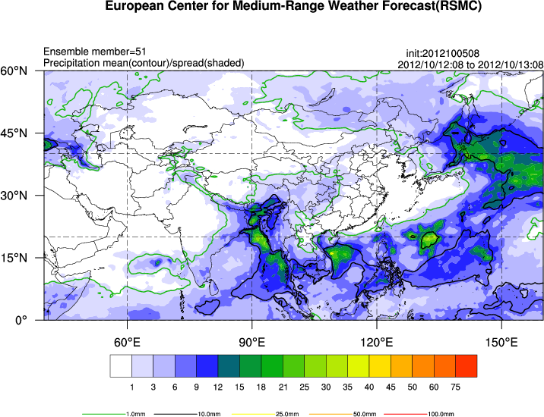
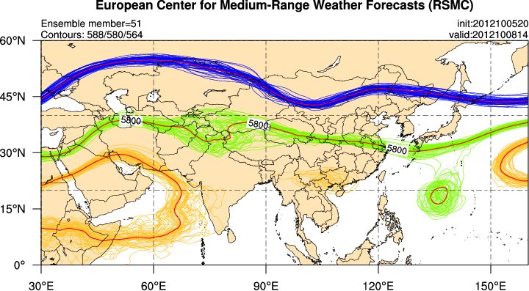
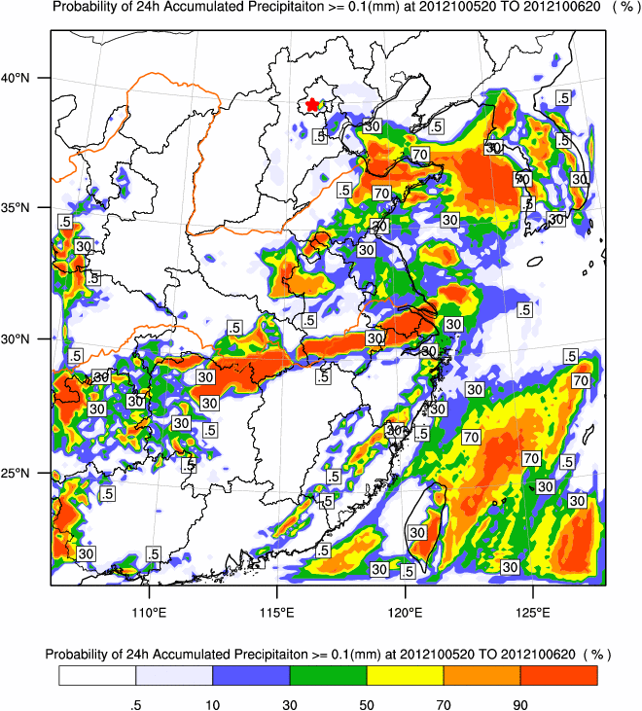
Weather Forecast
Short-term and medium-range high impact weather forecasts and the maximum probability and uncertainty analyses based on the ensemble models (such as SMS-EnWARMS: the SMS Ensemble WRF ADAS Real-Time Modeling System, and the THORPEX Interactive Grand Global Ensemble Products)

Slide 21
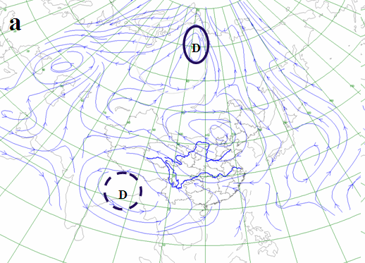
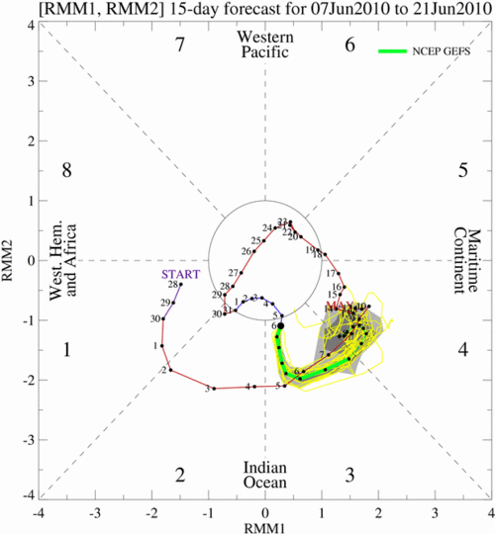
Extended-Range Weather Forecast
D
10-30dy forecast of heavy rainfall process
D
D
D
D
D
LFO system evolution
LFO system
distribution map
10-50dy forecast of pentad rainfall anomaly
2 weeks forecast of extreme rainfall occurrence

Slide 22
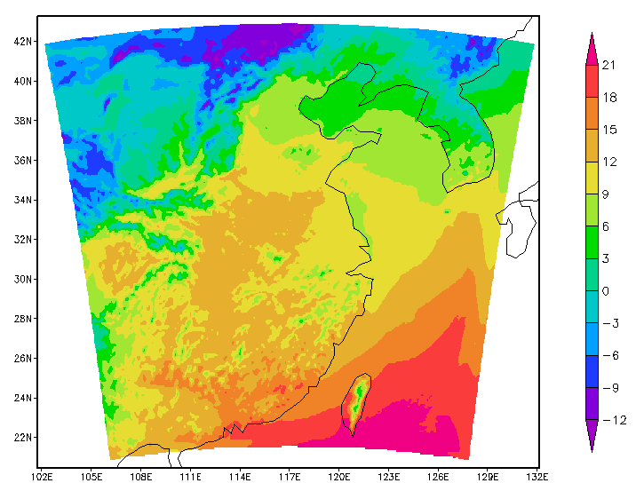
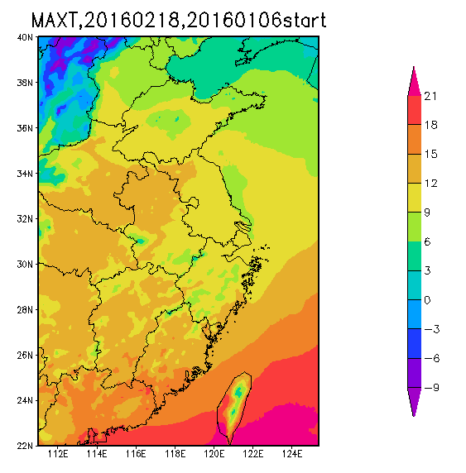
Extended-Range Weather Forecast
Extended-range weather forecast basing on dynamical downscaling by use of WRF regional model
Horizontal resolution: 9 km
Lateral boundary condition and initial fields: CFS V2 from NOAA
WRF downscaling: daily update
Products: 11-45dy grid meteorological elements forecast
Integration range of WRF
Output of temperature maximum

Slide 23
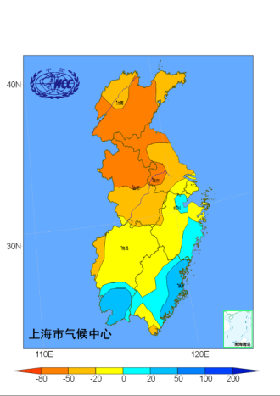
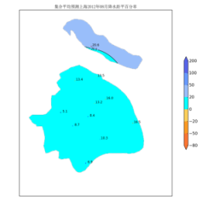
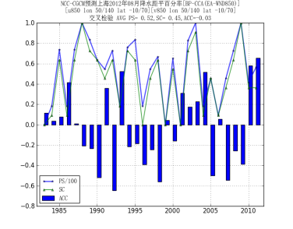
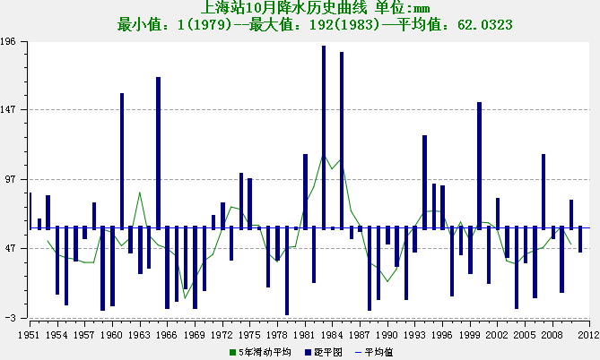
Climate Prediction
Climate prediction spanned from monthly, seasonal and annual scale, focusing on the high impact weather and climate events (i.e. heat wave, drought, flood, etc.)
Forecast system of dynamical
and analogous skills(FODAS)
Climate information processing and analysis system
（CIPAS）
Multi-Model downscaling ensemble
system (MODES) products

Slide 24
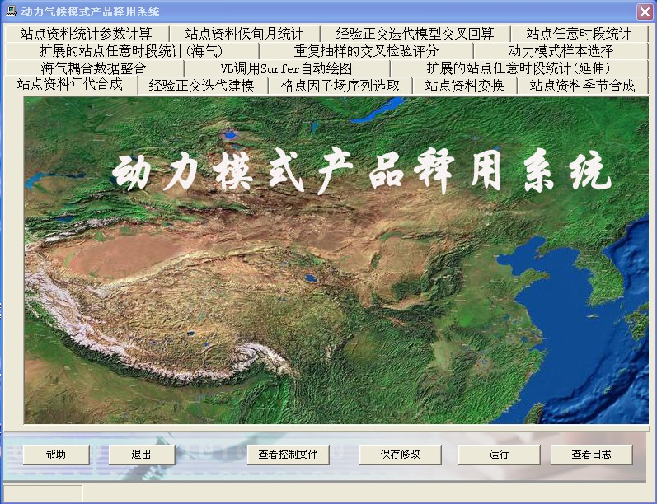
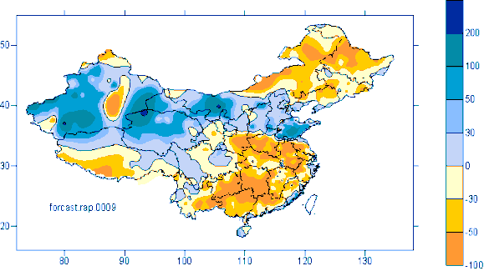
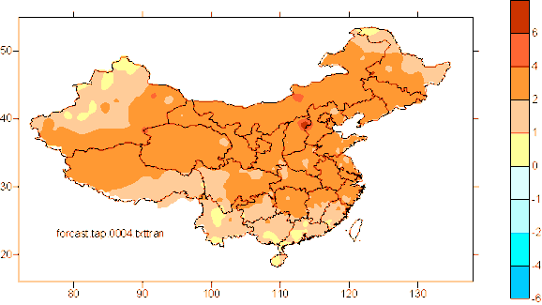
Climate Prediction
Dekadly update monthly prediction basing on statistical & dynamical combination method
Statistical interpretation & application of dynamical forecast model of BCC
Dekadly update monthly Rainfall anomaly prediction
Dekadly update monthly temperature anomaly prediction

Slide 25
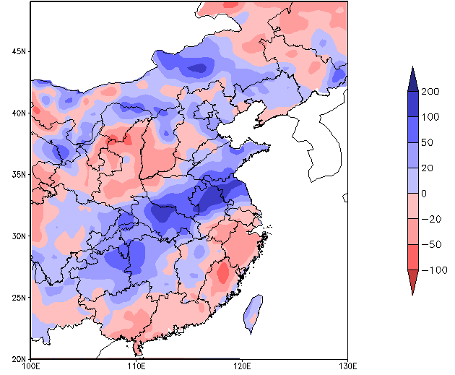
Climate Prediction
Seasonal prediction basing on dynamical downscaling method
Seasonal prediction of Eastern China from Regional climate model RegCM-NCC (a altered RegCM2)& RegCM3 driven by CGCM ( BCC_CM1.0) )
Improving method for dynamical downscaling prediction:
driven by bias corrected CGCM
summer precipitation anomaly

Slide 26
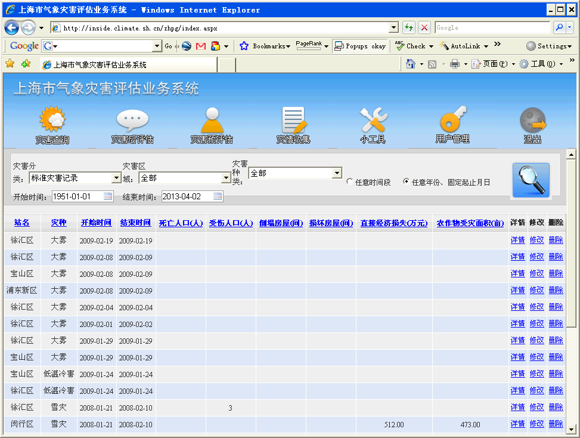
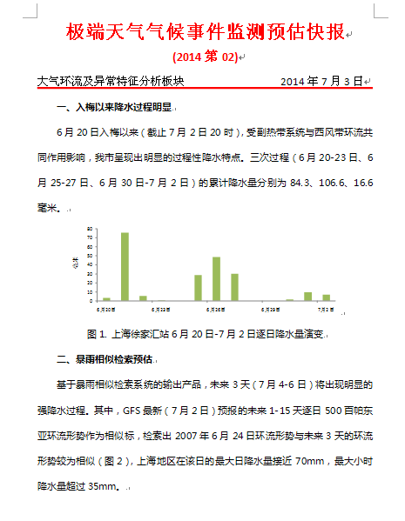
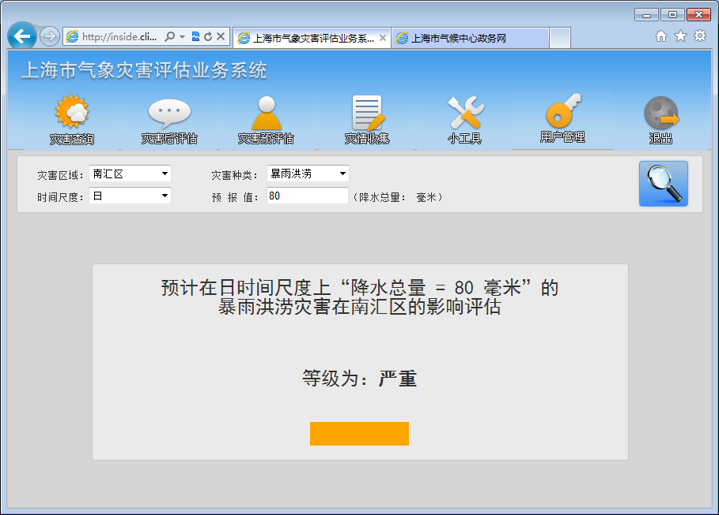
Extreme Events Pre-assessment
Interface of Meteorological disaster assessment system
Express of extreme event monitoring & pre-assessment
Multi-modules: Collection, inquiry, assessment & pre-assessment

Slide 27
Climate Change Projection
Projected changes in number of days for cold night, warm daylight, warm night and heavy rainfall in Shanghai, derived from eight GCMs.
Warm Daylight days
Warm night days
Heavy
rainfall days
Cold night days
Change
OBS
OBS
OBS
Compared with 2001-2010, extreme warm and heavy rainfall will increase while cold events will decrease in 2021-2030.

Slide 28
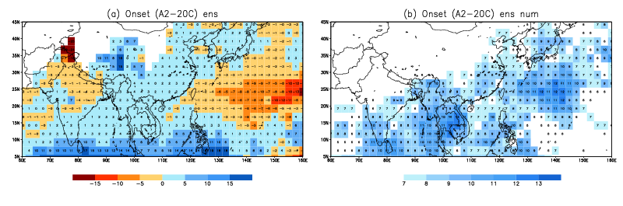
Climate Change Projection
Monsoon projection From CMIP3 to CMIP5:
consistent delay of monsoon onset date
By using 13 CMIP3 models
CMIP3 的迷茫与困惑
By using 26 CMIP5models
Notes:
28

Slide 29
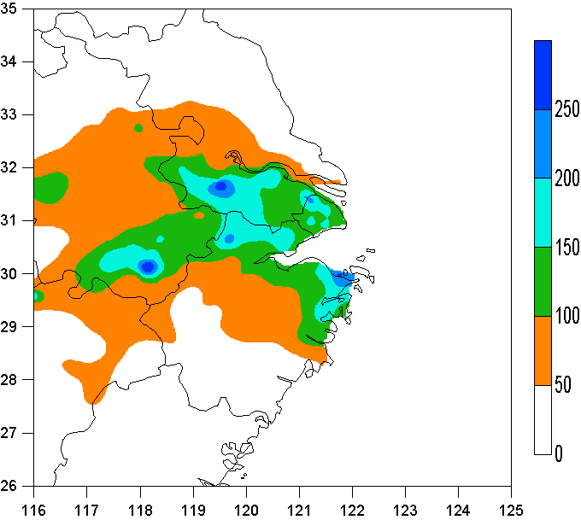
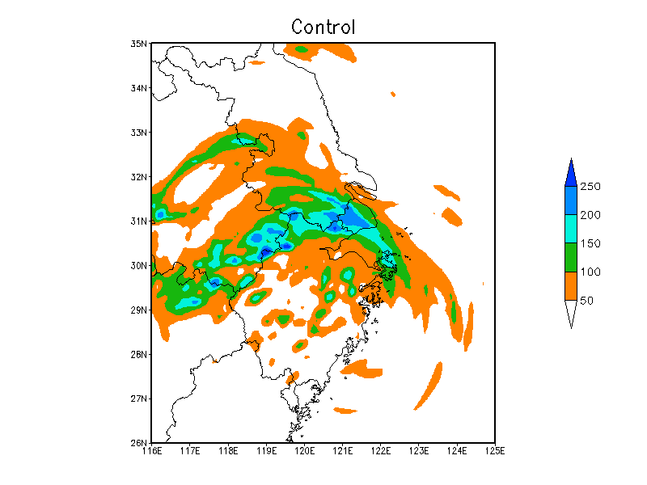
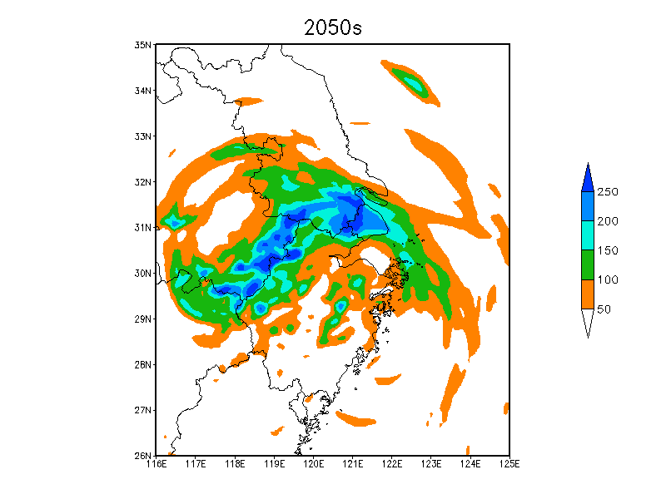
Climate Change Projection
Simulation of Future Typhoon Event under climate change in 2050
Observation
The result of 2050 shows a significant increase in precipitation for the same event of HAIKUI typhoon.

Slide 30

Climate Information Services
《Extreme Events Express》
The climate information delivery platform
《Overview of last week weather & climate》
《Historic weekly disaster evaluation》
《Weekly bulletin of subtropical monsoon》
《Weekly extended range forecast 》
《Monthly prediction from statistical downscaling》
《seasonal prediction from dynamical downscaling》
《long-term weather information》

Slide 31






Climate Information Service
User Interface Platform
Users
Governance Agencies
Emergency Management Office
Flood Prevention Office
Development and Reform Commission
Agricultural commission
Civil Affairs Bureau
…………
Emails
Meeting
Newspaper
Consultation
Commercial Business
Retail business
Architecture design Institutes
Wind Power Farms
Insurance Companies
……..
Internet
Telephone
Publics
Schools
Communities
Vulnerable groups
……..
TV
Policy briefs

Slide 32



Water-“Ocean view” in Shanghai
1
2
3
More serious storm surge disasters
2013.10.7 Typhoon “FITOW” rainstorm,Tongji University was flooded.(Daily precipitation amount reached 218.3mm);
2015.06.17 Meiyu vortex rainstorm, citizen was boating out.( Daily precipitation amount reached 179.0mm );
2015.08.24 Typhoon “Swan” rainstorm air hostesses ”catwalk show“(Daily precipitation amount reached 223.2mm）

Slide 33





Water-user oriented service
Prediction of climate anomaly during rainy season and its relative impacts are provided to Shanghai Municipal government for decision making of flood control . (monthly updated before flood season since Mar and all trough flood season during Jun-Sep)
Multi-hazard risk analysis
Climate prediction information ：total rainfall, Meiyu, hot wave, typhoon, haze
Thunder
嘉定/宝山
Gale
沿江沿海地区
Rainstorm & flood
黄浦江上游地区
Inundation & hot wave
中心城区及近郊

Slide 34



Water-user oriented service
for water affairs department of Taihu Lake Basin:
Prediction of climate anomaly during rainy season(Middle April)
Prediction of monthly climate anomaly (end of every month)
extended-range forecast (dekadly updated in flood season)
short-middle term forecast
Consulting advice
Precipitation anomaly prediction of Taihu Lake in summer of 2015（%）
Benefit for water resources & quality management

Slide 35





Water-user oriented service
Prediction of rainfall anomaly during both rainy season and next year for waterpower stations to reasonably manage water resource of large reservoirs over East China. (end of April & November & monthly update)
Prediction of monthly climate anomaly for commercial industry (clothing, cosmetics industry).
Xin Anjiang waterpower station
Jin Shuitan
Tan Keng

Slide 36


Water: Impact
The Shanghai Urban Inundation Model has been established and used to simulated impacts of heavy rainfall.

Slide 37


Energy & Infrastructure
Electricity consumption in winter and summer are closely related to temperature
Relation between variability of Temperature and electricity in Jan-Mar over 2004-2014
Relation between variability of Temperature and electricity in Jul-Sep over 2004-2014
Electricity Consumption Prediction in 2015

Slide 38
Energy & Infrastructure
The relationship between daily maximum temperature and peak load over 2001-2014
The relationship between daily maximum temperature and peak load，2010
Electricity Peak Load Prediction in 2015
Basing on prediction of daily maximum temperature which will reach 38～39℃, peak load will be 2773.6～2883.9 million kilowatts by use of the statistical forecast model.
User: Shanghai power department

Slide 39


Energy & Infrastructure
The wind energy potential distribution assessment of Shanghai was obtained by using of high resolution numerical model and historical wind observation data.
Operational forecasting system for wind farm output was established, which can produce wind speed and wind energy forecasts to wind farm owners and management agencies.
The Donghai Wind Farm
Wind power density (w/m²) in Shanghai
The first offshore wind farm in China

Slide 40



Energy & Infrastructure
The climate feasibility studies on large infrastructure construction projects
Climate and Extreme events influences
Environmental consequences
Pudong International Airport
Shanghai Disney Resort
Shanghai Stadium

Slide 41



Governance & Behaviour.
Climate Change Assessment Reports
1st Assessment Report of Climate Change in East China and summary for Policy Makers
Shanghai Climate Change Observation & Monitoring Report
Assessment Report of Climate change in the Yangtze River Delta City Cluster

Slide 42

Governance & Behaviour.
Services for policy support and decision making
Responding to climate change by improving design standard for urban infrastructure
The impact of sea level rise on Shanghai
Policy briefings
The Climate Change Newsletter

Slide 43


The 13th Five-Year Plan for Climate Change Adaptation in Shanghai
  This adaptation plan has been issued in 2016

Slide 44
Outline
Challenges
Climate services in Shanghai
Next steps
Notes:
In future, we still have a long way to go.

Slide 45
Risk and Uncertainty
To study city cluster impact on regional climate pattern.
To study urban ecosystem response to climate change.
Climate change scenarios downscaling .
To analyze uncertainty of climate change projection.

Slide 46
Impact and Adaptation
Assess Shanghai’s resilience to climate change .
Improve the urban inundation model to assess climate change risk on urban flooding.
Assess climate change impact on energy consumption through collaboration with other governmental agencies.
Assessment on ecological benefits of the ecosystem network planning, urban green field, farmland and wetland.

Slide 47


Shanghai Climate Change Research Center (SCCRC)
Shanghai Climate Change Research Center (SCCRC), has been established to carry out scientific supports, assessment missions and adaptation strategies for the publics and governmental agencies.
The first academic committee meeting of SCCRC
29-30 October, 2012.
The SCCRC administrative framework

Slide 48


Shanghai Key Laboratory of Urban Climate Change
In August 2014, Shanghai Key Laboratory of Urban Climate Change, a joint key lab of China Meteorological Administration, was developed by Tongji University and Shanghai Meteorological Service.
The laboratory will tackle key scientific problems of climate change in cities and carry out research on the scientific and policy issues in urban climate change.
The first academic committee meeting of Shanghai Key Laboratory of Urban Climate Change was held in Tongji University in 2017.

Slide 49







Networking
Research Institutes
  Shanghai Energy Saving and Emission Reduction Center
  Shanghai Water Engineering Design & Research Institute
  China Academy of Building Research Shanghai Branch
  Shanghai Agriculture Technology Extension Center
Universities
  University of London
  University of Maryland
  Tongji University
  Fudan University
  Zhejiang University
  East China Normal University
  Nanjing University of Information Science & Technology
CMA
  Regional climate centers
  SMS departments

Slide 50
Thanks for your attention

