Slide 1


ICEM 2017
June 27-29, 2017 @Bari, Italy
Accuracy of WRF simulations used for Japanese offshore wind resource maps
Teruo Ohsawa, Hirokazu Uede, Takeshi Misaki, Mari Kato
Kobe University, Japan
Susumu Shimada
The National Institute of Advanced Industrial Science and Technology, Japan
/23

Slide 2
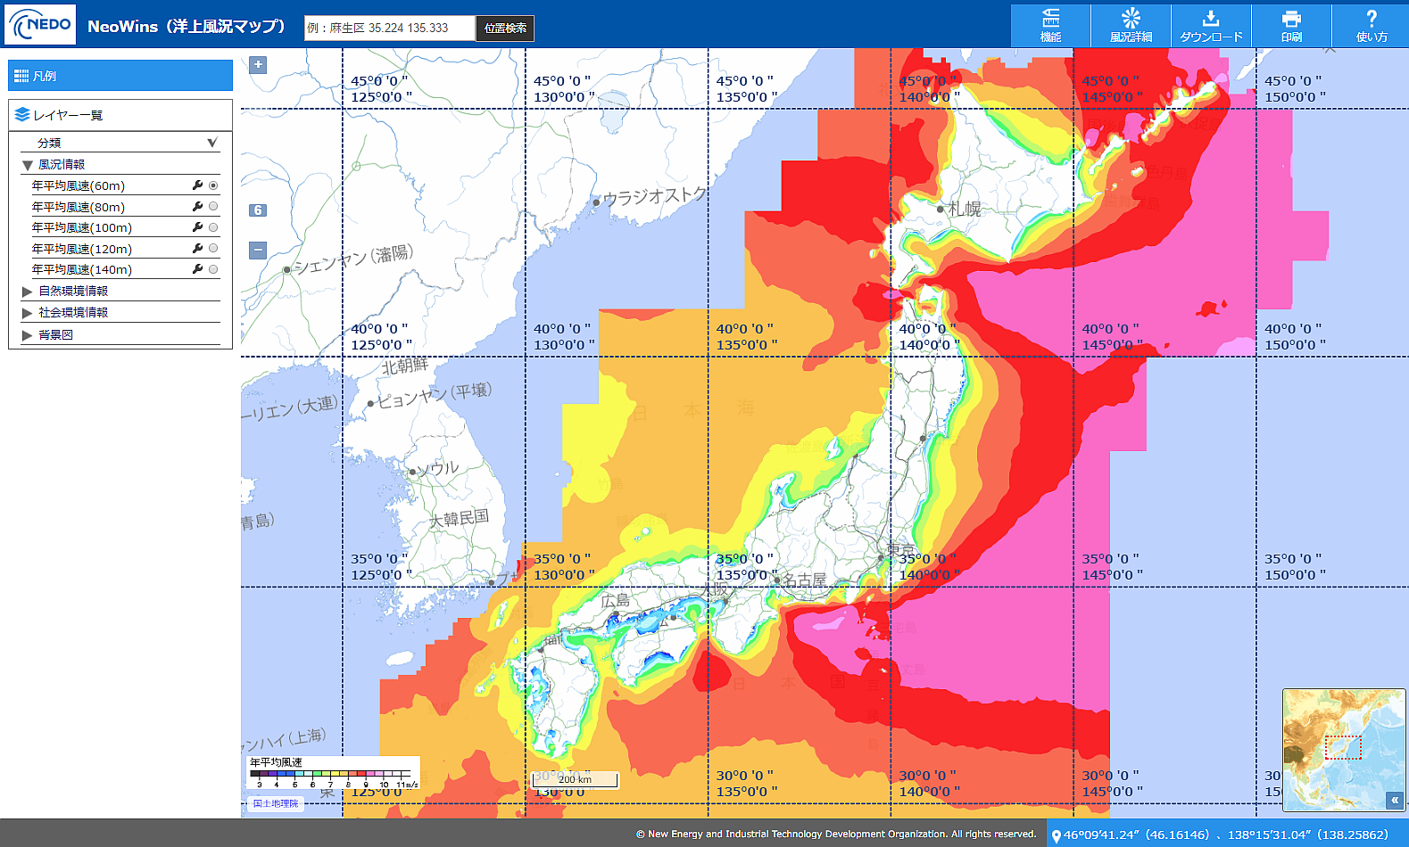
New offshore wind resource map in Japan
Published by the New Energy and Industrial Technology Development Organization (NEDO) on March 23rd, 2017.
NeoWins
http://app10.infoc.nedo.go.jp/Nedo_Webgis/top.html
/23

Slide 3
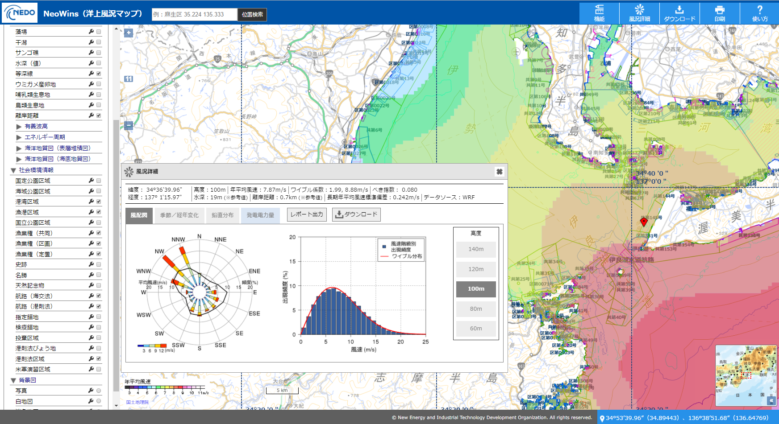
New offshore wind resource map in Japan
Integrating information on wind resources with that on social and natural environmental conditions
NeoWins
http://app10.infoc.nedo.go.jp/Nedo_Webgis/top.html
/23

Slide 4



Purpose of the study
This NEDO project was conducted by 4 pertners.
National Institute of Advanced Industrial science and technology
Kobe University
Asia Air Survey
Co., LTD.
Wind Energy Institute
of Tokyo, Inc.
Kobe University’s missions:
Design of wind simulation for NeoWins and variation of the simulated winds
In this presentation, we present
  Outline of the wind simulation in NeoWins
  Accuracy of the simulation based on validation at 41 offshore sites
/23

Slide 5
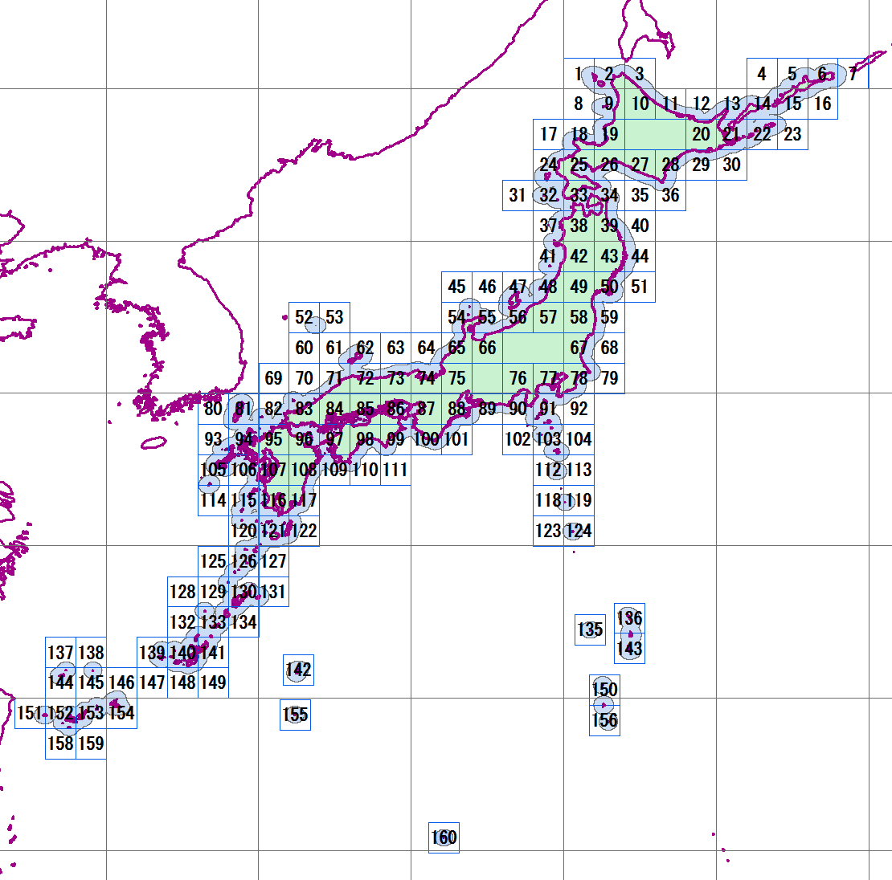
Outline of wind simulations for NeoWins
Mesoscale model WRF was used to obtain wind information for NeoWins.
Japanese waters within 30 km from the coast were divided into 160 areas.
WRF simulations with 2.5km and 500m domains were carried out for each area.
The simulations were conducted for three years (2009, 2012 and 2014).
It took about a half year to complete all the simulations using super computers with more than 4,000 CPU cores.
160 1º×1º areas
An example of WRF domains for an 1º×1º area
Domain 1
（100 x 100 2.5km-grids)
Domain 2
（216 x 251 500m-grids)
Kitakyushu
/23

Slide 6
Model configuration and input data
 | Model | Advanced Research WRF (ARW) ver 3.6.1
 | Period | 3 years (2009, 2012 and 2014)
 | Input data | Met: JMA Meso Analysis MANAL (3-hourly, 5 km×5 km)
 |  | Soil: NCEP Final Analysis FNL (6-houlry, 1º×1º)
 |  | SST: AIST-Kobe Univ. MOSST (daily, 0.02º×0.02º)
 | Terrain data | Elevation: METI-NASA ASTER-GDEM (30 m)
 |  | Land use: MLIT National Land Numerical Information (100 m)
 | Grids | Domain 1: 2.5 km×2.5 km (100×100 grids)
 |  | Domain 2: 0.5 km×0.5 km (adjusted to the size of a 1º×1º area)
 | Vertical | 40 levels (Surface to 100 hPa)
 | levels | Lowest half levels: 23m, 73m, 130m, 199m, 287m, ・・・
 | FDDA | Domain 1: Enabled (U, V, T, Q)
 |  | Domain 2: Enabled (U, V, T, Q), excluding the interior of PBL
 | Physics options | Shortwave process: Dudhia scheme
 |  | Longwave process: RRTM (Rapid Radiative Transfer Model) scheme
 |  | Cloud microphysics process: Ferrier (new Eta) scheme
 |  | PBL Process: Mellor-Yamada-Janjic (Eta operational) scheme
 |  | Surface layer process: Monin-Obukhov (Janjic Eta) scheme
 |  | Land-surface process: Noah land surface model scheme
 |  | Cumulus parameterization: None
/23

Slide 7
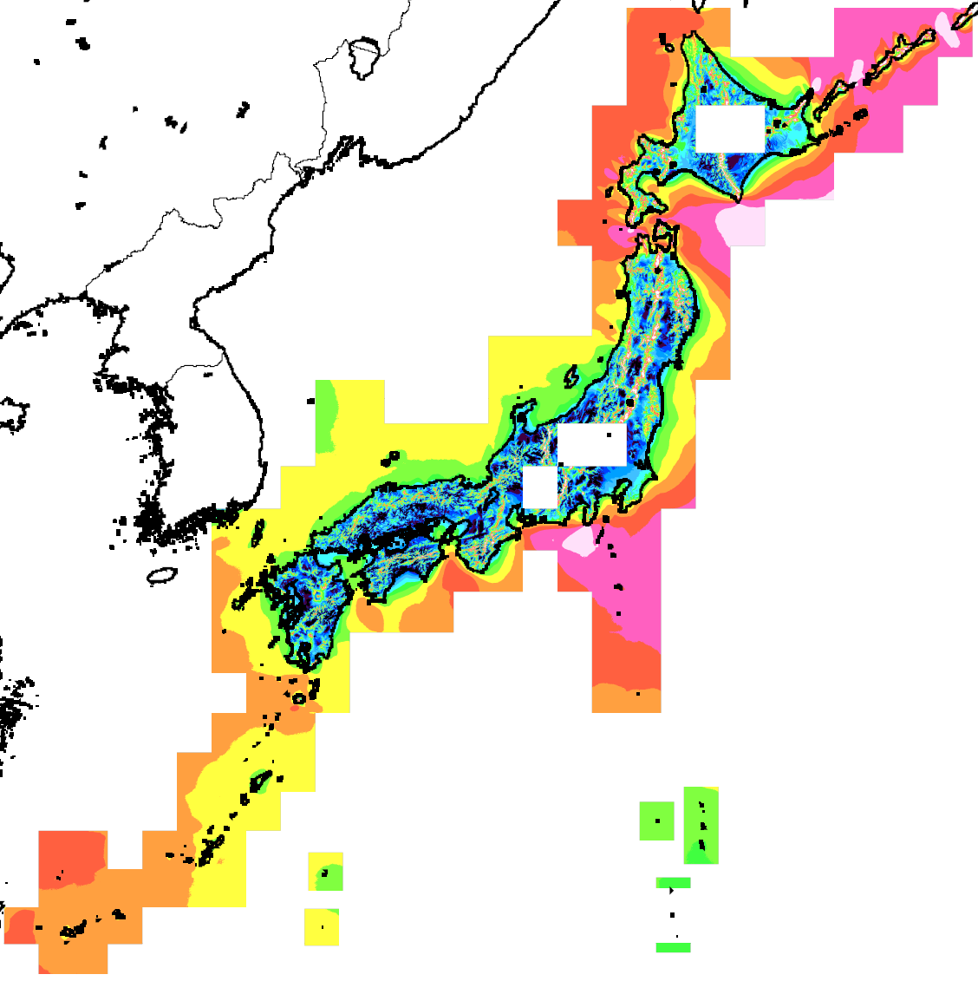
Annual mean wind speed from 160 domains
（made by WEIT）
/23

Slide 8
Method of validation
WRF-simulated winds are evaluated as follows.
Hourly values of WRFOUT (max. 8,760 data for a year)
Nearest grid value to an observation site
Vertical interpolation (liner(U)–logarithmic(log Z))
For 3 years (depending on data availability at an observation site)
This presentation is focusing on annual and monthly wind speeds.
/23

Slide 9
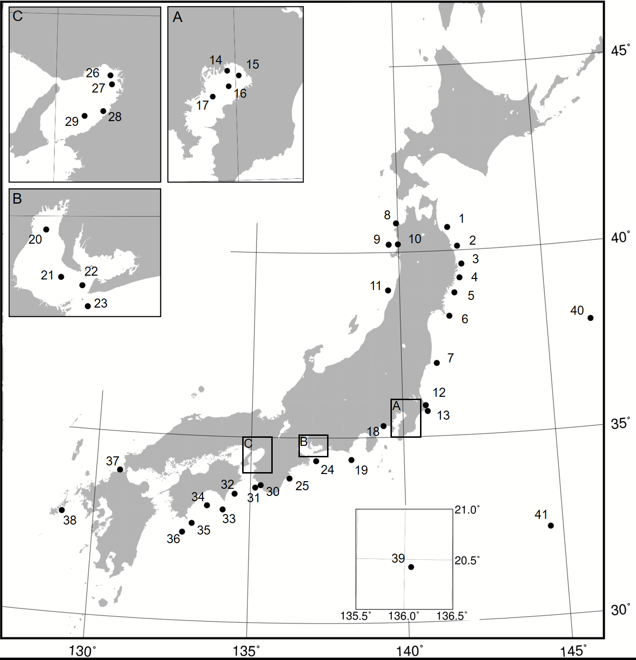
In-situ observation sites for validation
1. 青森東岸沖（GPS波浪計）
2. 岩手北部沖（GPS波浪計）
3. 岩手中部沖（GPS波浪計）
4. 岩手南部沖（GPS波浪計）
5. 宮城北部沖（GPS波浪計）
6. 宮城中部沖（GPS波浪計）
7. 福島県沖（GPS波浪計）
8. 青森西岸沖（GPS波浪計）
9. 秋田県沖（GPS波浪計）
10. 能代港風況観測タワー
11. 山形県沖（GPS波浪計）
12. 波崎桟橋ライダー/桟橋上風速計
13. 銚子沖洋上風況観測タワー
14. 浦安沖
15. 千葉港波浪観測塔
16. 千葉港口第一号灯標
17. 川崎人工島
18. 平塚沖総合実験タワー
19. 静岡御前崎沖（GPS波浪計）
20. 伊勢湾湾奥
21. 伊勢湾湾央
22. 中山水道(2号灯標)
23. 伊勢湾湾口
24. 伊勢湾口沖（GPS波浪計）
25. 三重尾鷲沖（GPS波浪計）
26. 淀川河口
27. 大阪湾波浪観測塔
28. 阪南沖窪地
29. 関空MT
30. 田辺中島高潮観測塔
31. 和歌山南西沖（GPS波浪計）
32. 徳島海陽沖（GPS波浪計）
33. 黒潮牧場10号ブイ(室戸沖)
34. 黒潮牧場12号ブイ(高知沖）
35. 高知西部沖（GPS波浪計）
36. 黒潮牧場13号ブイ(足摺沖）
37. 北九州沖洋上風況観測タワー
38. 椛島沖浮体式洋上タワー
沖の鳥島
JKEOブイ
41. KEOブイ
Red: Hub-height ( > 50m) measurements
Black: Lower-height (< 30m) measurements
In-situ measurements were collected from 41 offshore sites and used for validation.
/23

Slide 10
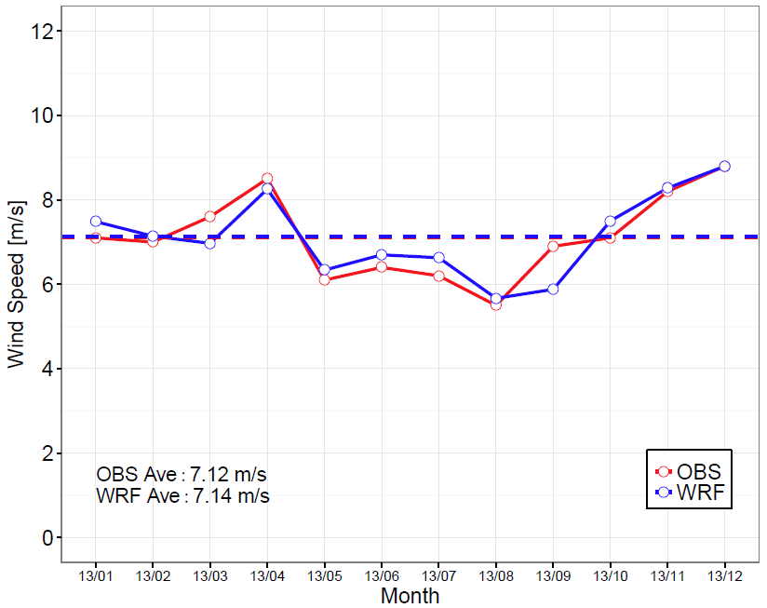
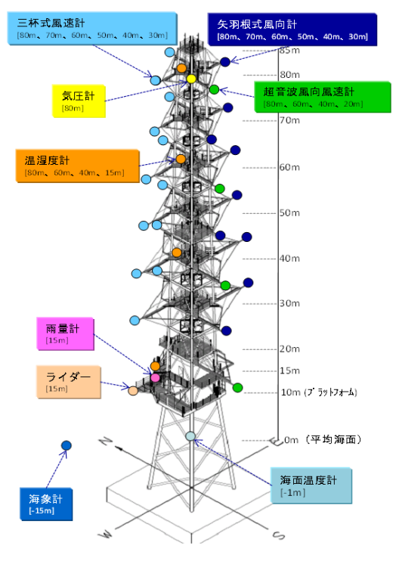
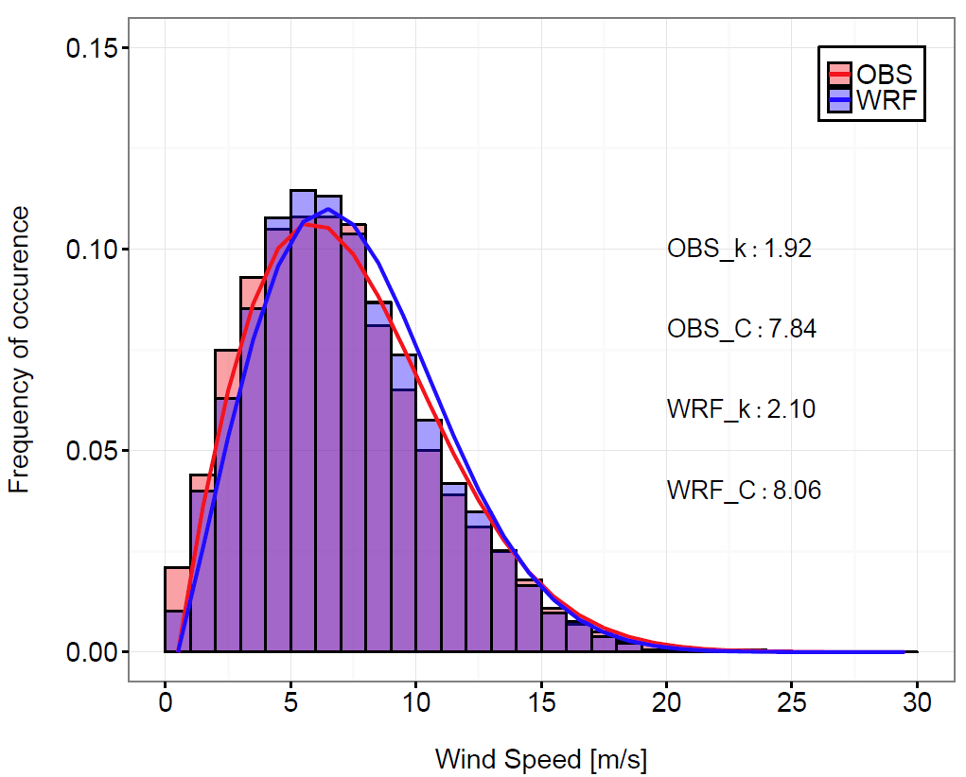
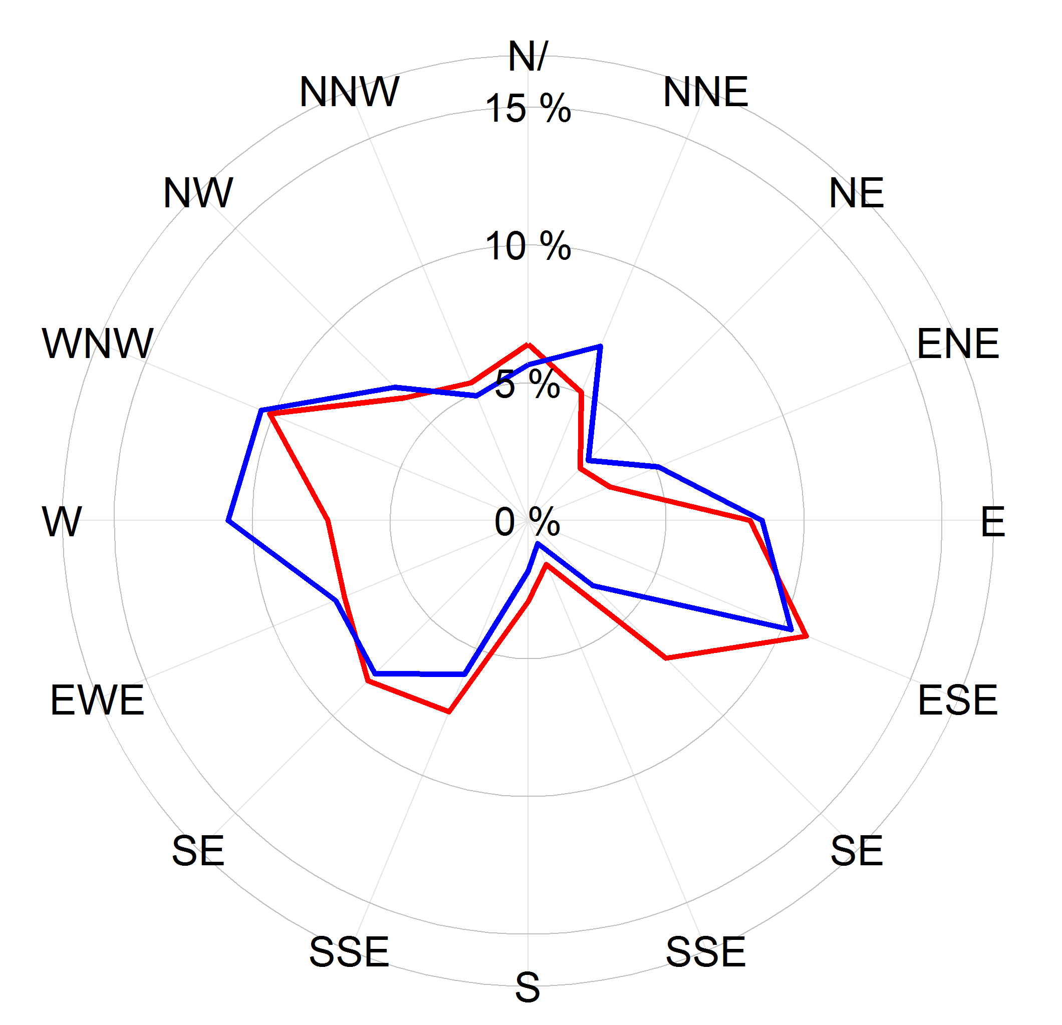
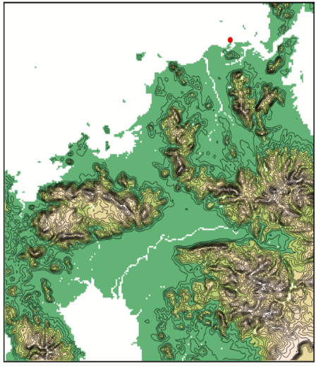
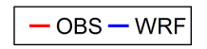
Validation at hub height - Kitakyushu -
NEDO met mast at Kitakyushu
Monthly mean @80m
Annual bias: +0.3%
Wind speed histogram @80m
Wind rose @80m
（from NEDO HP）
Area 95
Data source: Offshore wind measurement data published on NEDO website.
/23

Slide 11
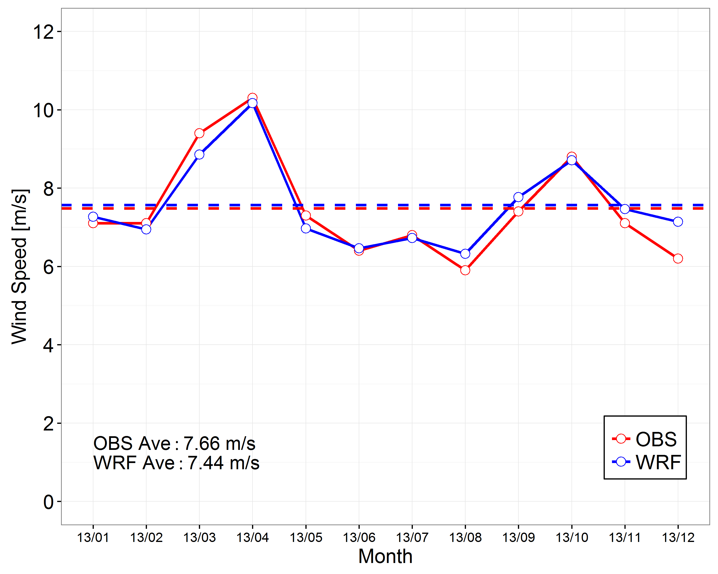
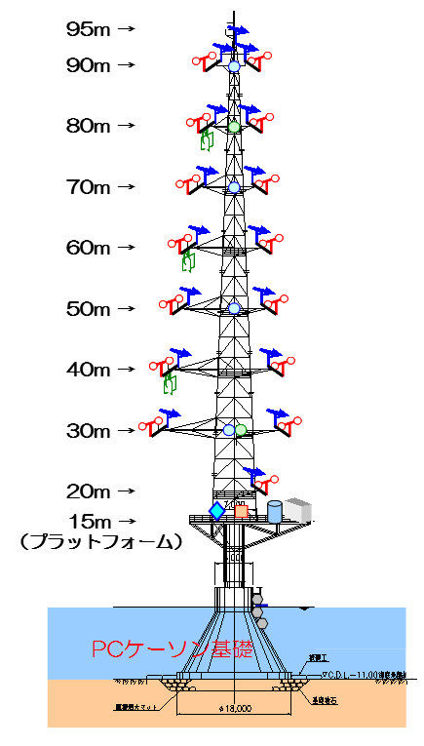
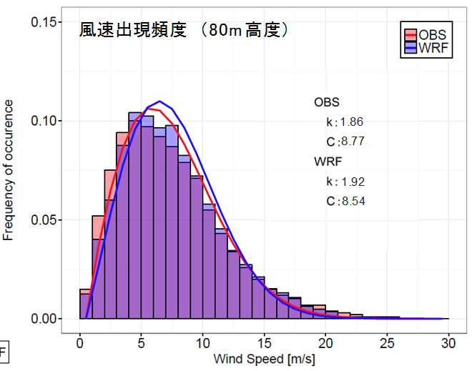
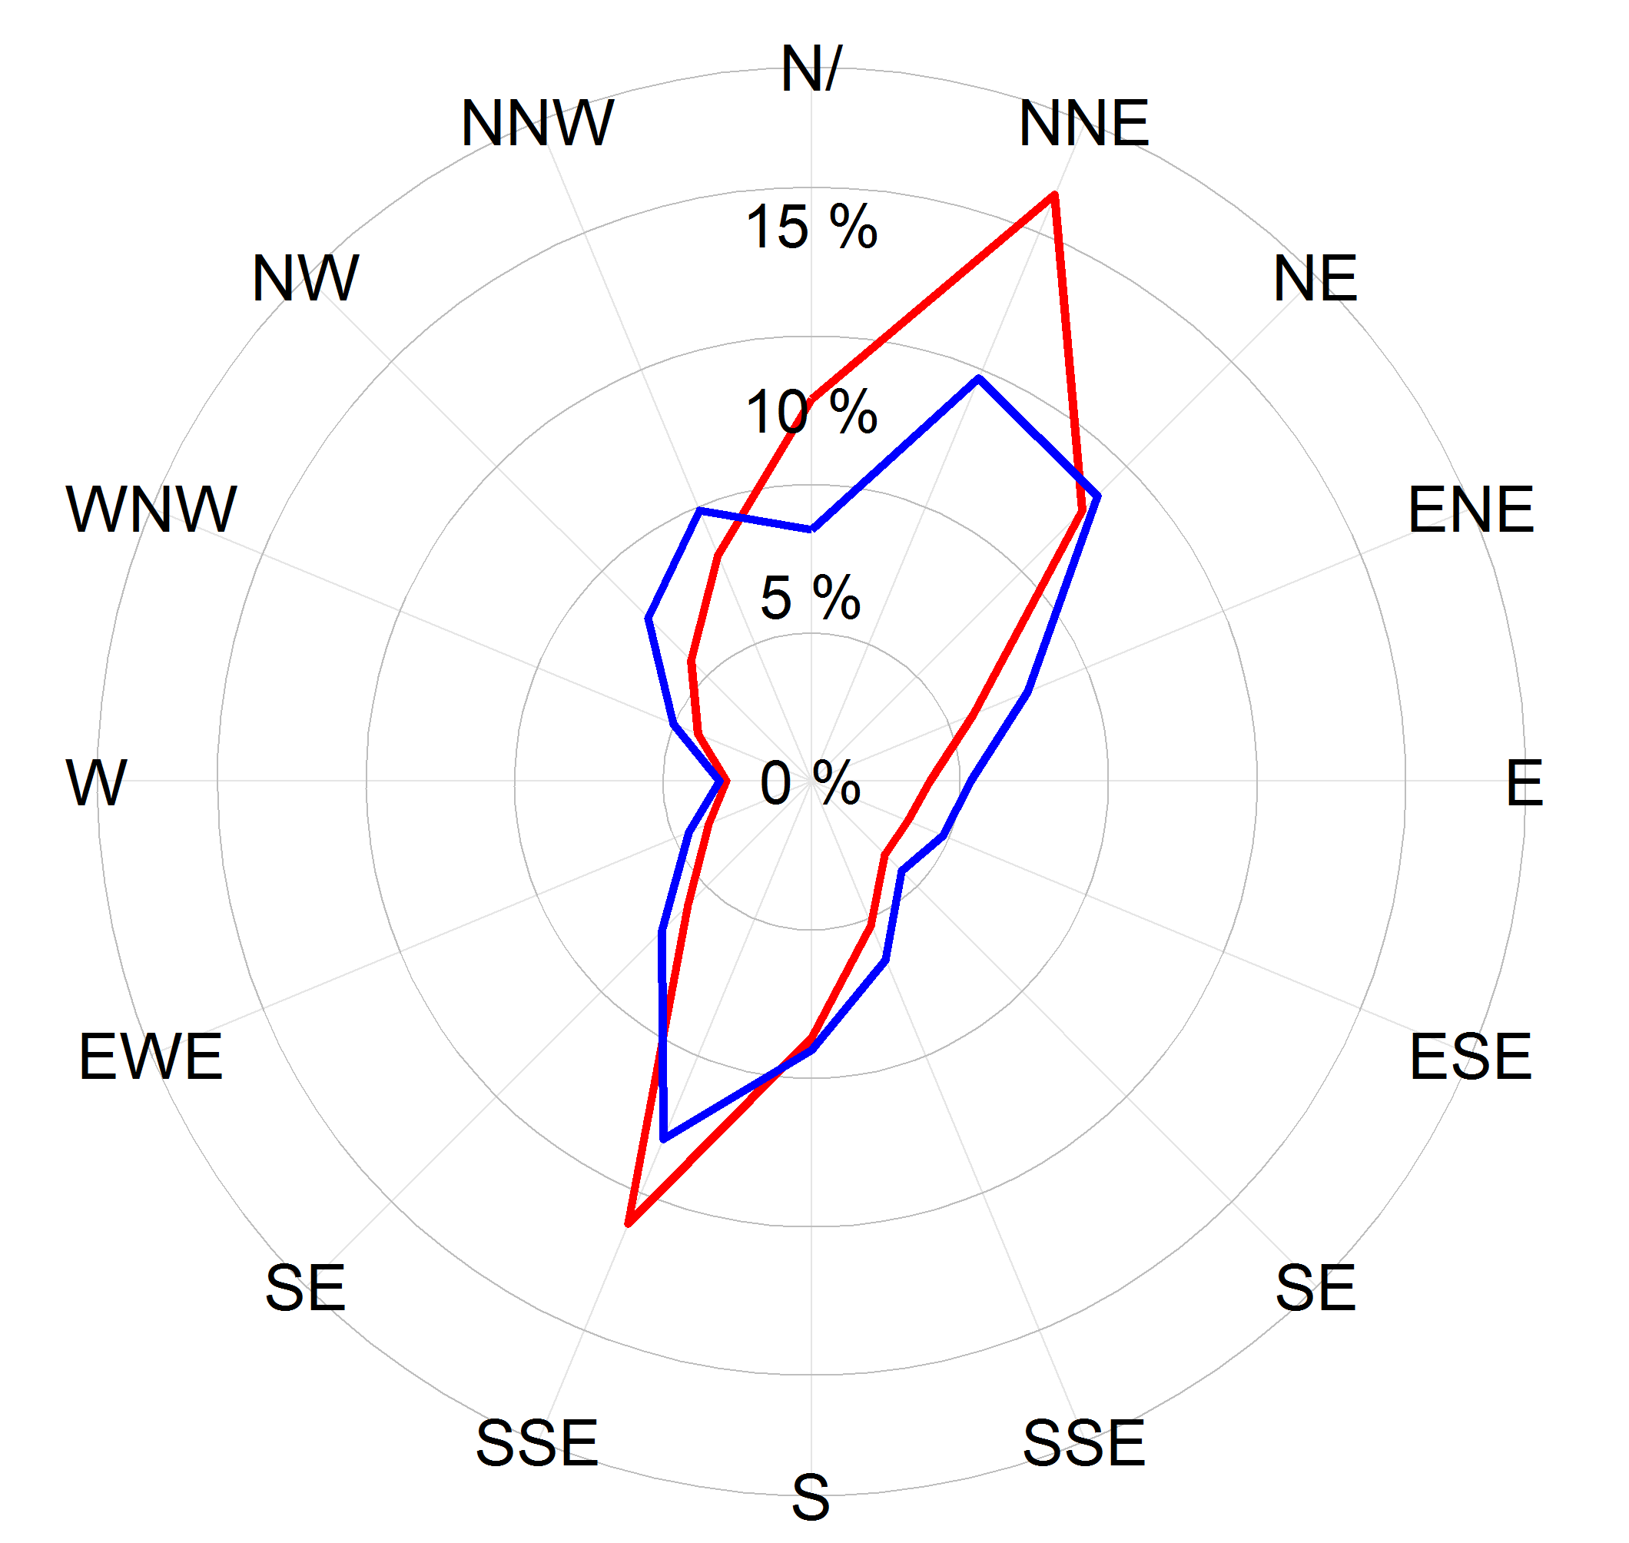
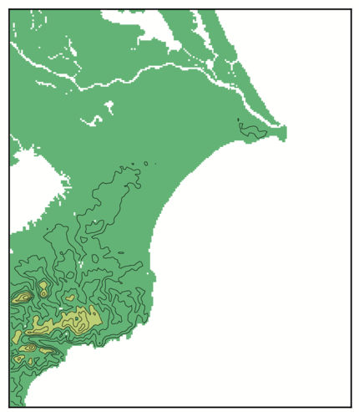
Validation at hub height - Choshi -
NEDO met mast at Choshi
Monthly mean @80m
Annual bias: +1.2%
Wind rose @80m
Wind speed histogram @80m
(from NEDO HP)
Area 78
Data source: Offshore wind measurement data published on NEDO website.
/23

Slide 12
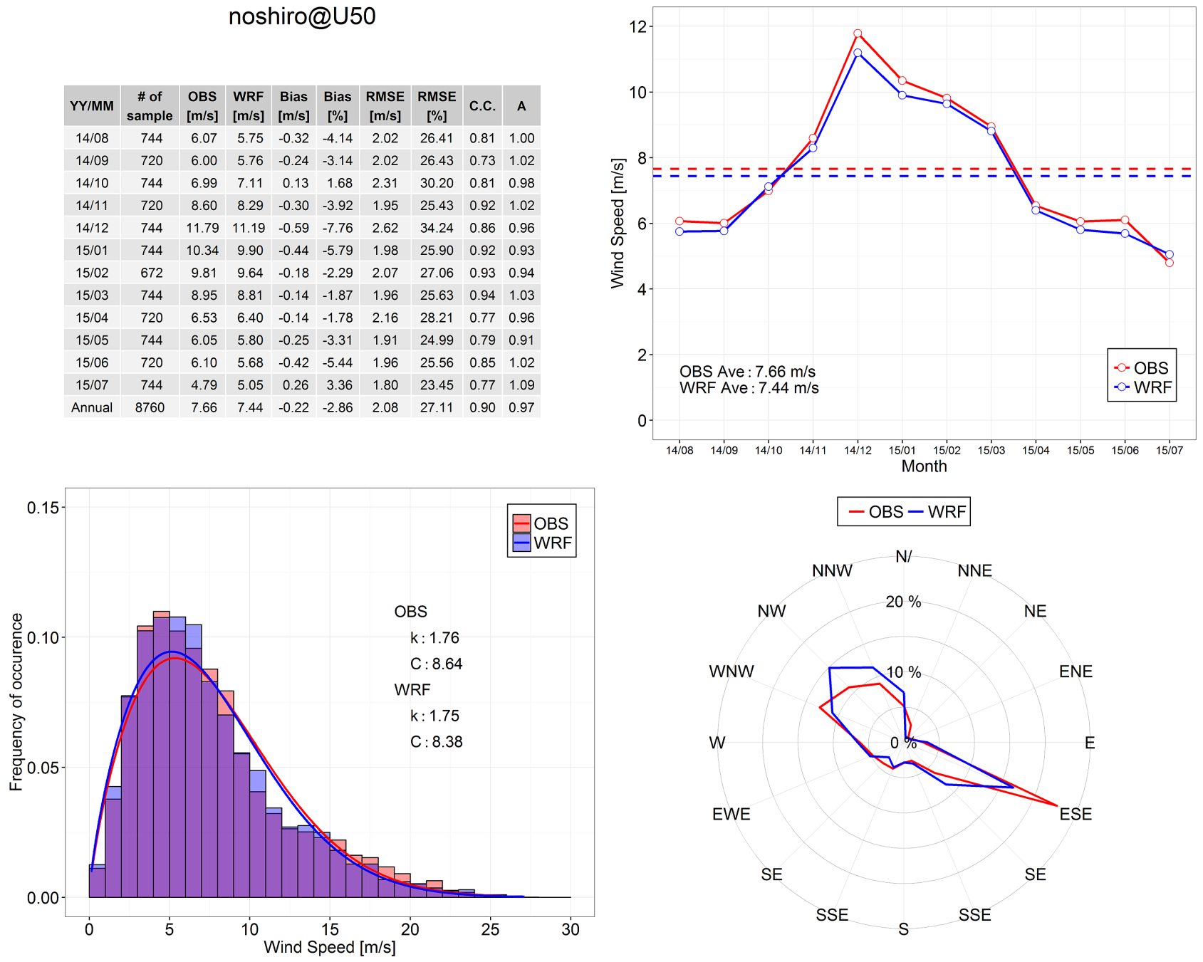
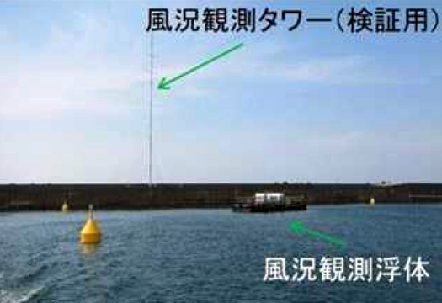
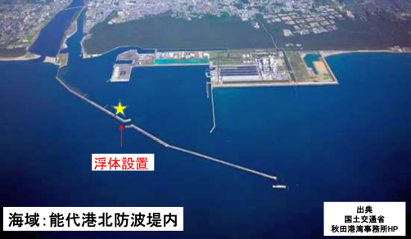
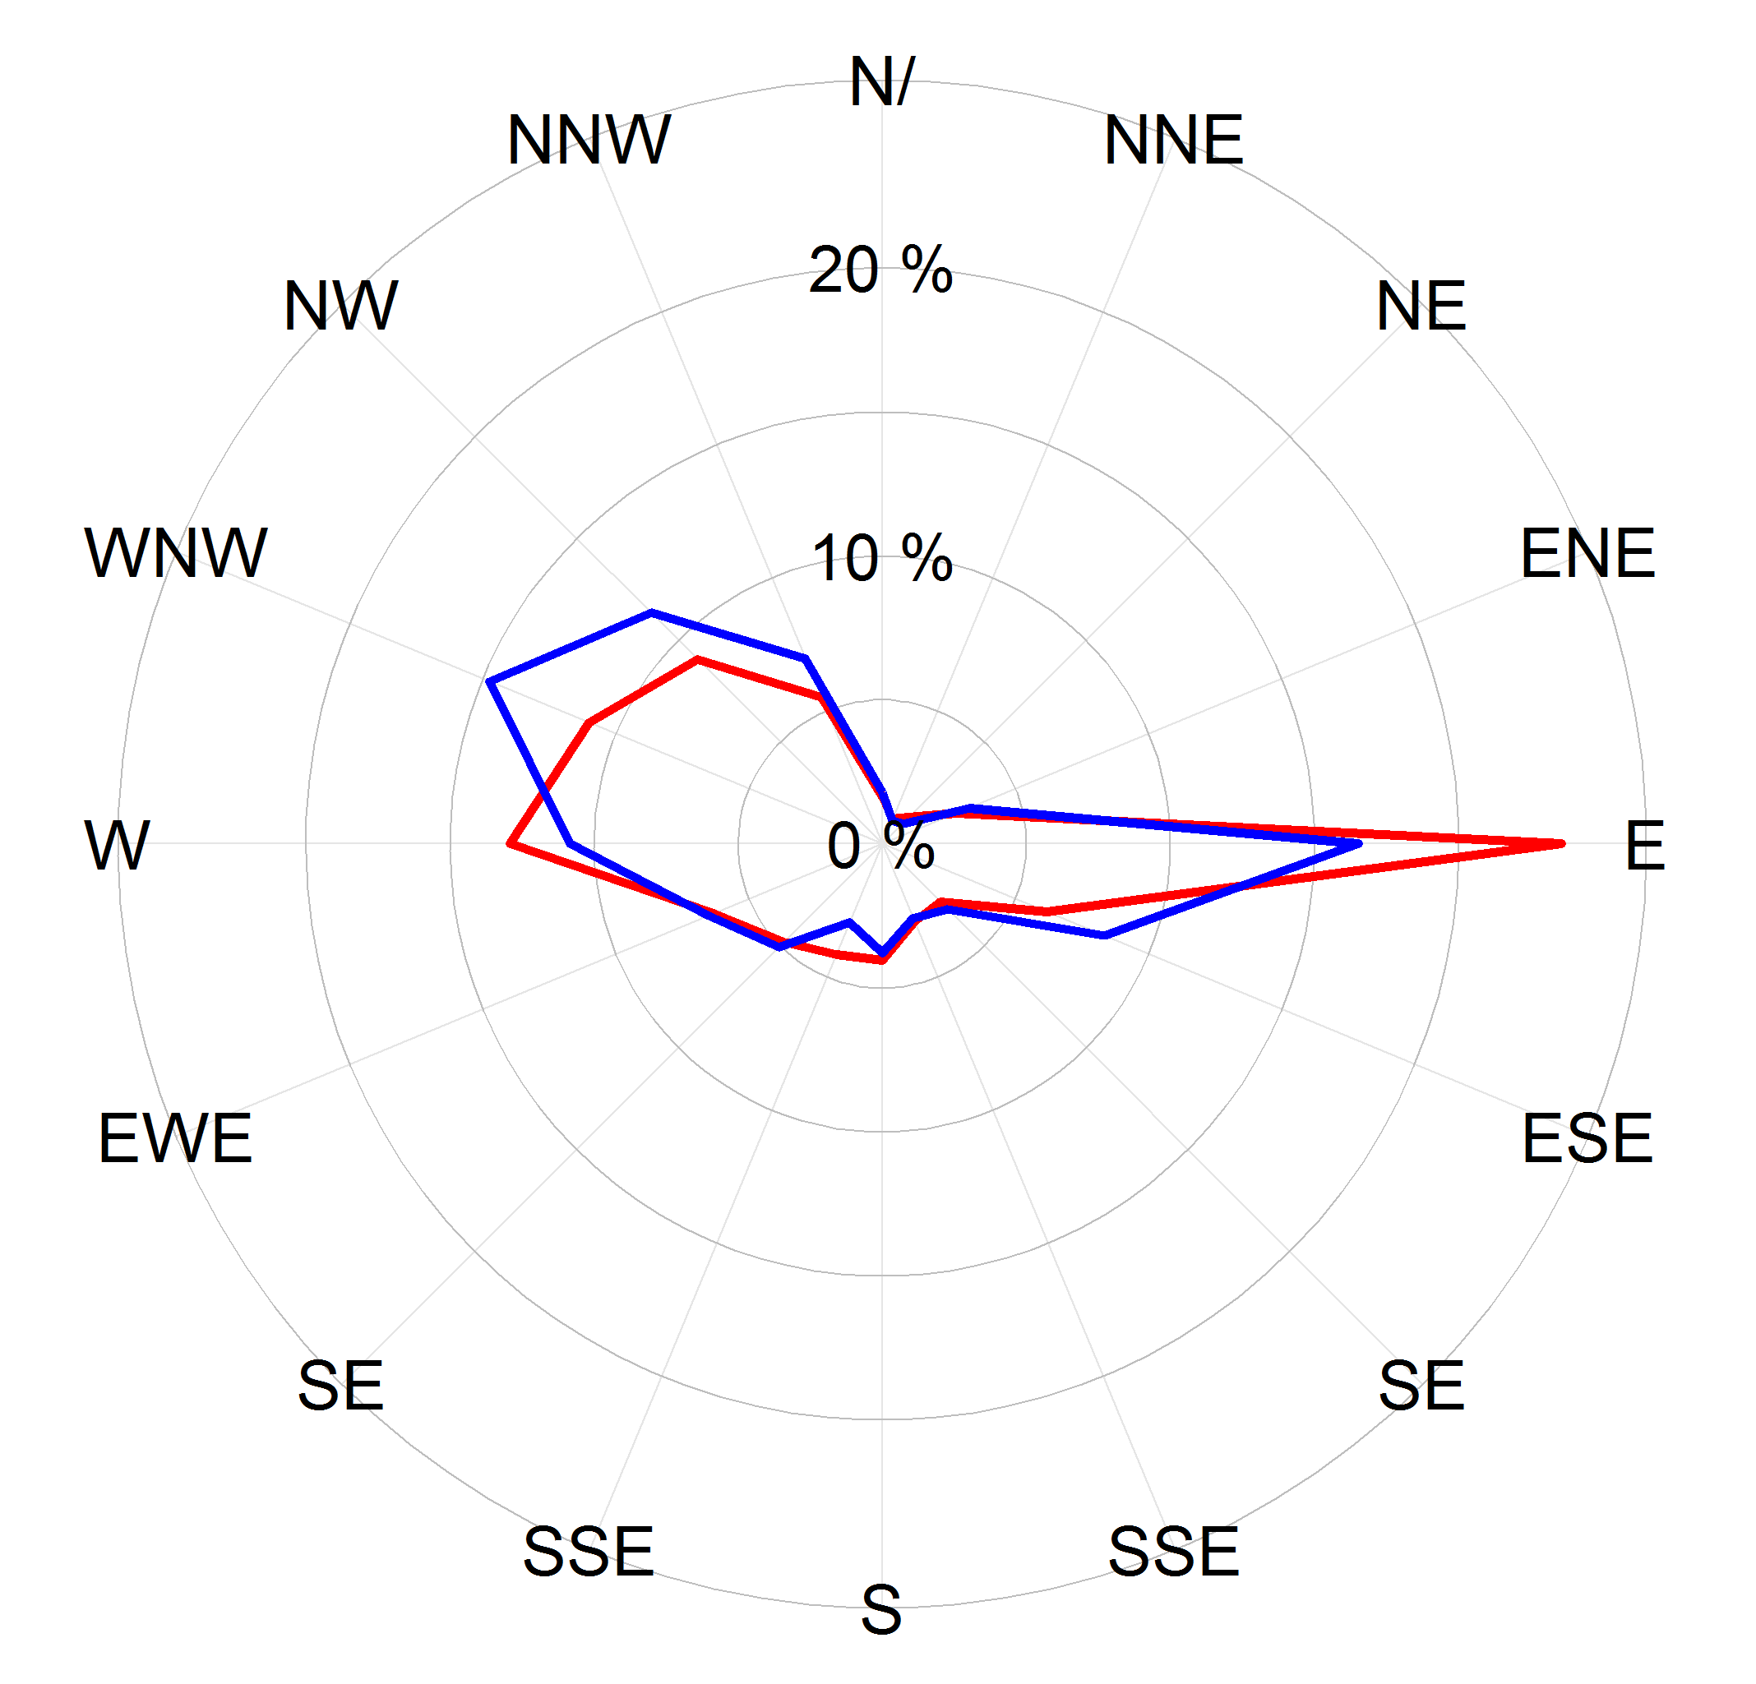
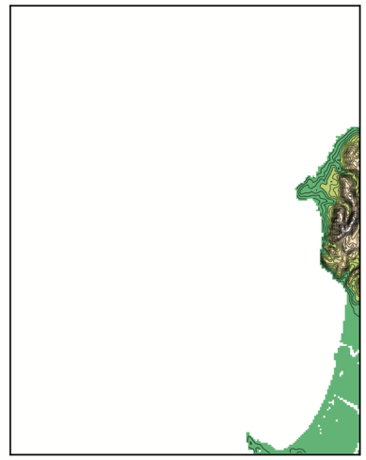
Validation at hub height - Noshiro -
Met mast at Noshiro
Monthly mean @50m
Annual bias：-2.9%
Wind speed histogram @50m
Wind rose @50m
(from proceedings of NEDO annual workshop 2015)
Area 38
Data source: Offshore wind measurement data in the NEDO project conducted by Obayashi Corporation and Omori Kensetsu KK.
/23

Slide 13
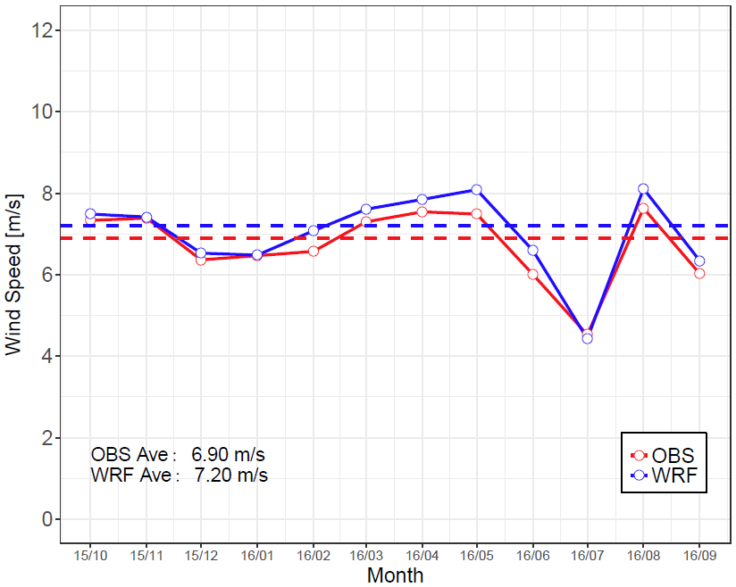
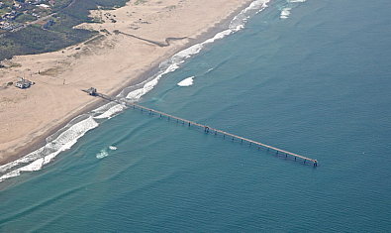
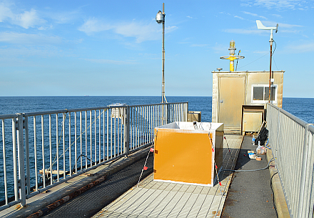
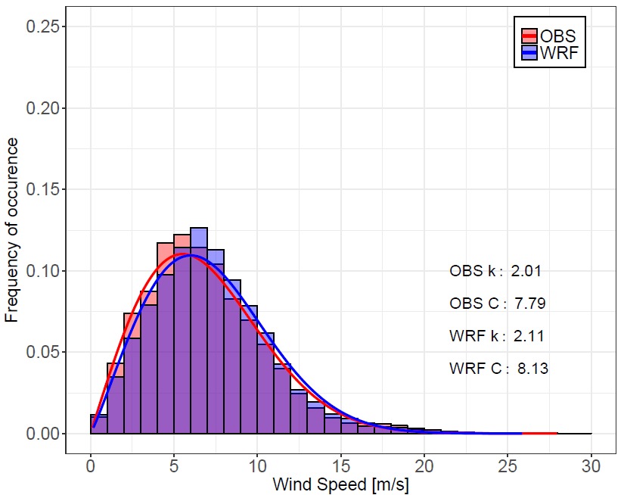
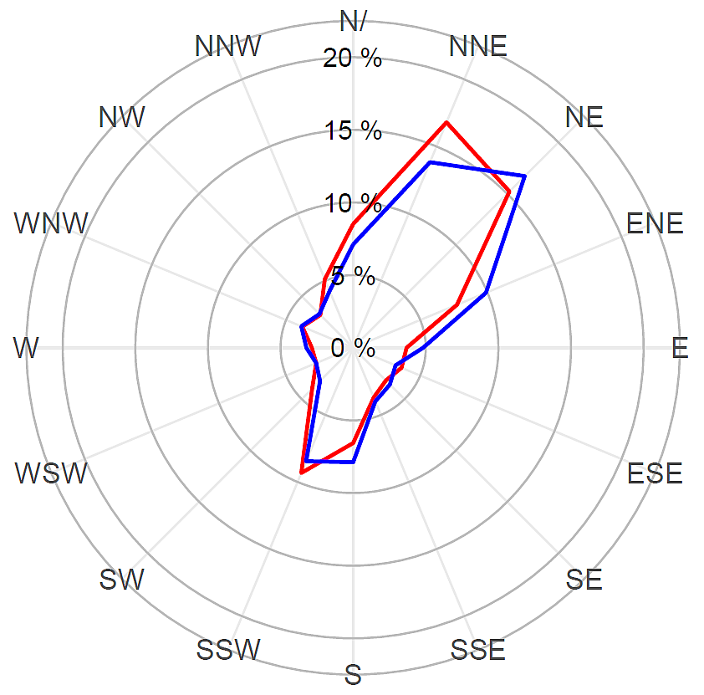
Validation at hub height - Hazaki -
LIDAR on pier of HORS
Monthly mean @87m
Hazaki Oceanographic Research Station (HORS)
Annual bias: +4.5%
Doppler LIDAR
Wind rose @87m
Wind speed histogram @87m
Area 78
Data source: LIDAR measurement conducted in the NEDO project regarding offshore wind resource map.
/23

Slide 14
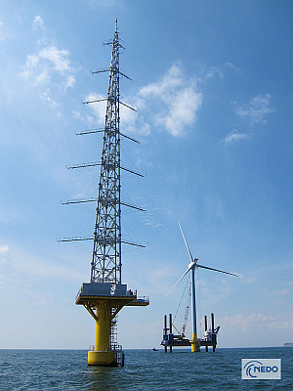
Annual bias at hub-height observation sites
Annual bias (estimation error in annual mean wind speed)
Ave 0.8%
±5%
2013
2013
Aug/2014 – Jul/2015
Oct/2015 – Sep/2016
Doppler LIDAR
(NEDO HP)
(NEDO HP)
(sited from proceedings of NEDO annual workshop 2015)
Annual biases are within ±5 %, which is the target accuracy of the project.
The average is 0.8 % and three sites indicate a positive bias. → slightly overestimation
/23

Slide 15
Monthly bias at hub-height observation sites
Monthly bias
RMS value of 12 monthly biases at each site
Ave 5.1 %
Monthly bias is about ±5 % on average, though the max and min exceed ±15%.
/23

Slide 16
Annual bias at lower-height observation sites
Annual bias at 31 lower-height (<30m) observation sites
(averaged for 1 to 3 years with available data at each site)
Ave.
+2.8%
Minimum：-4.7% and Maximum: +12.1%
26 sites of 31 indicate a positive bias. → Overestimation
Average for 31 sites is +2.8%. → cf. +0.8 % at hub-height observation sites
/23

Slide 17
Monthly bias at lower-height observation sites
RMS value of 12 monthly biases at each of 31 lower-height observation sites
(averaged for 1 to 3 years with available data at each site)
Ave.
10.2%
Minimum：5.6% and maximum: 20.5%
Average for 31 sites: 10.2% → cf. 5.1 % at hub-height observation sites
Indicating that the bias of WRF wind speed becomes smaller with height.
/23

Slide 18
Vertical variation of bias
Vertical profiles of annual mean wind speed
Vertical profile of annual bias
Decreasing
with height
WRF tends to output a weaker vertical shear than the measured profile.
The positive bias tends to decrease with height.
/23

Slide 19
Spatial variation of bias
Relation between annual mean wind speed and distance from coast
Relation between bias and distance from coast
Decreasing with distance
A bias of several % is found in nearshore waters within 30 km.
The overestimation gradually decreases with the distance from coast.
/23

Slide 20
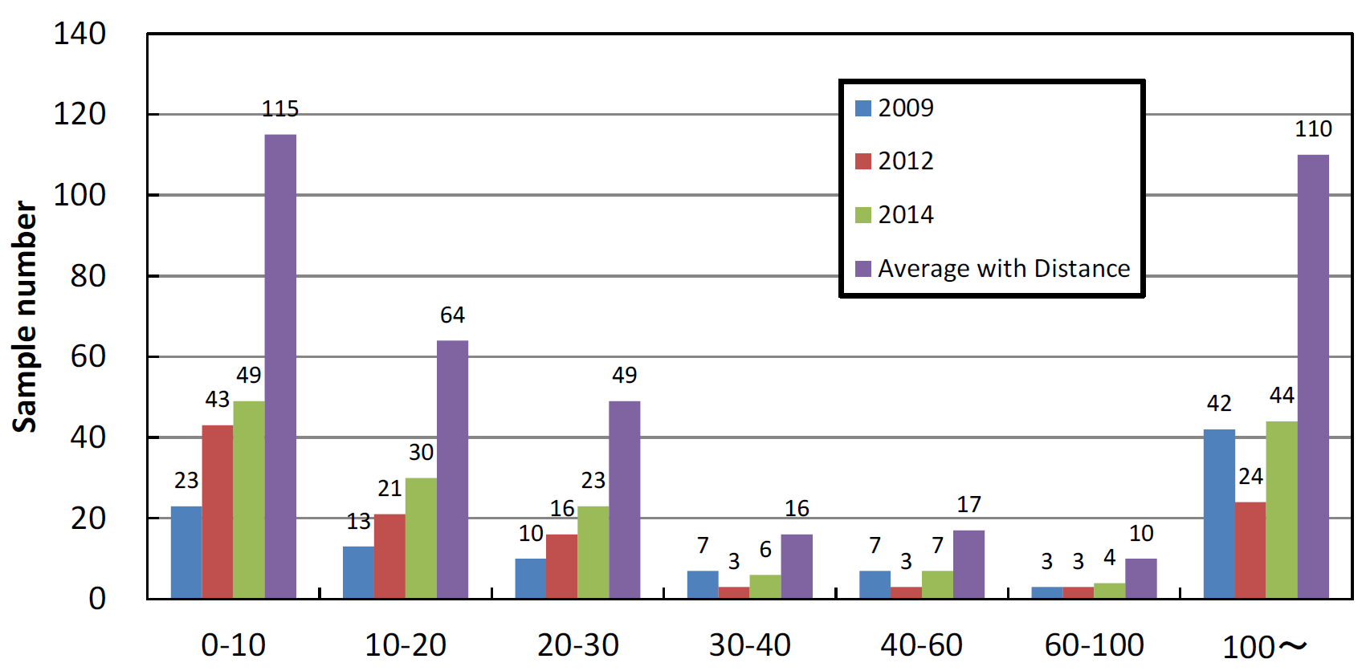
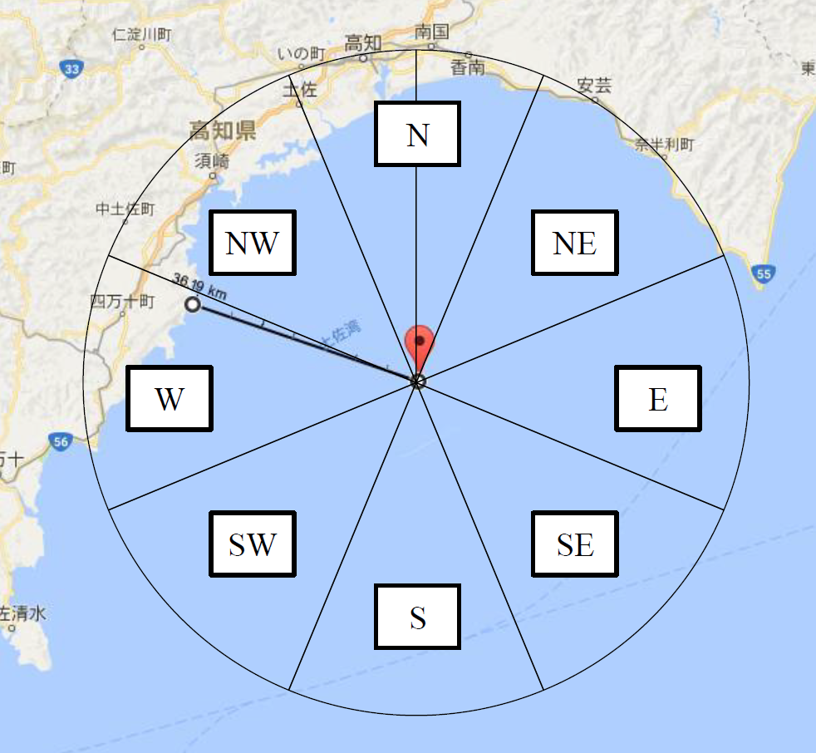

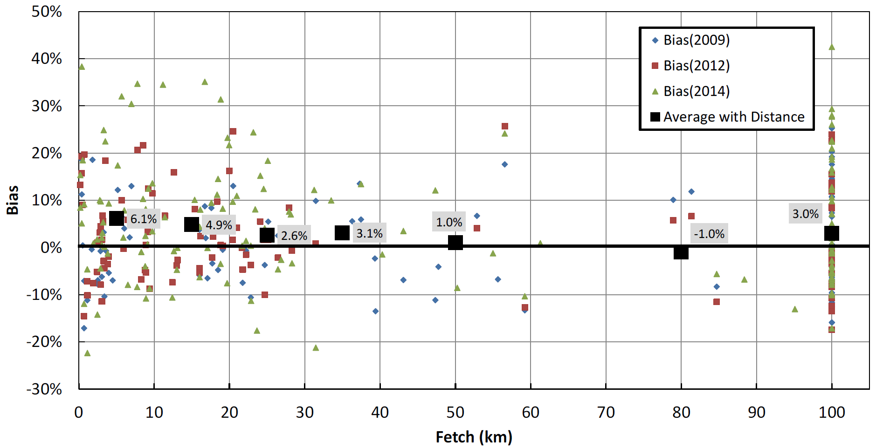
Relation between bias and fetch
Definition of fetch
Number of samples in each bin of fetch
Fetch vs. bias (all plots)
Wind direction is divided into 8.
The distance to the nearest coast is defined as fetch for the direction.
/23

Slide 21
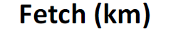
Relation between bias and fetch
Fetch-bin averaged bias
All data
Exc. <1m/s
Exc. <2m/s
Exc. <３m/s
Exc. <４m/s
Exc. <５m/s
Wind blowing over a shorter fetch (< 40 km) exhibits a positive bias.
This indicates that the positive bias found in nearshore waters is attributed to the winds blowing from land sectors.
/23

Slide 22
Conclusions
In this study, the accuracy of WRF simulations used for the Japanese offshore wind resource map NeoWins, using measurements from 41 offshore observation sites. Main results are summarized as follows.
WRF-simulated wind speed at a hub height has an annual bias within ±5 %, which is the target accuracy of the NEDO project.
At a lower height (<30m) WRF has a positive bias of +2.8 % on average in coastal waters, while it is +0.8 % at a hub height. This indicates that the positive bias decreases with height.
The large positive bias found in nearshore waters gradually decreases with the distance from coast, vanishing at around 30 km.
The positive bias is primarily caused by winds blowing from land, though physical factors of this overestimation are still unknown. Further investigation is necessary to find them to solve this problem.
/23

Slide 23
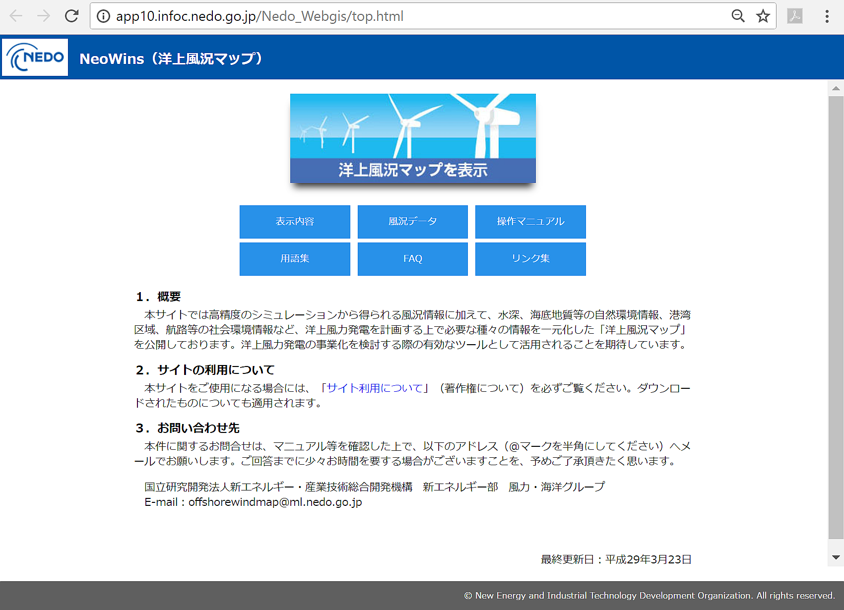
Acknowledgement
This work has been conducted under the NEDO project P07015 “Offshore Wind Condition Observation System Proving Research (Offshore Wind Map)”.
Please visit here!
http://app10.infoc.nedo.go.jp/Nedo_Webgis/
/23

