Slide 1
Global Wind Atlas
Global overview with the details
Presented by Jake Badger
Head of Section, Wind Resource Assessment Modelling
Department of Wind Energy
Technical University of Denmark
DTU Wind Energy
A lecture given as part of the course on:
Building Weather and Climate Services for the Energy Sector
18-20 May, Shanghai, China

Slide 2
Outline
Introduction to DTU Wind Energy
Background and context of the Global Wind Atlas
The Team
The Methodology
The Service: overview
The Service: demonstration
Future developments

Slide 3
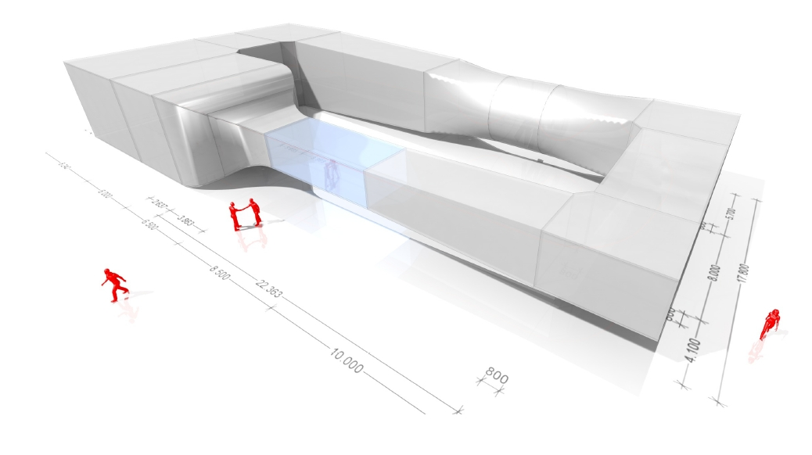
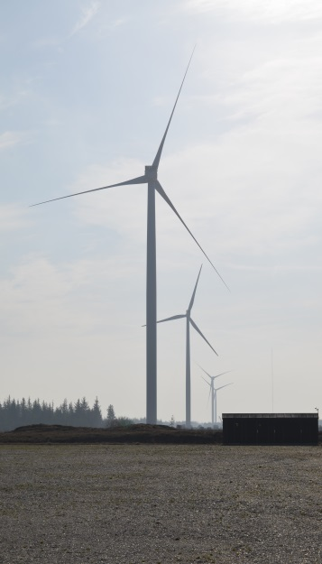
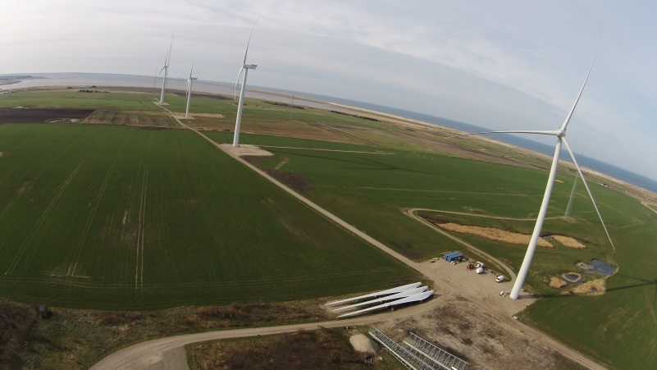
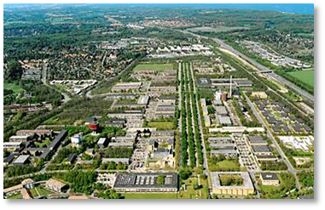
Østerild Test Centre 2014
Introduction to DTU Wind Energy
DTU Risø Campus
DTU Lyngby
Høvsøre Test Station 2003

Slide 4
DTU Wind Energy
Test and Measurements
Aerodynamic Design
Fluid Mechanics
Material Science & Characterization
Composites & Materials Mechanics
Resource Assessment Modelling
Meteorology and Remote Sensing
Integration and Planning
Loads and Control
Structures and Component Design
Introduction to DTU Wind Energy
Siting and integration
Offshore wind energy
Wind turbine technology
Education and teaching
Research based consultancy and tests

Slide 5
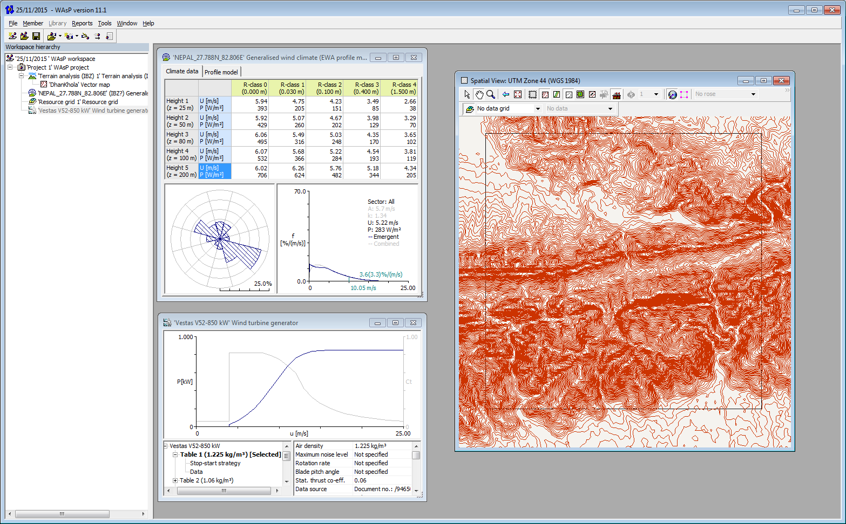
DTU Resource Assessment software: WAsP
Generalized Wind Climate from NWA
High resolution map
WAsP includes option for CFD calculation of flow corrections
Turbine power curve
5

Slide 6
DTU Resource Assessment Software on the world map
Methodology global impact
National wind atlases … ■
Regional and local studies … ■
WAsP course venues … ■
Certified users … ■
30 years of development
o More than 5000 users
o More than 250 certified WAsP users

Slide 7
Background and context of the Global Wind Atlas
23 participating CEM governments account for 80 percent of global greenhouse gas emissions
Lead countries are Denmark, Germany and Spain.+ 11 countries and EC
Global Wind Atlas by DTU Wind Energy
Funded by
Energy Technology development and Demonstration (EUDP)
Coordinated by
International Renewable Energy Agency (IRENA)
Global Wind Atlas
GWA 1.0
2015

Slide 8
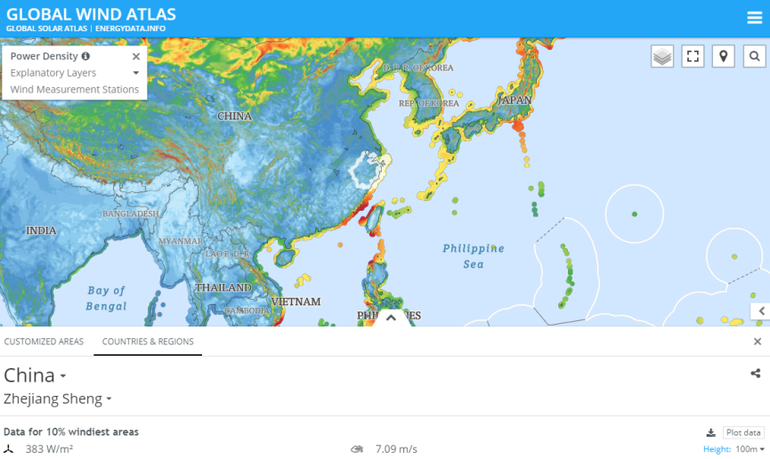
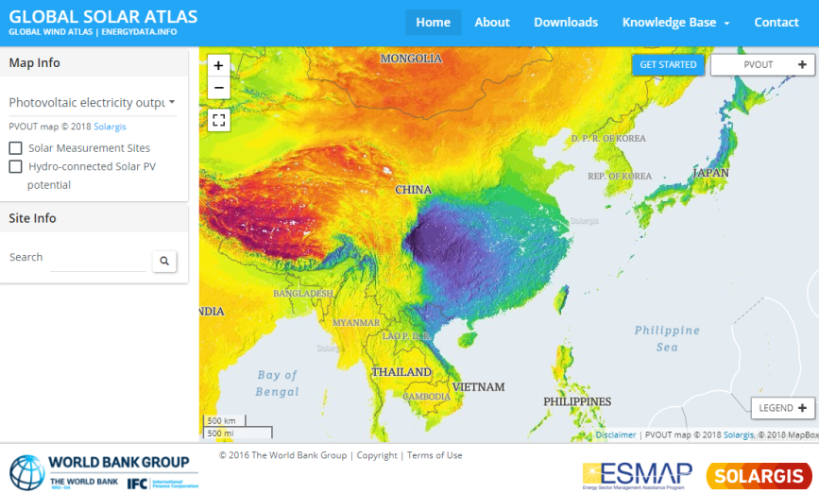
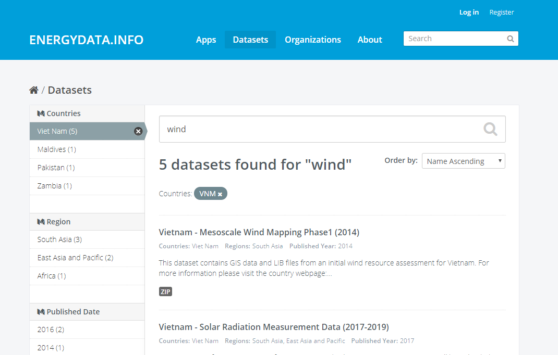
Background and context of the Global Wind Atlas
Next step of Global Wind Atlas (GWA 2.0) 2017
www.globalwindatlas.info
www.globalsolaratlas.info
www.energydata.info

Slide 9
The Team
DTU Wind Energy
J Badger, B Hansen, N Davis, B Olsen, A Hahmann, N Mortensen, J Hansen
Nazka Mapps
I Bauwens, I Dautashvil, D Codrescu, A Vaidya
World in a Box
and colleagues
D Heathfield, M Onninen

Slide 10
The Team
Vortex
O Lacave, P Casso, G Lizcano, A Bosch
World Bank
O Knight, T P Nguyen, S Krohn

Slide 11
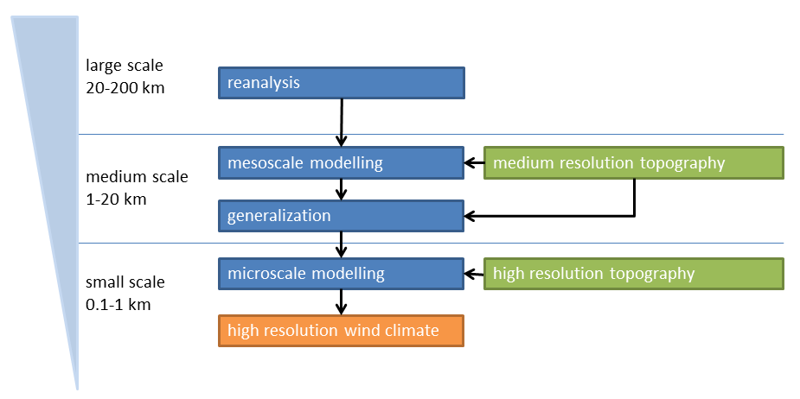
Global Wind Atlas model chain

Slide 12
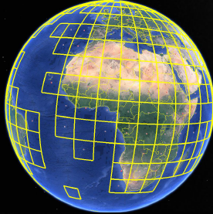
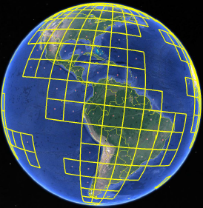
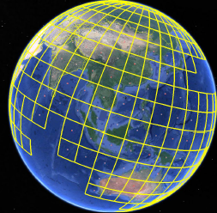
Mesoscale modelling
310 WRF mesoscale modelling tiles
Each is 9 x 9 degrees (+buffer)
Resolution is 9km
ERA-Interim reanalysis provides the boundary conditions
Sampled from period 1997-2016

Slide 13
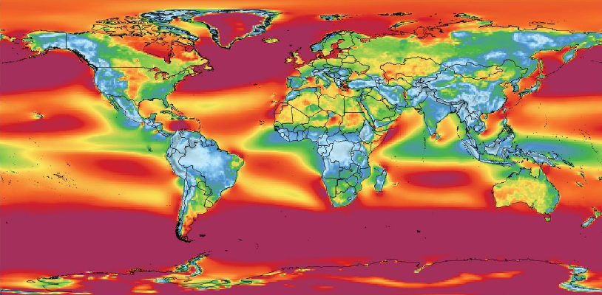
ERA-Interim reanalysis at ~70 km resolution
Resolution not high enough
Reanalysis ECMWF ERA-Interim 1997-2016 average wind speed at 100 m a.s.l.

Slide 14
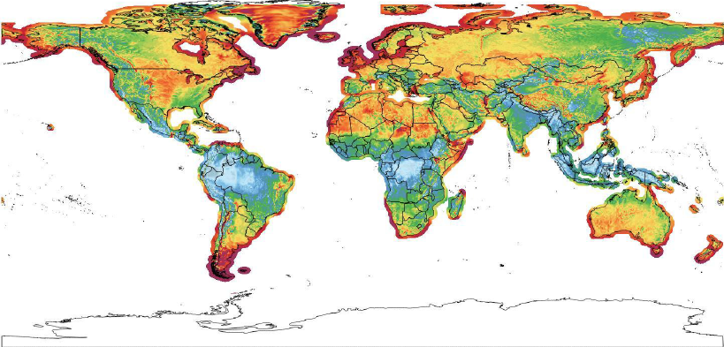
Mesoscale downscaling at 9 km resolution
Resolution not high enough
Vortex WRF Downscaling driven by ERA-Interim 1997-2016 average wind speed at 100 m a.s.l.

Slide 15
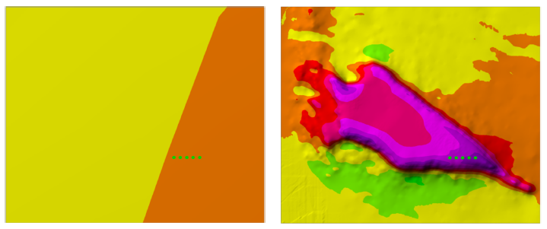
The need for downscaling
Mesoscale modelling
Microscale modelling

Slide 16
The need for downscaling

Slide 17
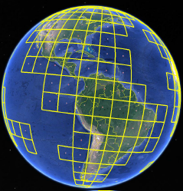
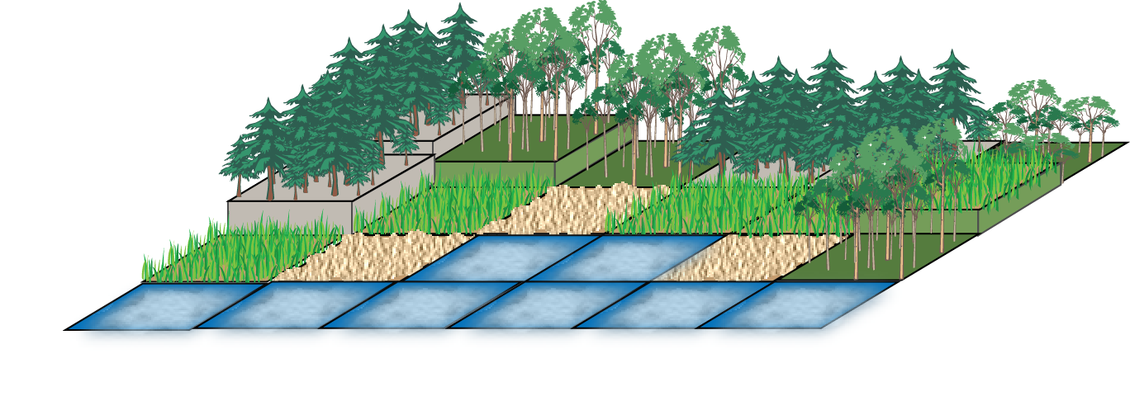
Global Wind Atlas model chain Generalization
Each mesoscale model grid point climate is generalized
The purpose of generalization
to express wind climate in a standardized way
to remove the impacts of the mesoscale topography on the local winds
To prepare input for microscale modelling
Result: wind climate for flat terrain with uniform roughness

Slide 18
Global Wind Atlas model chain Generalization
Before
Mesoscale modelling performed on overlaping domains on native modelling grids
Generalized wind climate regridded to regular longitude latutide grid
Slight difference in wind climate at mesoscale boundaries
Interpolation performed between domains
After

Slide 19
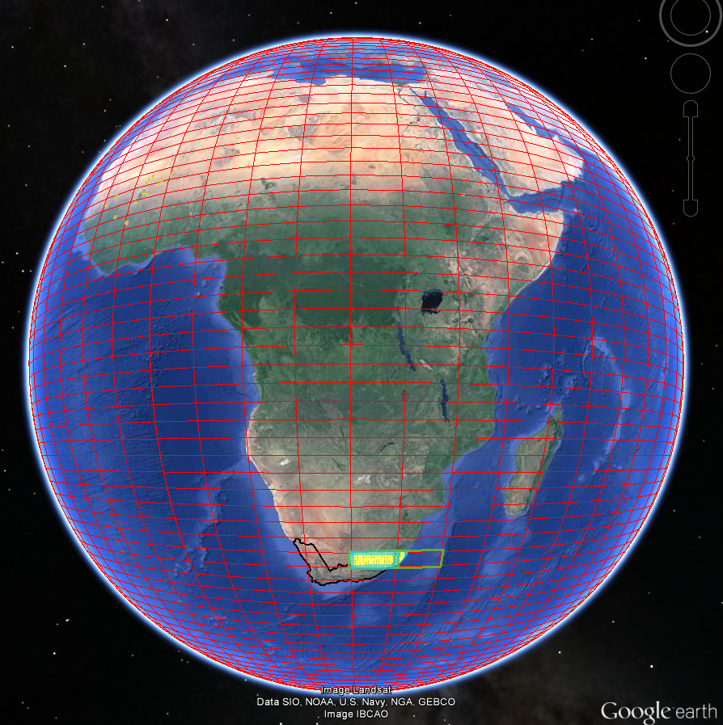
Global Wind Atlas model chain microscale modelling
2439 jobs required to cover land and 30 km offshore
Calculation system runs WAsP-like microscale modelling over vast areas using many computer nodes.
It manages and despatches inputs
Generalized reanalysis winds
High resolution elevation and surface roughness data
First pass, sample spacing is 1 km
Second pass, sample spacing 250 m

Slide 20
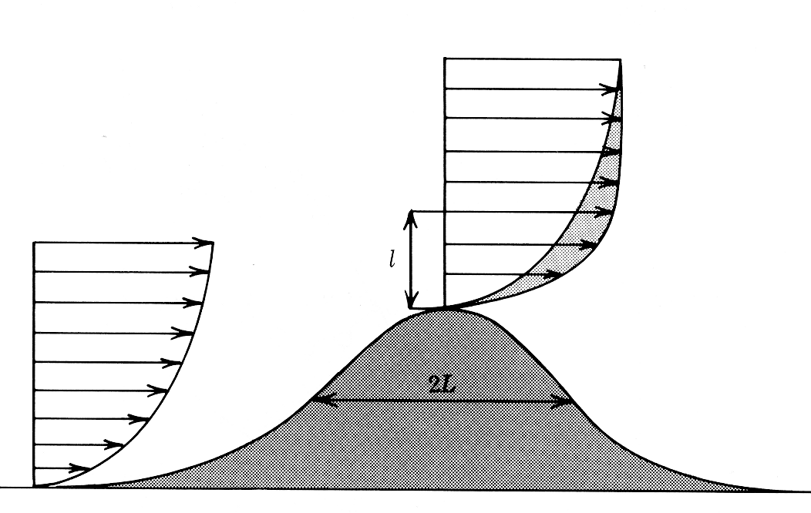
Microscale Orographic speed-up
Handled by WAsP modelling
Winds speed up on hills
Winds slow down in valleys
Modification of the wind profile

Slide 21
Microscale Surface roughness length
Handled by WAsP modelling

Slide 22
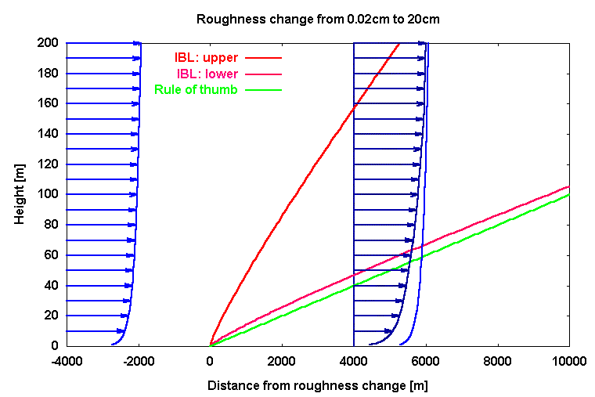
Microscale Surface roughness length
Handled by WAsP modelling
Unchanged profile
Transition profile
Rule of thumb: 1:100
New log-profile

Slide 23
Datasets terrain: elevation and roughness
Elevation
Viewfinder, compiles SRTM and other datasets resolution 90 - 30 m, remapped on 150 m grid
Land cover
ESA GlobCover resolution 300 m
Modis, land cover classification resolution 500 m, for gap filling.

Slide 24
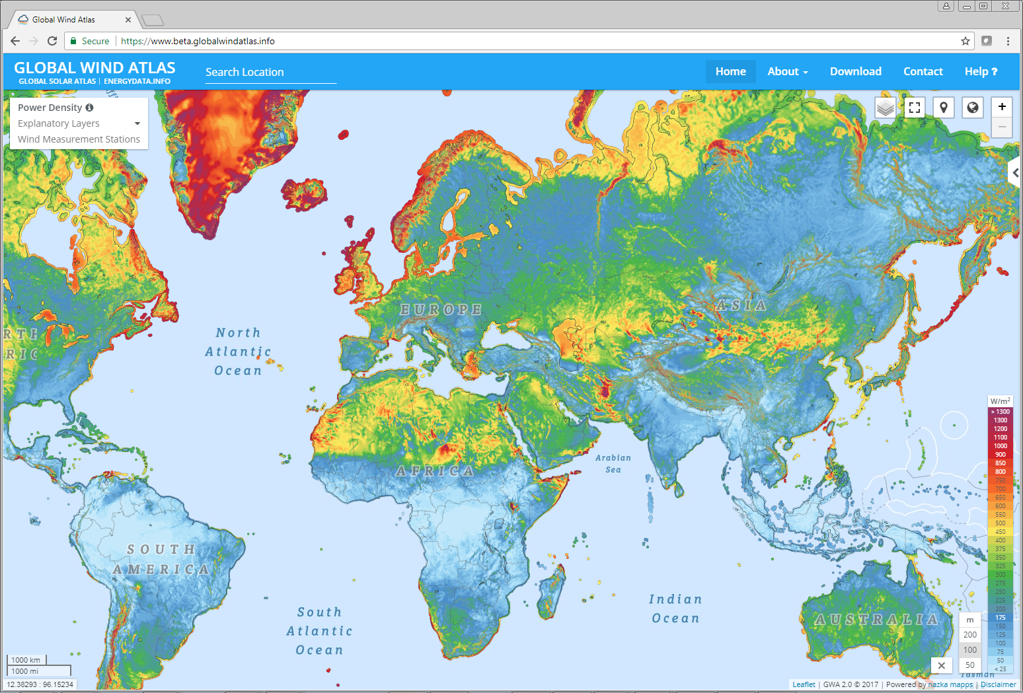
A tour of the website
The website has been completely reinvented
More user friendly
More intuitive and interactive
Search and navigation functions
Simplified
Fewer and most relevant layers remain
Many of the same analysis tools remain
Download possibilities
Documentation

Slide 25
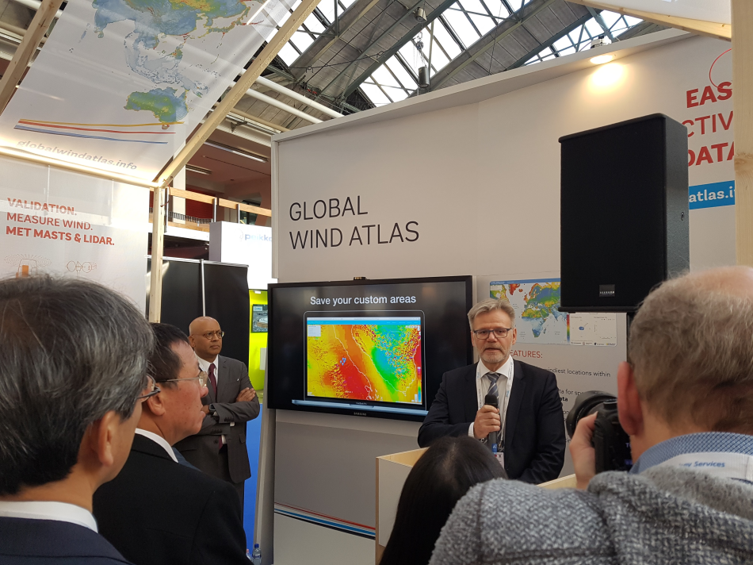
Launch of Global Wind Atlas 2.0 at WindEurope
High Profile
Ranjit Lamech, Director at World Bank’s Energy & Extractives
Jens-Otto Horslund, Ambassador of Denmark to the Netherlands
Laurent Humbert, Engineering Manager at EREN Groupe
globalwindatlas.info

Slide 26
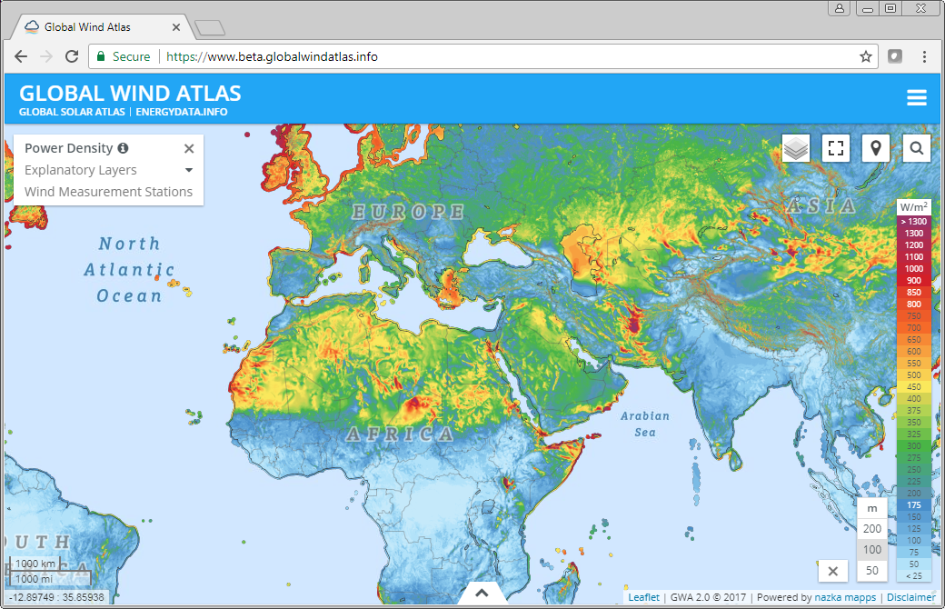

Slide 27
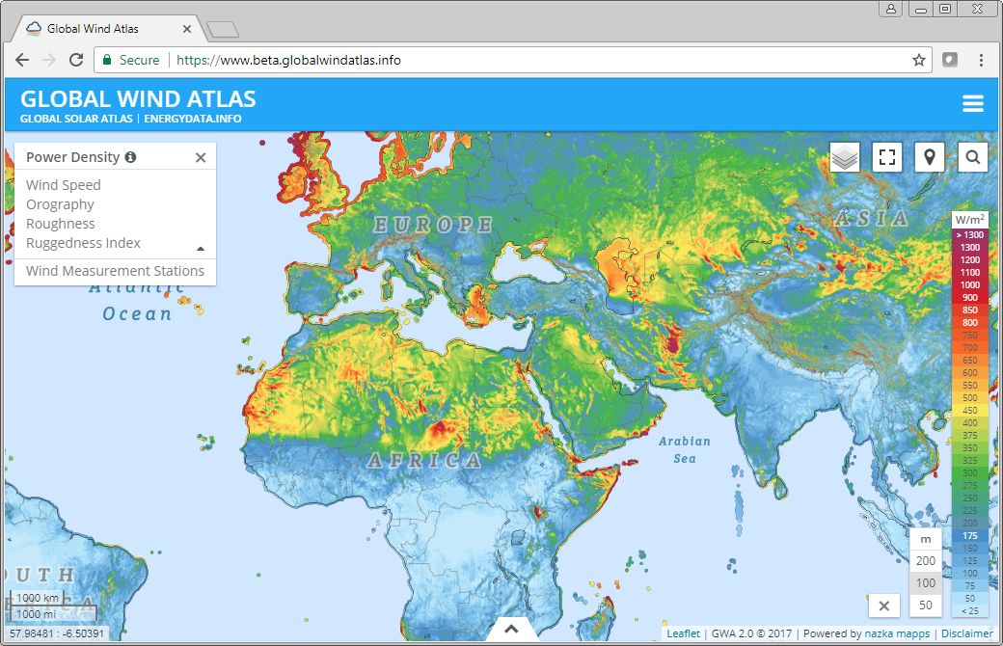

Slide 28
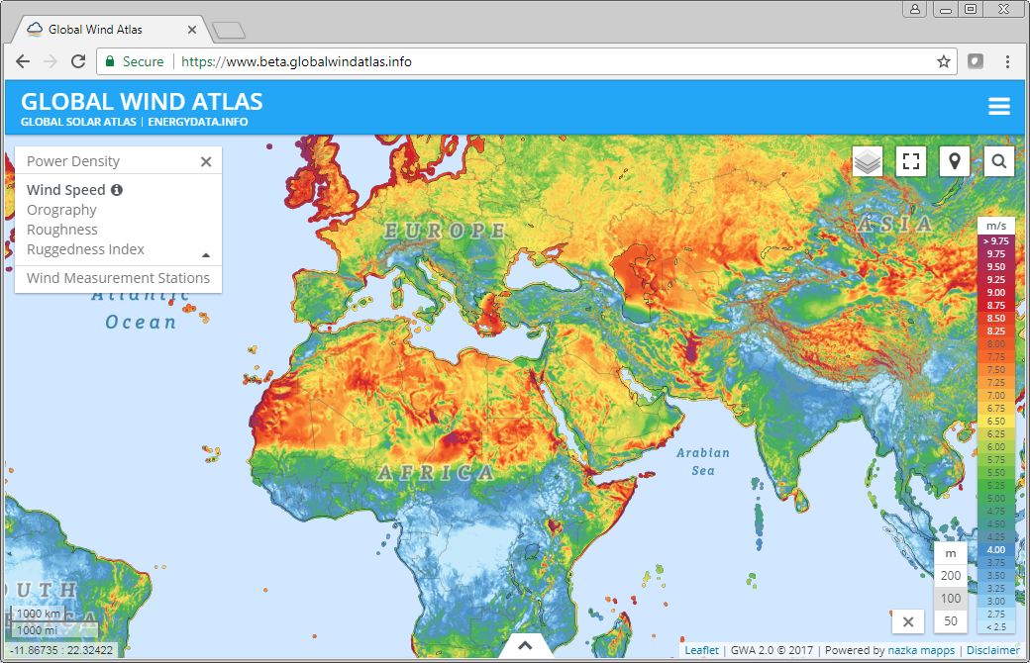

Slide 29
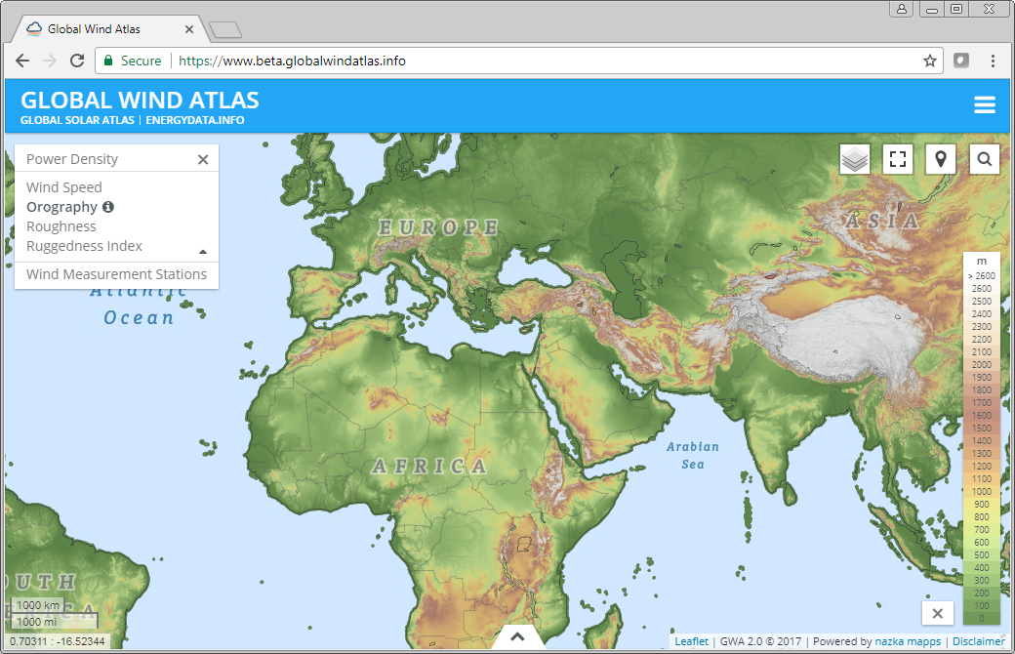

Slide 30
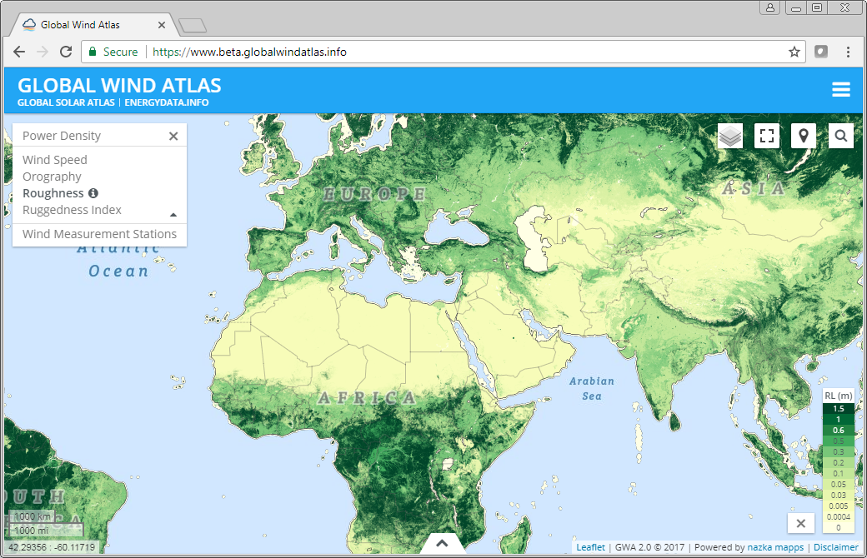

Slide 31
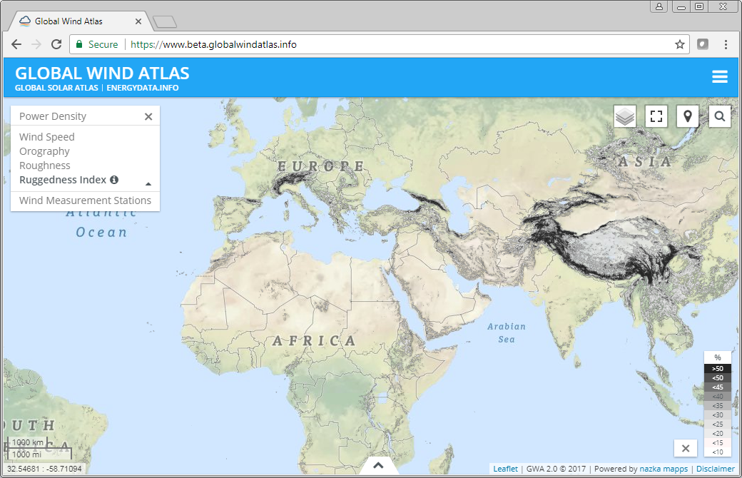

Slide 32
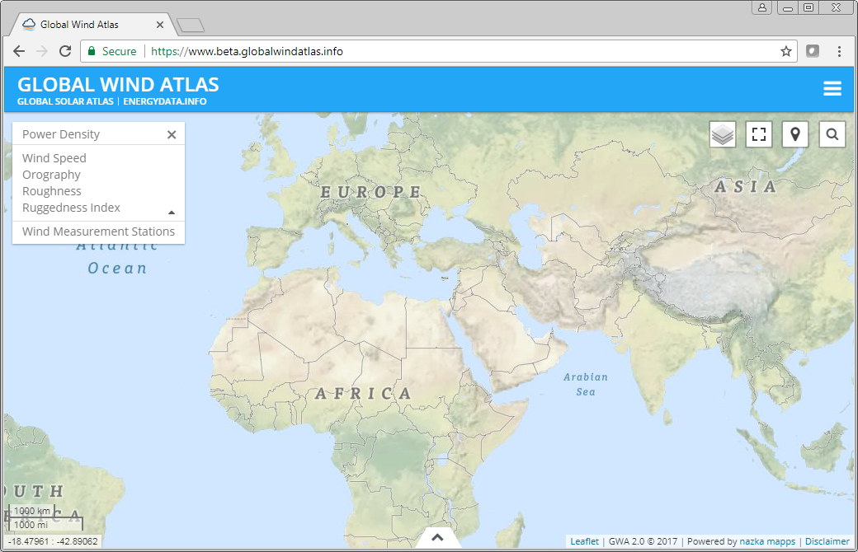

Slide 33
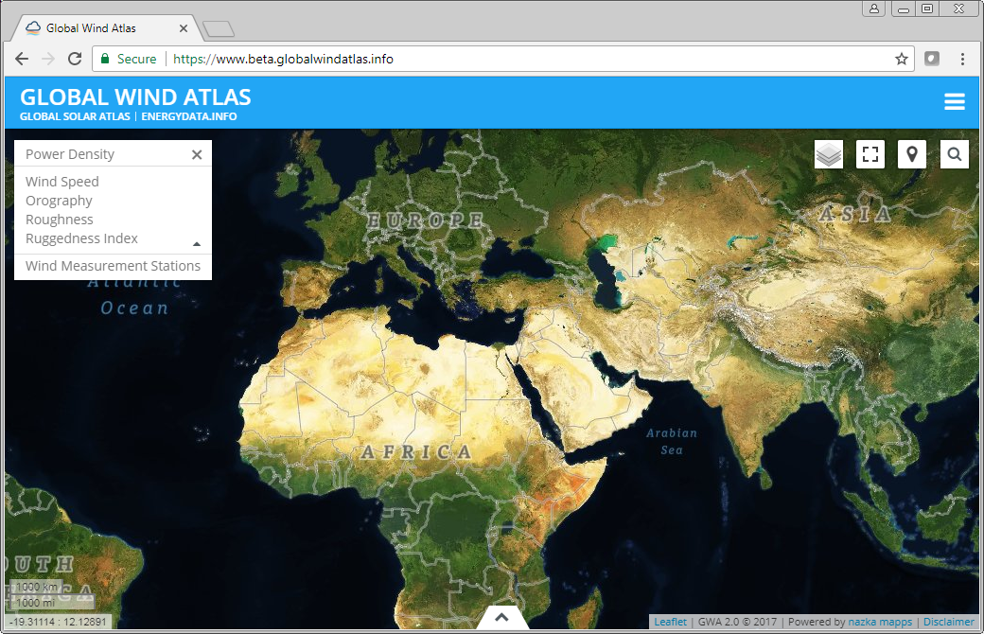

Slide 34
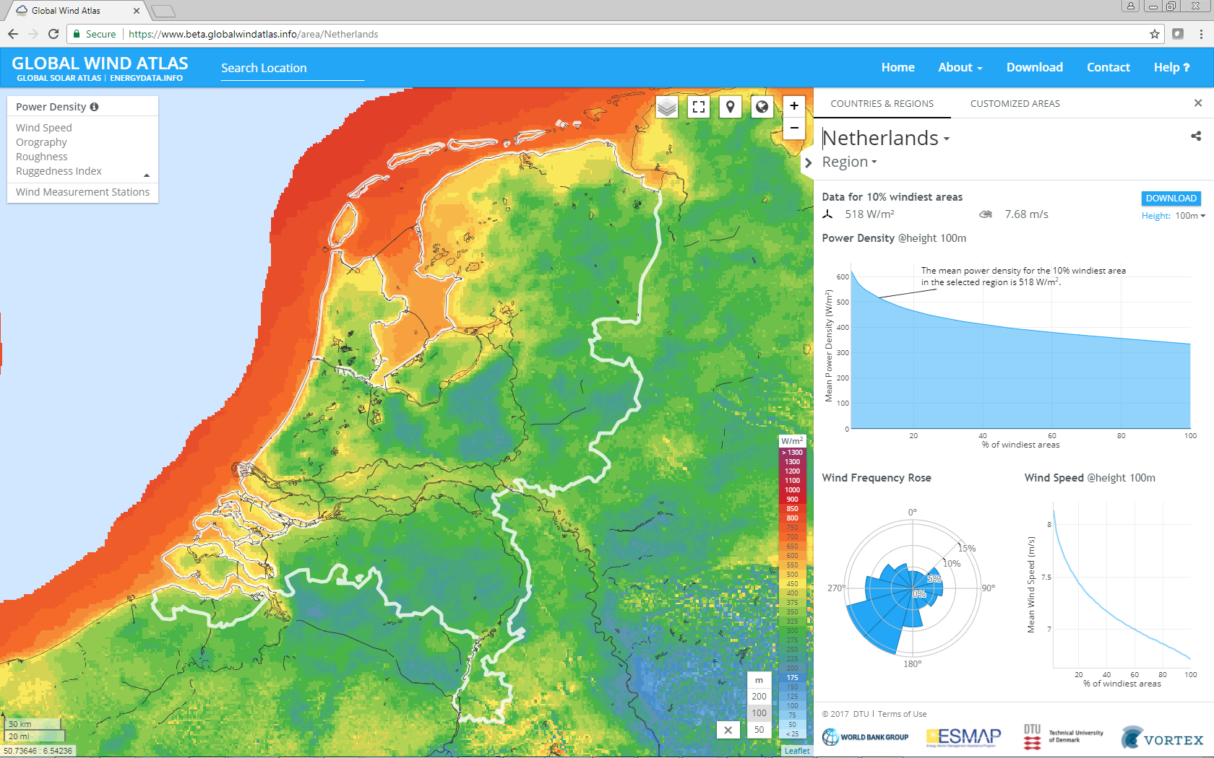

Slide 35
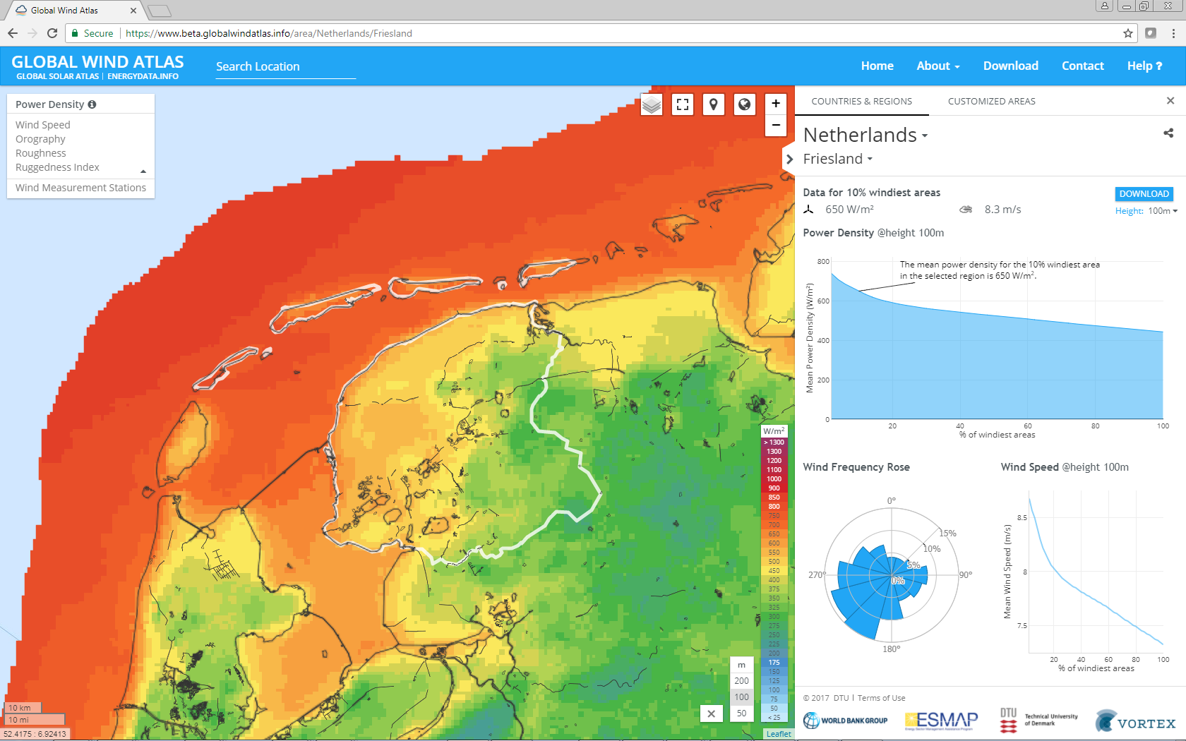
10 % windiest area
power density at 100m
650 W/m²

Slide 36
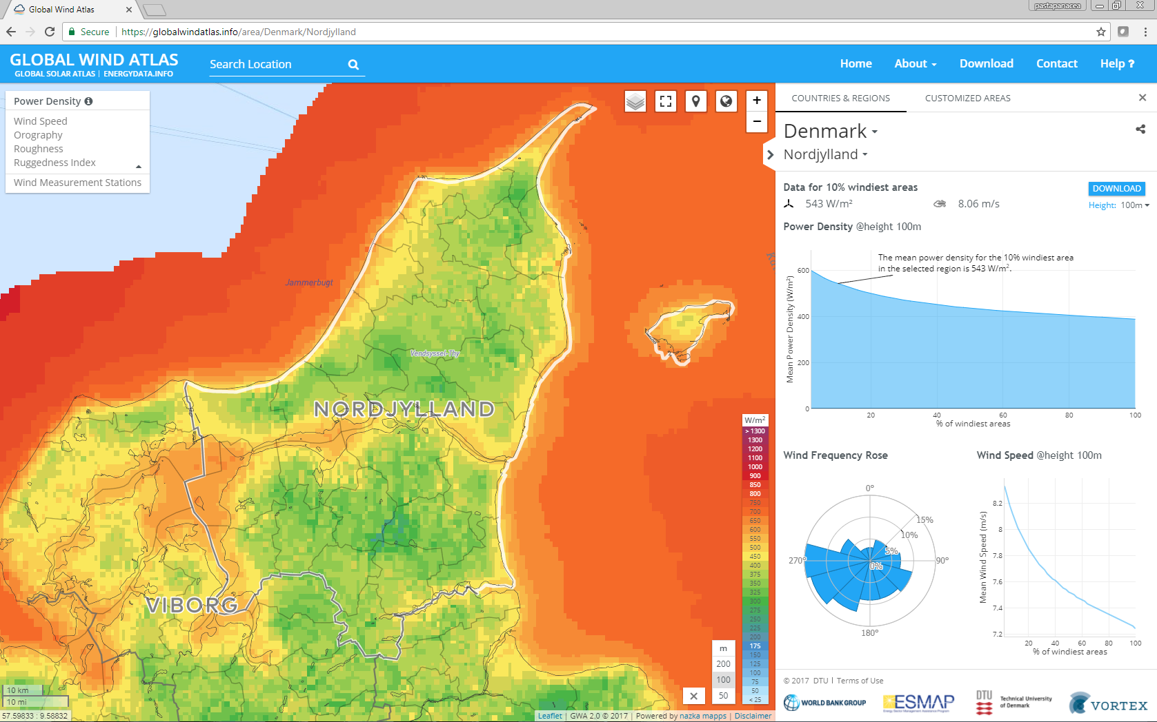
10 % windiest area
power density at 100m
542W/m²

Slide 37
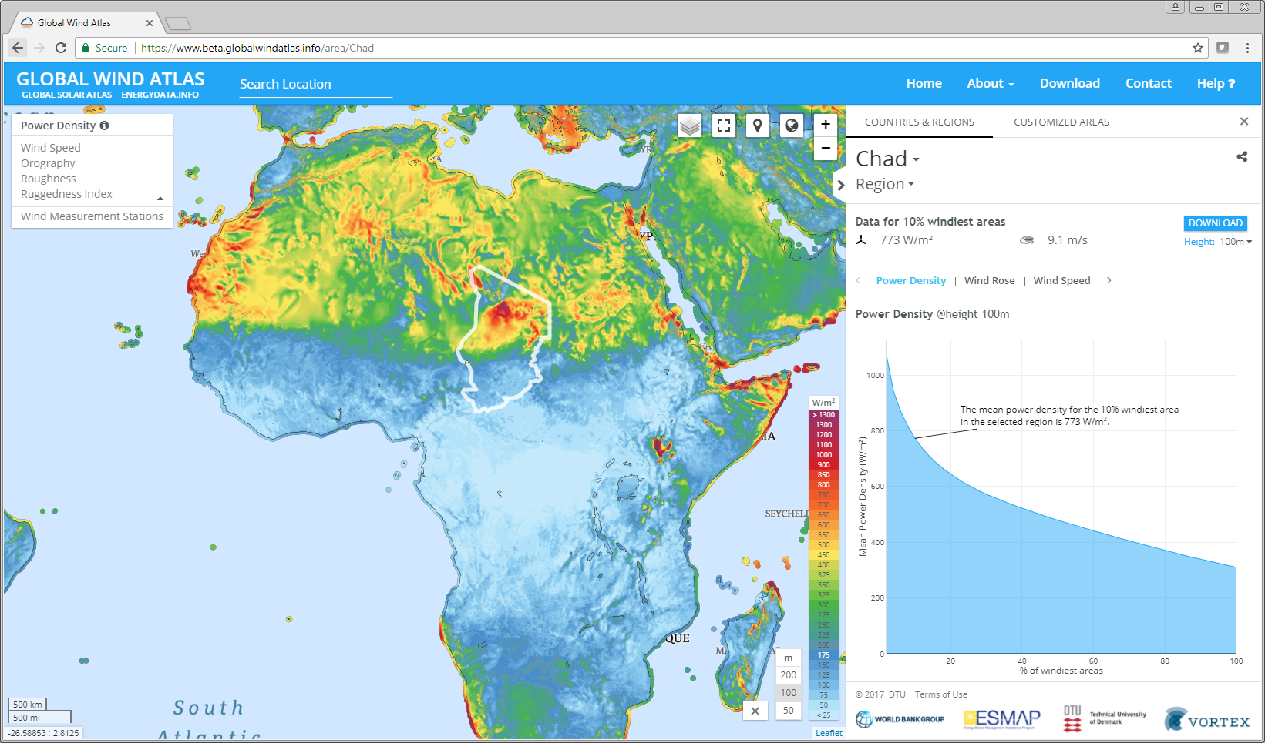
10 % windiest area
power density at 100m
773 W/m²

Slide 38
Exploring an interesting area in Chad with the GWA
An area with power density in excess of 800 W/m² at 100 m a.s.l.

Slide 39
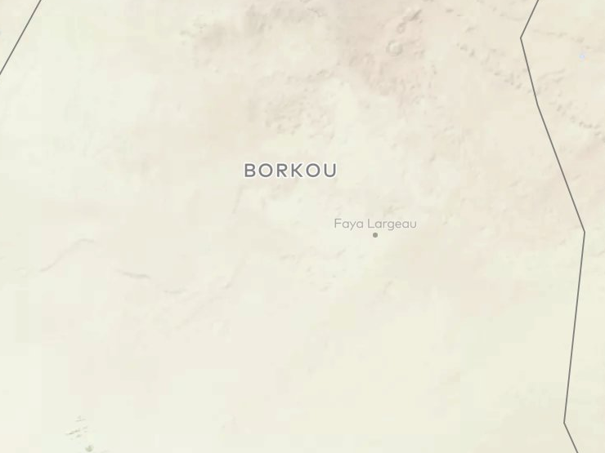
Exploring an interesting area in Chad with the GWA
An area with power density in excess of 800 W/m² at 100 m a.s.l.
The area is near the city of Fayo Largeau
The area is in Borkou region

Slide 40
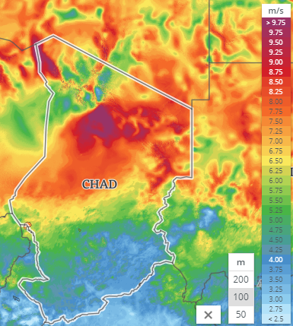
Exploring an interesting area in Chad with the GWA
An area with power density in excess of 800 W/m² at 100 m a.s.l.
The area is near the city of Fayo Largeau
The area is in Borkou region
Wind speeds in the area in excess of 8 m/s at 100 m a.s.l.

Slide 41
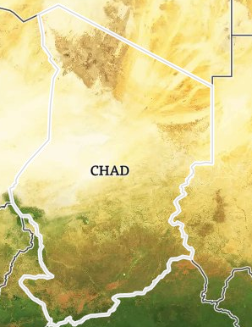
Exploring an interesting area in Chad with the GWA
An area with power density in excess of 800 W/m² at 100 m a.s.l.
The area is near the city of Fayo Largeau
The area is in Borkou region
Wind speeds in the area in excess of 8 m/s at 100 m a.s.l.
It appears to be a desert region in contrast to the southern regions of Chad

Slide 42
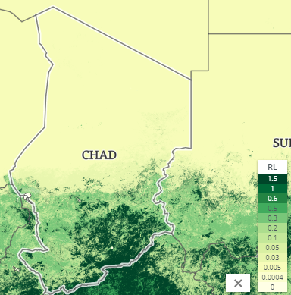
Exploring an interesting area in Chad with the GWA
An area with power density in excess of 800 W/m² at 100 m a.s.l.
The area is near the city of Fayo Largeau
The area is in Borkou region
Wind speeds in the area in excess of 8 m/s at 100 m a.s.l.
It appears to be a desert region in contrast to the southern regions of Chad
The roughness length is very low

Slide 43
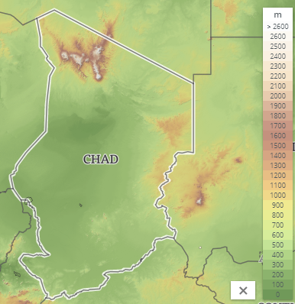
Exploring an interesting area in Chad with the GWA
An area with power density in excess of 800 W/m² at 100 m a.s.l.
The area is near the city of Fayo Largeau
The area is in Borkou region
Wind speeds in the area in excess of 8 m/s at 100 m a.s.l.
It appears to be a desert region in contrast to the southern regions of Chad
The roughness length is very low
There is an orographic gap feature

Slide 44
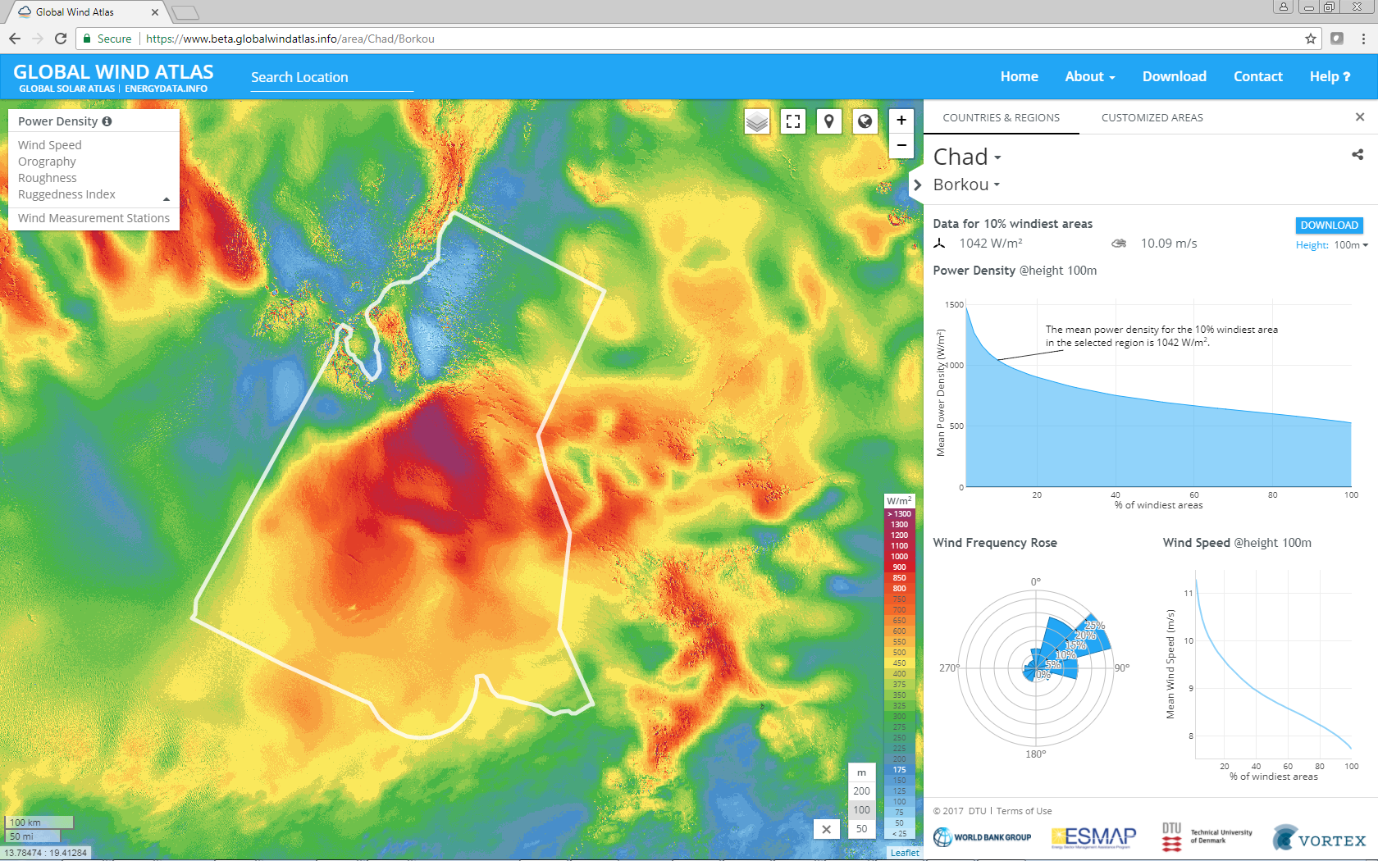
10 % windiest area
power density at 100m
1042W/m²

Slide 45
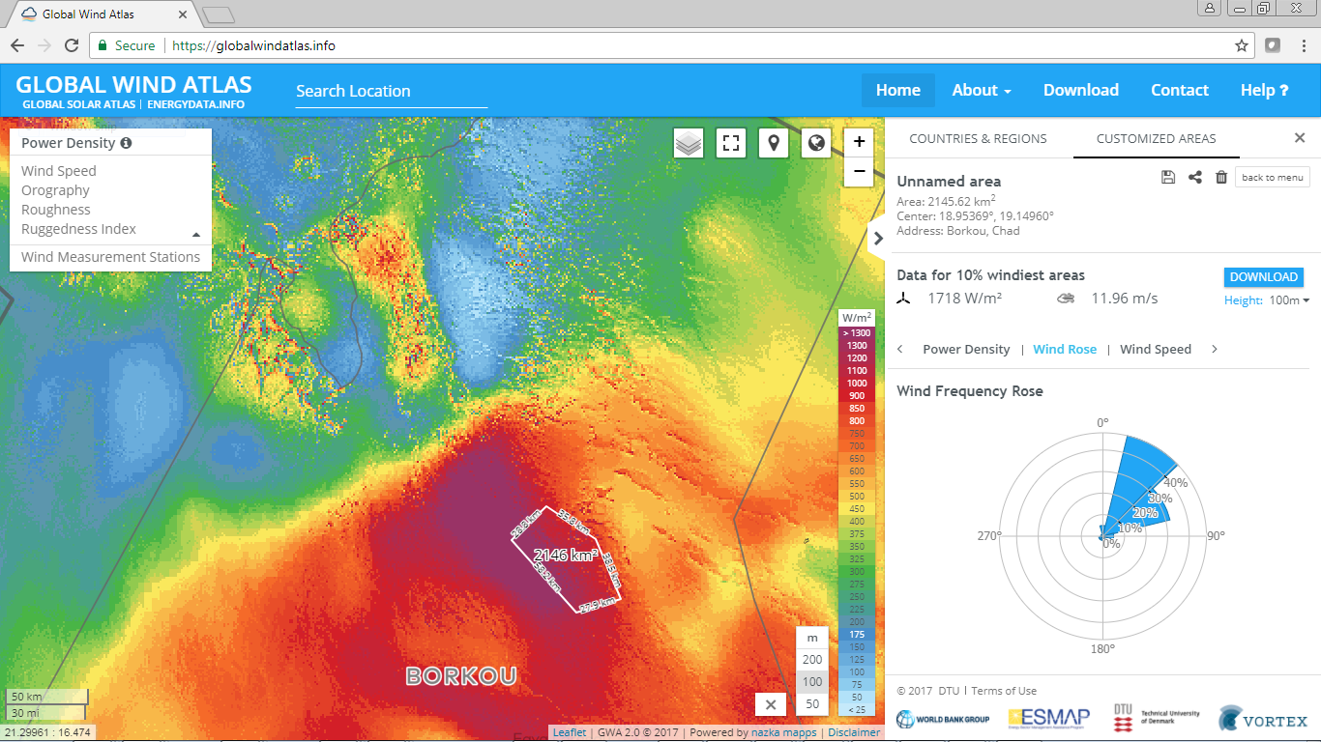
10 % windiest area
power density at 100m
1718 W/m²

Slide 46
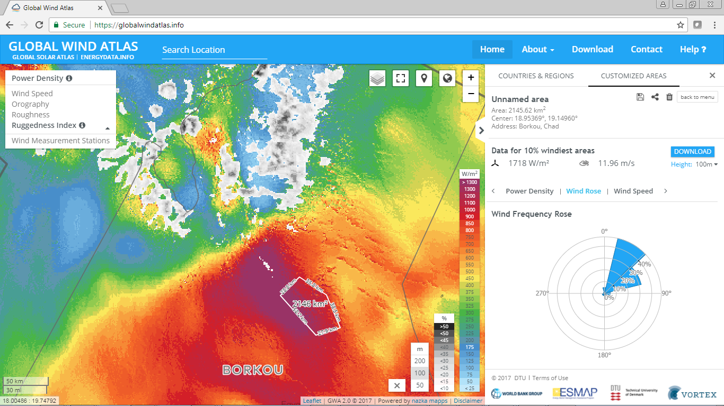

Slide 47
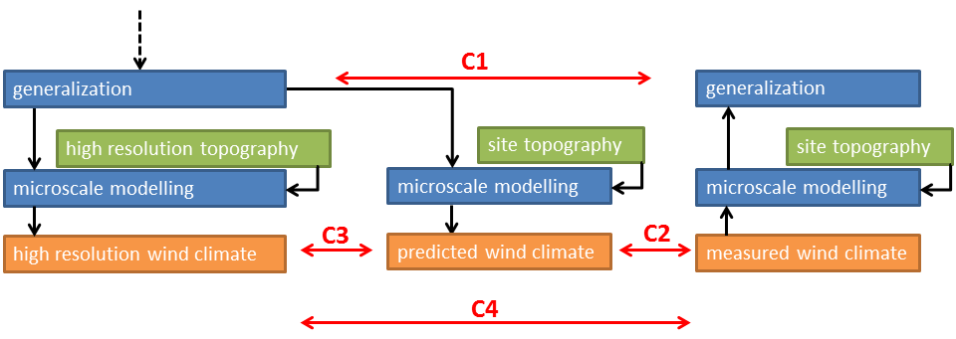
Validation at sites
Mesoscale modelling
C1, check model derived generalized wind climates: test of mesoscale modelling and generalization
ref: measurement derived generalized wind climate
C2, check predicted wind climate using model derived generalized wind climate and best site topography
ref: measured wind climate
C3, check global wind atlas (nearest point): test of global topography + displacement of site effect
ref: predicted wind climate using model derived generalized wind climate and best site topography
C4, check global wind atlas (nearest point): test of complete model chain and + displacement of site effect
ref: measured wind climate

Slide 48
Validation
C2, check predicted wind climate using model derived generalized wind climate and best site topography
ref: measured wind climate
44 Sites
Mean error: -6% Mean absolute error: 10%

Slide 49
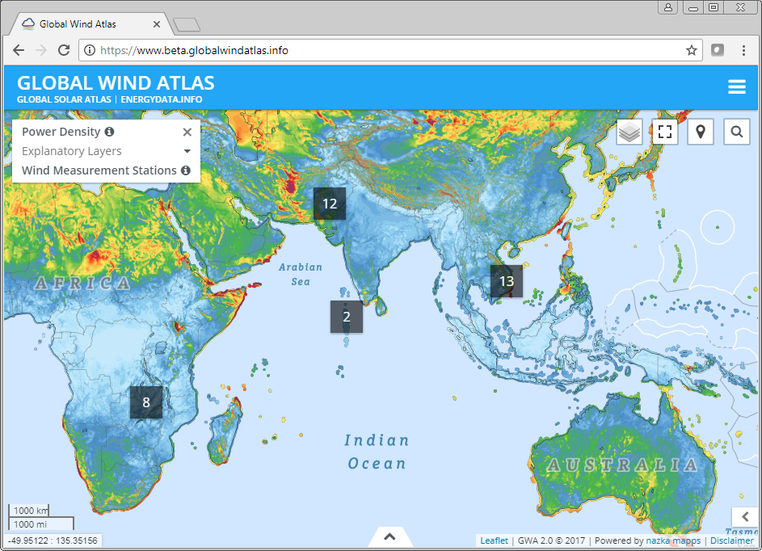
Validation
ESMAP measurement campaigns
High quality wind measurements
Site survey and microscale modelling
Plus our measurement datasets

Slide 50
Future perspectives for GWA 2.0, GWA 3.0, and beyond
Over all aim is to making GWA
more accurate
more relevant
more valuable
How?
Validation and new model chain
Quantify and characterize uncertainty
Flow in complex terrain and stability effects
Roughness length evaluation
New Layers
Design parameters: extreme wind load conditions EOG, EWS, ECD, EDC and ETM
Capacity factor for custom power curves
Cost modelling
Validation and research are interlinked
The GWA is DTU Wind Energy’s
as launch pad for new wind energy datasets to increase impact

Slide 51
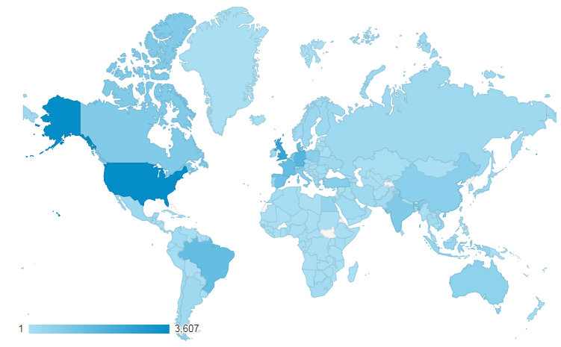
www.globalwindatlas.info
THANK YOU FOR YOUR ATTENTION
GWA2.0 in first 169 days has attracted
>54920 sessions
>31492 users
in 201 countries
Approximately:
250 sessions per day
150 users per day

Slide 52
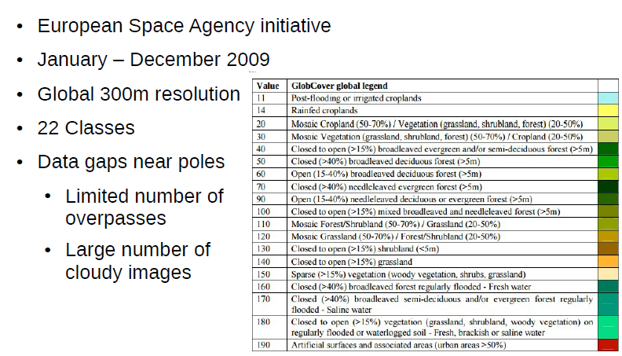

Slide 53
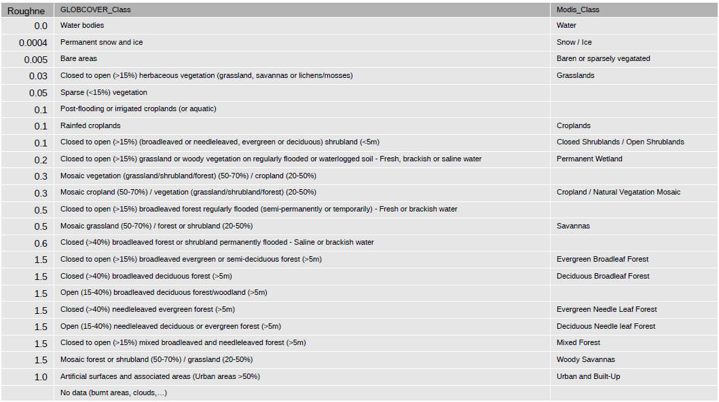
Globcover classes to Roughness length (m)

Slide 55
10 % windiest area
power density at 100m
650 W/m²

Slide 56
10 % windiest area
power density at 100m
542W/m²

